Slide 1
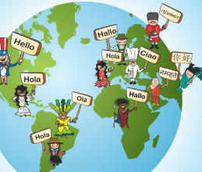
Talking About Language https://www.youtube.com/watch?v=iWDKsHm6gTA Body Language https://www.youtube.com/watch?v=1sfM-xx7tHI positive body language https://www.youtube.com/watch?v=6vT6sqjBFrs

Slide 2
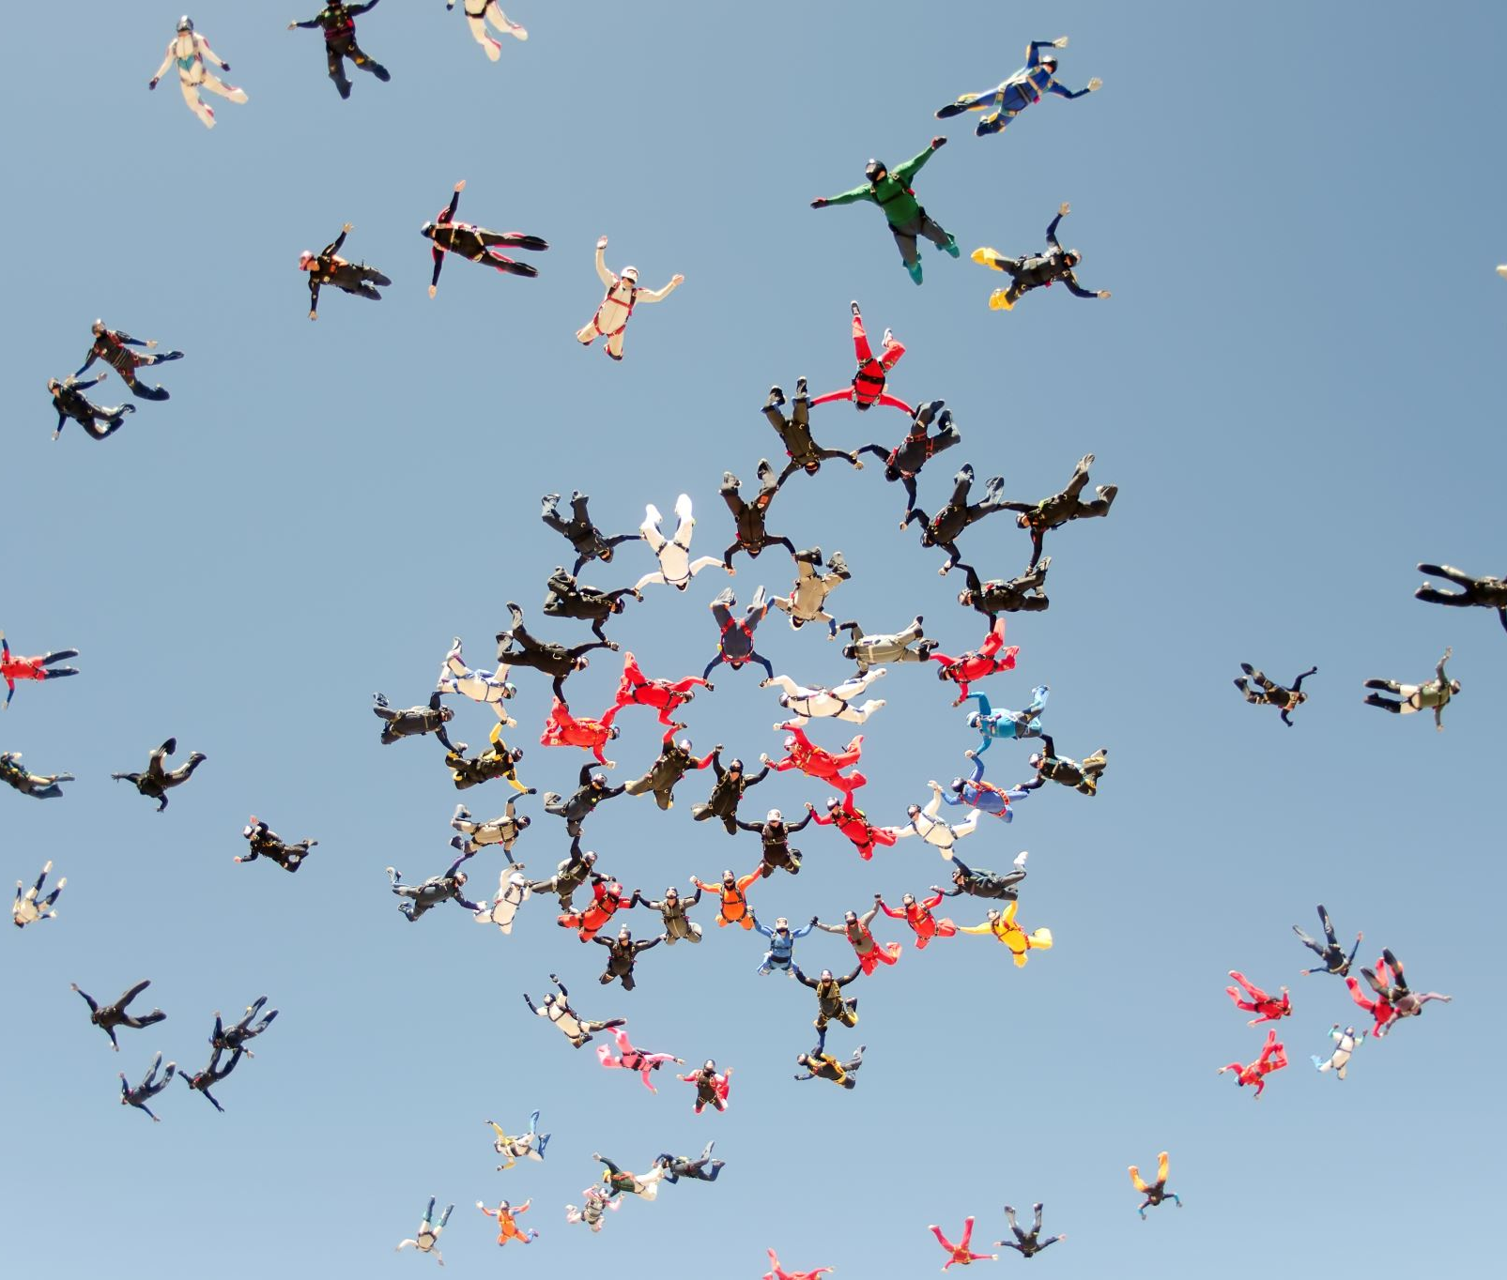
Gesture/ beckon/ refusal/ disapproval/ conceal/ lack/ raised/ enable/ invaluable/ consist/ distress/ transmit

Slide 3
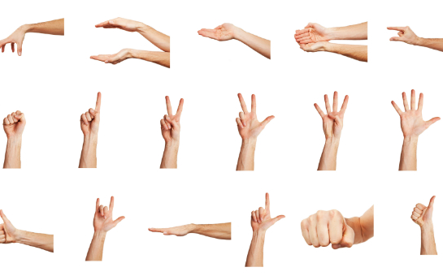
Gesture/ beckon/ refusal/ disapproval/ conceal/ lack/ raised/ enable/ invaluable/ consist/ distress/ transmit

Slide 4
Gesture a movement of the hands, arms, or head, etc. to express an idea or feeling. Specific gestures can indicate moods.

Slide 5
Gesture/ beckon/ refusal/ disapproval/ conceal/ lack/ raised/ enable/ invaluable/ consist/ distress/ transmit

Slide 6
Refusal/ noun the act of saying or showing that you will not do or accept sth. My request for more money was met with a flat refusal.

Slide 7
Gesture/ beckon/ refusal/ disapproval/ conceal/ lack/ raised/ enable/ invaluable/ consist/ distress/ transmit

Slide 8
invaluable/ adj priceless an invaluable source of information

Slide 9
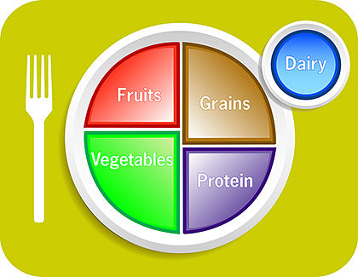
Gesture/ beckon/ refusal/ disapproval/ conceal/ lack/ raised/ enable/ invaluable/ consist/ distress/ transmit

Slide 10
Consist Verb: to be made up of sth. Her responsibilities consist of answering the phone and greeting visitors.

Slide 11
Gesture/ beckon/ refusal/ disapproval/ conceal/ lack/ raised/ enable/ invaluable/ consist/ distress/ transmit

Slide 12
Transmit: verb to send or pass sth from one person to another His broadcasts were transmitted late at night.

Slide 13
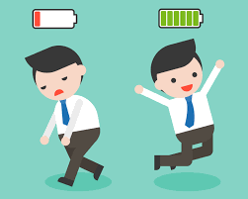
Gesture/ beckon/ refusal/ disapproval/ conceal/ lack/ raised/ enable/ invaluable/ consist/ distress/ transmit

Slide 14
Lack/ verb to have none or not enough of sth We won't be going away this year - lack of funds, I'm afraid.

Slide 15
Gesture/ beckon/ refusal/ disapproval/ conceal/ lack/ raised/ enable/ invaluable/ consist/ distress/ transmit

Slide 16
disapproval/ noun There was a note of disapproval in the teacher's voice.

Slide 17
Gesture/ beckon/ refusal/ disapproval/ conceal/ lack/ raised/ enable/ invaluable/ consist/ distress/ transmit

Slide 18
Distress/ noun a feeling of extreme worry, sadness, or pain. It was terrible for her to see her child in such distress.

Slide 19
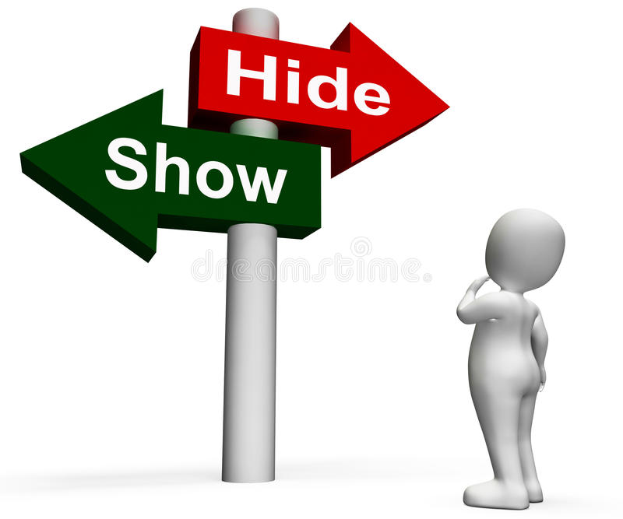
Gesture/ beckon/ refusal/ disapproval/ conceal/ lack/ raised/ enable/ invaluable/ consist/ distress/ transmit

Slide 20
Conceal/ verb to hide sth or someone from being seen or discovered The sewage tank was concealed behind a line of bushes.

Slide 21
Gesture/ beckon/ refusal/ disapproval/ conceal/ lack/ raised/ enable/ invaluable/ consist/ distress/ transmit

Slide 22
Beckon/ verb to move your hand or head in a way that tells someone to come nearer. "Hey you!" she called, beckoning me over with her finger.

Slide 23
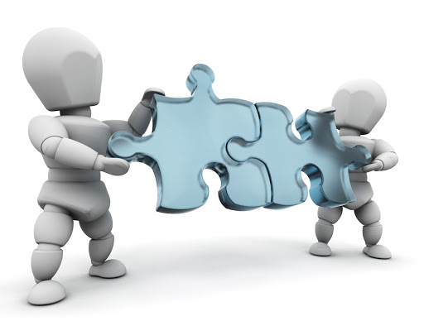
Gesture/ beckon/ refusal/ disapproval/ conceal/ lack/ raised/ enable/ invaluable/ consist/ distress/ transmit

Slide 24
Enable/ verb to make possible for sth or someone to do sth. Only good team work will enable us to get the job done on time.

