Slide 1
Reported Speech Study sheet

Slide 3
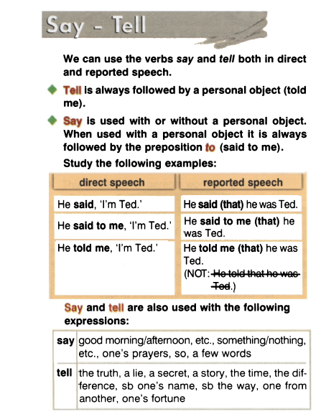

Slide 7
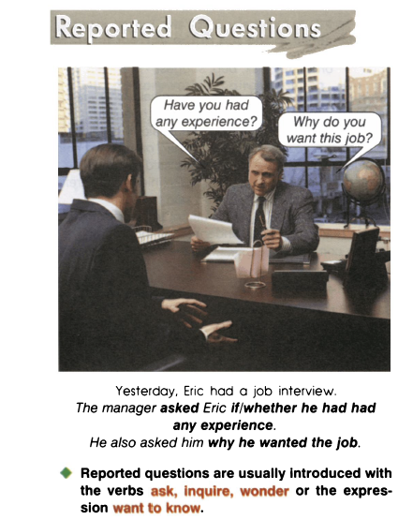

Slide 8
