Slide 1
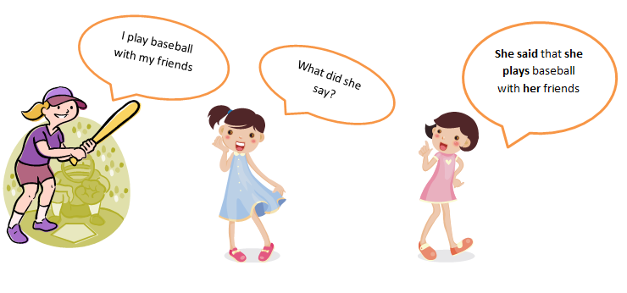
Reported Speech

Slide 2
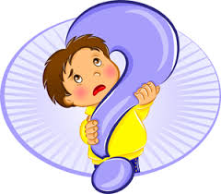

What is the difference between the two sentences?
He said to the class, “ I am very happy with your results.”
He told the class that he was very happy with our results.

Slide 3
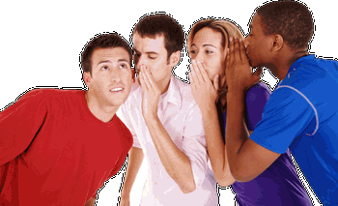
Sam said, "I am leaving for Germany with my family tomorrow.”
Sam said that he was leaving to Germany with his family the following day.

Slide 4
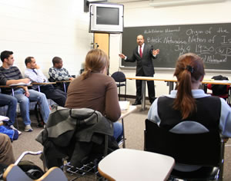
Reported Speech
What did Mr. Reed tell the class yesterday?
He said to the class, “ I am very happy with the results.”
He told the class that he was very happy with the results.

Slide 5

Direct Speech is the exact words someone used. We use quotation marks “…….”.

Slide 6

Reported Speech is the exact meaning of what someone said , but not the exact words and we don’t use quotation marks “…….”.

Slide 7
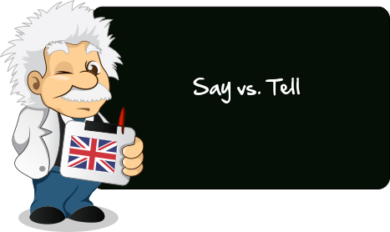
Direct speech
He said, “I’m Ted”.
He said to me,” I’m Ted”.
He told me “I’m Ted”.
Reported speech
He said (that) ……………
He said to me (that) …..…
He told me (that) ………….

Slide 8

Say
Good morning/ afternoon, something/ nothing, one's prayers, so, a few words.
Tell
the truth, a lie, a secret, a story, the time, the difference, one from another, one’s name, one’s fortune.

Slide 9

Verb tenses can either change or remain the same , when reporting a general truth or law of nature.
“The sun sets in the west.” the teacher said.
The teacher said (that) …………………………

Slide 10

Direct speech
Reported speech
He said,” I’ll have some tea.”
He said,” She can type fast.”
He said,” I can talk to you tomorrow.”
He said, "They may come home.
He said, “ You must stay in.”
He said (that) …………………..
He said (that) …………………..
He said (that) …………………..
He said (that) …………………..
He said (that) …………………..

Slide 11
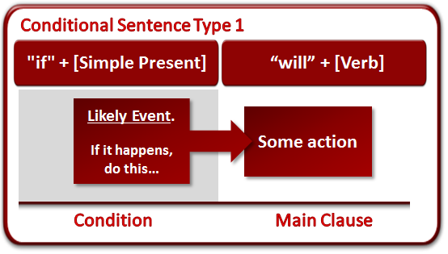
Reported speech
Direct speech
“If I have the time, I will come round.” Lisa said.
Lisa said (that) …………………..

Slide 12
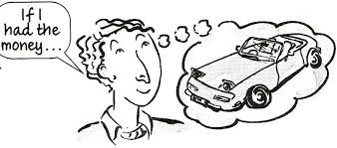
Conditionals type 2 and 3
Direct speech
Reported speech
“If she knew, she would help us.” Tony said.
Tony said (that) ………………

Slide 13

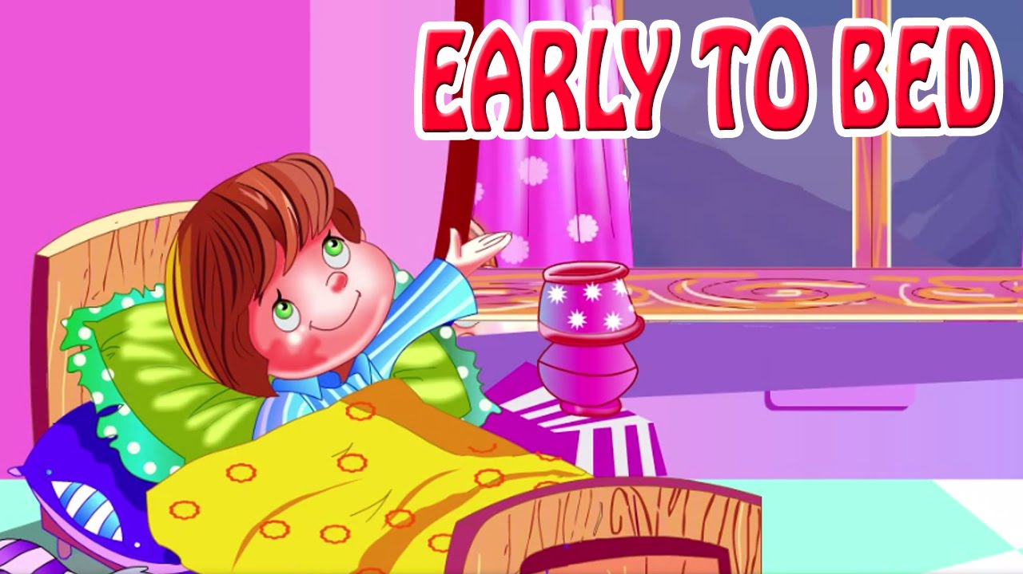
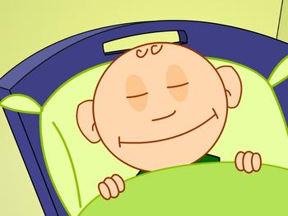
Out of date reporting.
“I want to go to bed early.” he said
He said(that) …………………

Slide 14
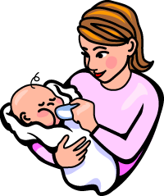
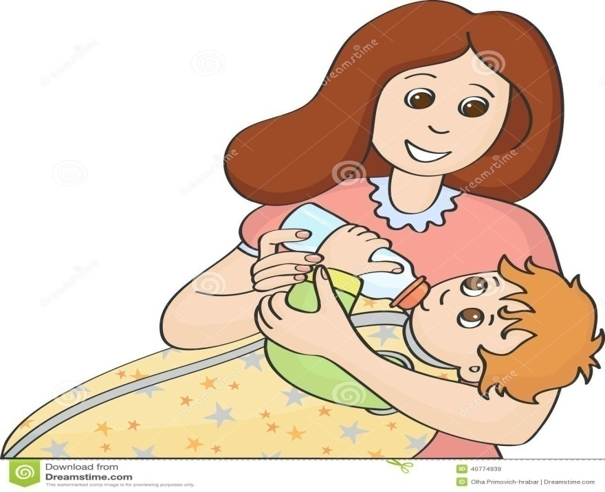
‘She’s feeding the baby.’ he said.
He said (that) ………………

Slide 15
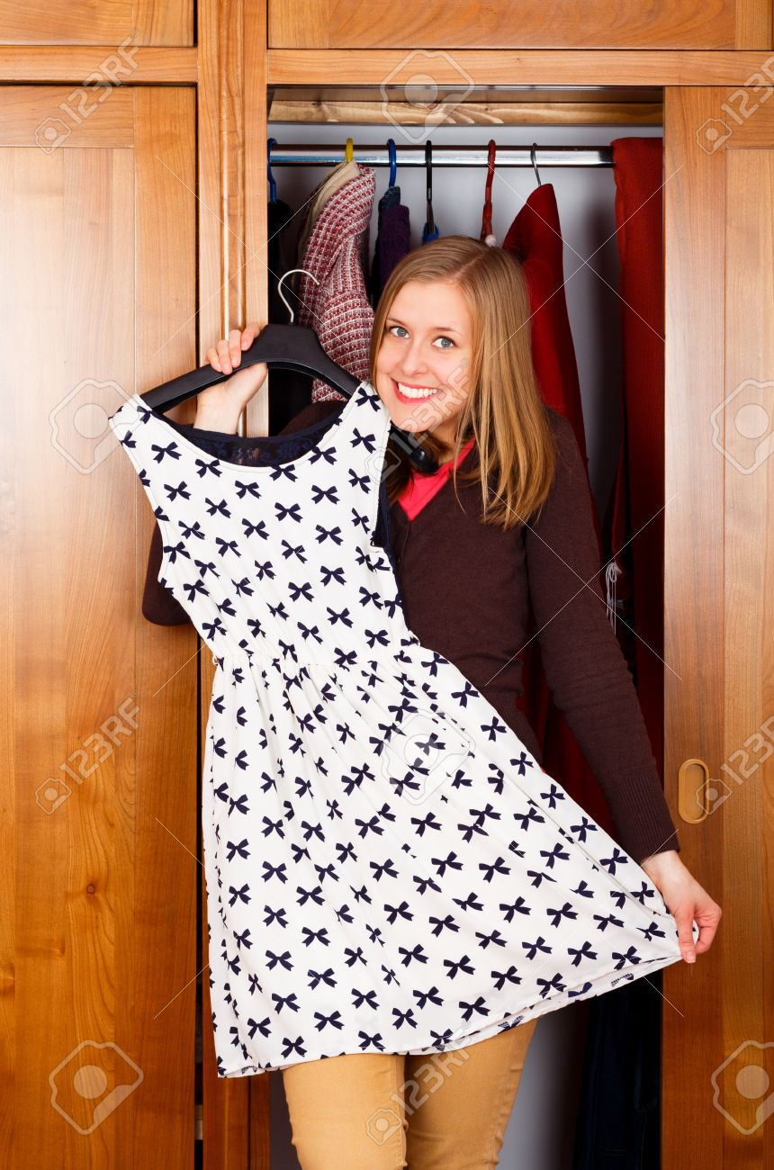

“I’ve bought a new dress.” she said.
She said (that) ……………..

Slide 16


“I finished my work early.”Alex said,
Alex said (that) ……………

Slide 17


“I was planning to call you later.” She said.
She said (that) ……………..

Slide 18
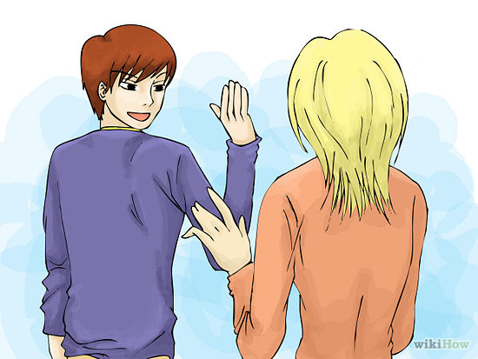
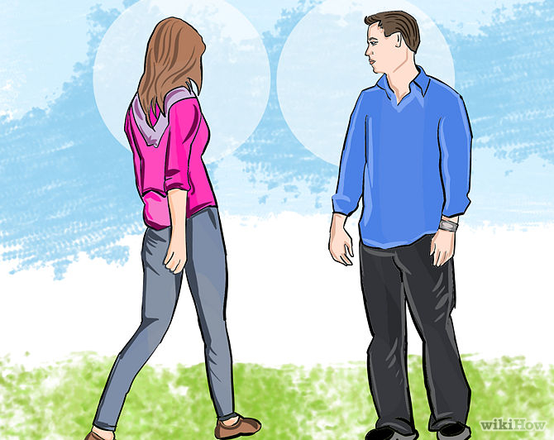
“I’ll talk to you tomorrow.” she said.
She said (that) ……………

Slide 19

“The film had finished by the time I got home." he said.
He said (that) …..........

Slide 20
Time expression change according to the meaning of the sentence.
Now ………>
Today, tonight ………..>
Yesterday ………………>
Tomorrow …………….>
This week……………...>
Last week……………...>
Next week……………..>
Two days ago ……….>
Here………………….….>
come………………..…..>
Then, at that time, immediately.
That day, that night.
The day before, the previous day.
The next day, the following day.
That week.
The week before, the previous week.
The week after, the following week.
Two days before.
There.
Go.

Slide 21
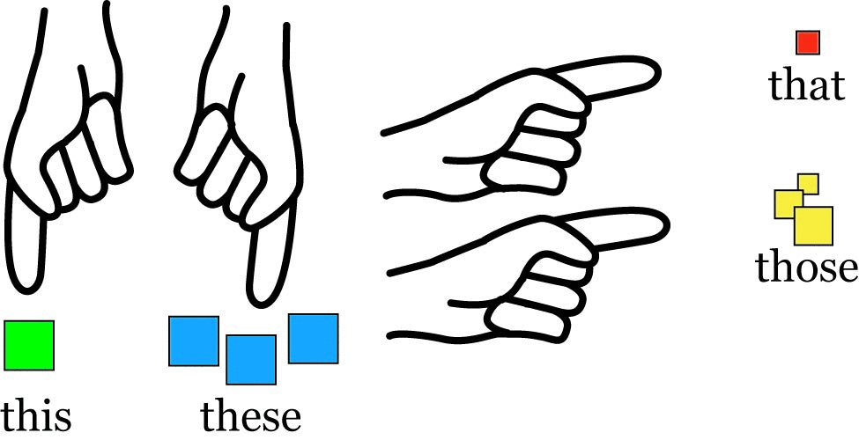
This week ………..>
These days…………>
That week.
Those days.

Slide 22
When this , these are used in time expressions, they change to that / those.
This week
That week
These days
Those days

Slide 23
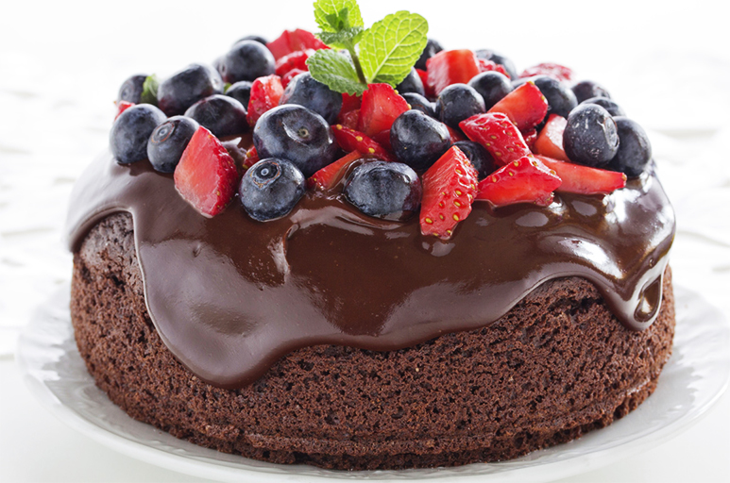
“This cake is delicious”. Pam told me.
This is NOT used as time expression
Pam told me (that) the cake was delicious.

Slide 24

“This is a brilliant idea.” Debbie said.
Debbie said (that) it was a brilliant idea.

Slide 25

He said,” Those are the men who helped me.”
He said (that) they were the men who helped him.

