Slide 1
Narratives - Stories

Slide 2
This kind of writing can be found in novels and articles.

Slide 3
Narrative can be written in the first, second or third person

Slide 4
A Good narrative should consist of:

Slide 5
To attract the reader’s attention

Slide 6
You set the scene (people, time and place in an interesting way to catch the reader attention and make him /her to continue reading your story.

Slide 7
Main Body Consisting of two or more paragraphs in which you develop your story.

Slide 8
Conclusion In which you can refer to people’s feelings, comments and reactions. The more unpredictable your conclusion is, the longer lasting the impression it will make on the reader.

Slide 9
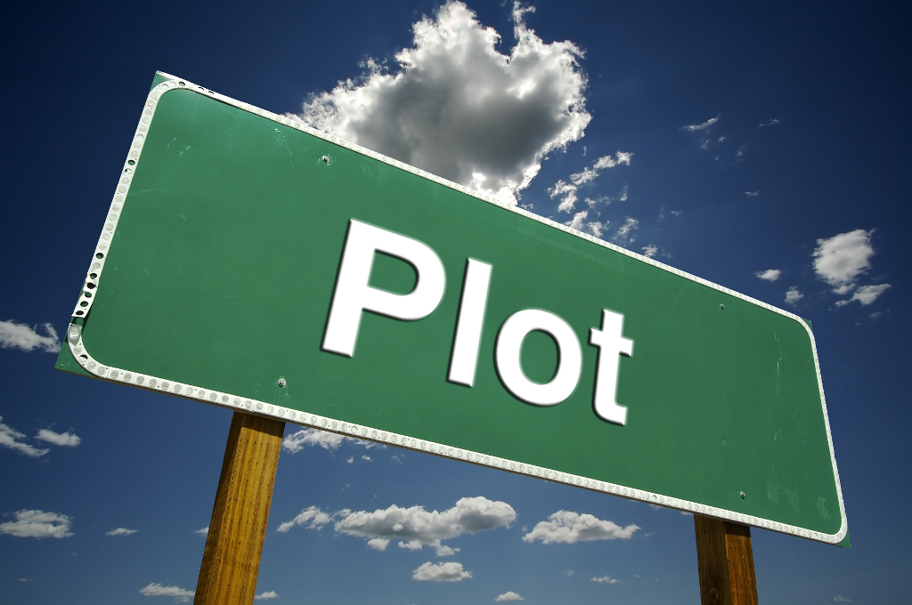
Points to consider 1. You should never start writing your story before you have decided on a plot.

Slide 10
Points to consider 2. Use Various adjectives and describe feelings and actions

Slide 11
Points to consider 3. Be careful with tenses you choose. You can use past continuous to set the scene, Past simple to describe the main events, Past perfect to give the background of the story.

Slide 12
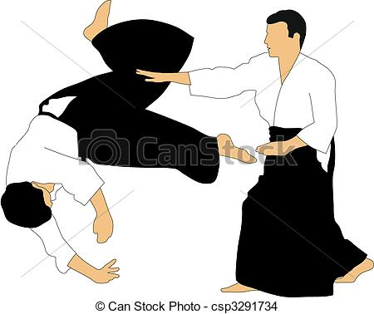
Points to consider 4. Description of people, places, objects, or events and descriptive techniques can be used in a narrative when you want to emphasise specific parts of your narrative.

Slide 13
Techniques to begin your story
Describing weather, people, surrounding, etc. using the senses.
Using direct speech.
Asking a question which expects no answer.
Creating mystery or suspense

Slide 14
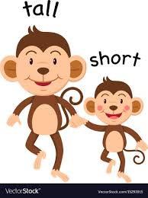
Classwork # 1
How would you like to be only two cm high .What would be some of the advantages of being so tiny? What would be some of the problems? Write a children's story about a person of unusual size. In your story, show how this character's size creates a problem or helps to solve one.

Slide 15
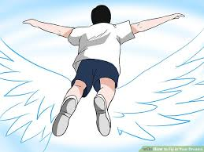
Class work# 2
Sometimes we wonder what it would be like if we could fly. Imagine that you woke up one morning and were able to fly. Write a story about where you went and what you did.

