Slide 1
Unit 8: Geometry

Slide 2
Types of angles
1) Acute angle
2) Obtuse angle
3) Right angle
4) Straight angle
5) Reflex angle

Slide 3
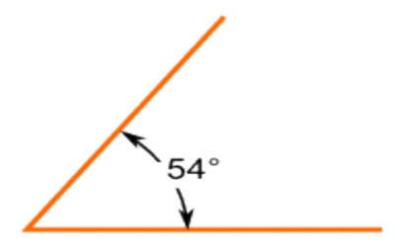
Acute angle
The measure of the acute angle is less than 90 ͦ

Slide 4
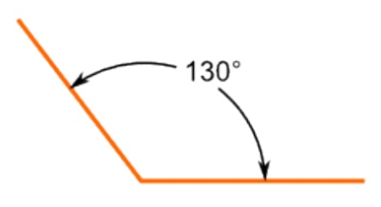
Obtuse angle
The measure of the obtuse angle is more than 90 ͦ but less than 180 ͦ

Slide 5
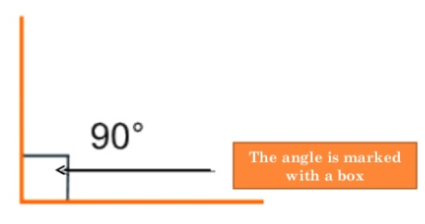
Right angle
The measure of this angle is exactly 90 ͦ

Slide 6
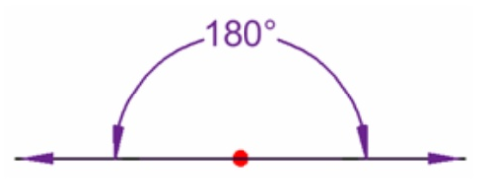
Straight angle
The measure of this angle is exactly 180 ͦ

Slide 7
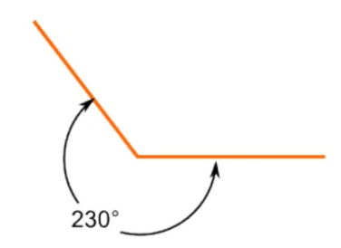
Reflex angle
The measure of the reflex angle is more then 180 ͦ but less than 360 ͦ

Slide 8
Video
To review watch the video below:
https://www.youtube.com/watch?v=UgfSwlqi4Qg

Slide 9
Remember the following:
A corner measures 90 ͦ (complementary)

Slide 10
A straight angle measures 180 ͦ (Supplementary)

Slide 11
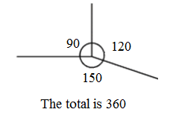
Angles at a point add up to 360 ͦ

Slide 12
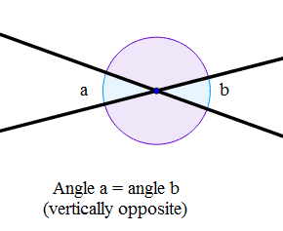
Vertically opposite angles are equal

Slide 13
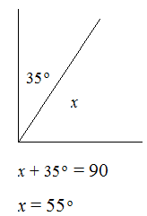
Examples:
Without measuring, find the missing angles.
1)

Slide 14
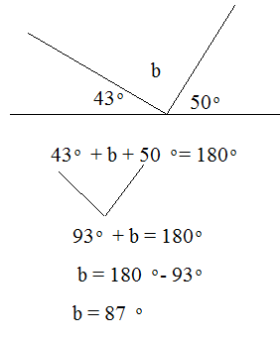
2)

Slide 15
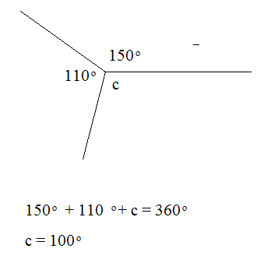
3)

Slide 16
To review, watch the video below:
https://www.youtube.com/watch?v=_n3KZR1DSEo
Page 117, Ex. 8A
Q1 + Q2 + Q5 + Q7

Slide 17
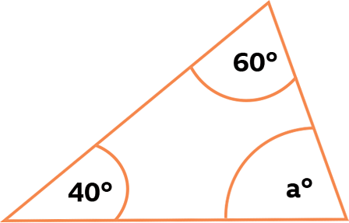
Angles in triangles and quadrilaterals
Angles in triangles.
The angles in a triangle add up to 180 ͦ
Example: find the missing angle a.
We know that:
60° + 40° + a = 180°
100° + a = 180°(use algebra)
-100 = -100
a = 80°

Slide 18
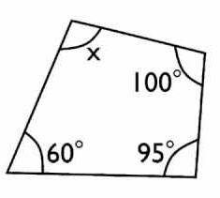
Angles in quadrilaterals.
Angles in quadrilaterals add up to 360º.
Example: find the missing angles.
We know that:
100° + 95° + 60° + x = 360°
255° + x = 360°(use algebra)
-255 = -255
x= 105°

Slide 19
To review watch the video below:
https://www.youtube.com/watch?v=IhPLCCZKzw0
Page 120, Ex. 8B
Q1 (a, b, c, d) + Q2 + Q5 + Q7

Slide 20
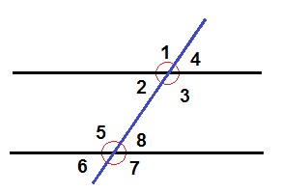
Corresponding and alternate angles.
If we have two parallel lines and have a third line that crosses them as in the figure below - the crossing line is called a transversal line.
When a transversal intersects with two parallel lines eight angles are produced.

Slide 21
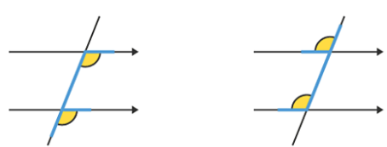
Corresponding angles.
On parallel lines, corresponding (or F) angles are equal.

Slide 22
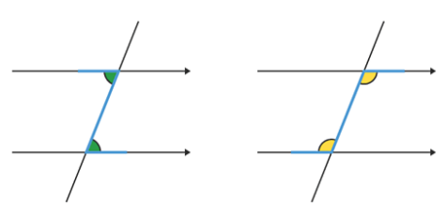
Alternate angles.
On parallel lines, alternate (or Z) angles are equal.

Slide 23
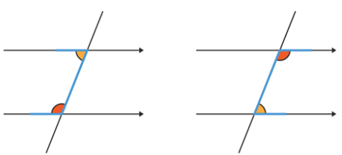
allied angles.
On parallel lines, allied (or C) angles add up to 180°.

Slide 24
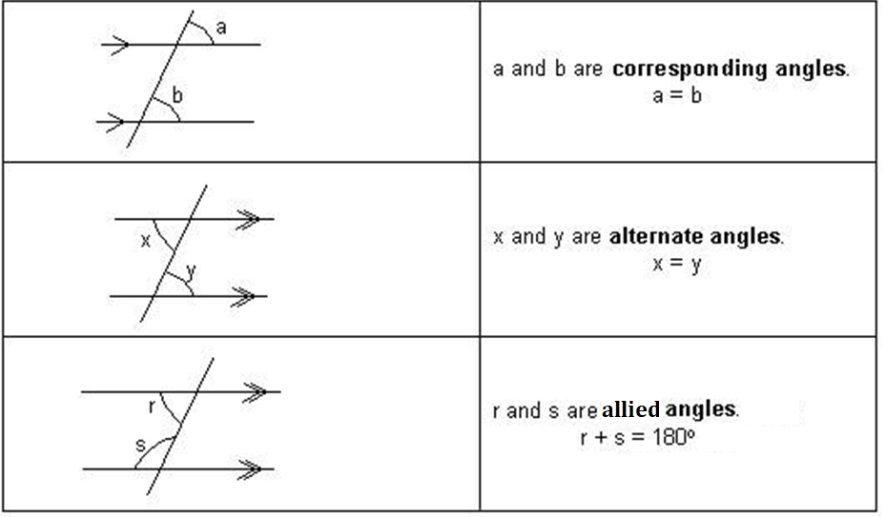
Conclusion

Slide 25
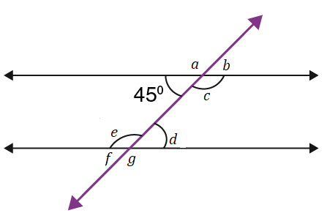
Example: find the missing angles.

Slide 27
To review watch the videos below:
Corresponding angles: https://www.youtube.com/watch?v=fhvR6lzy_jg
Alternate angles:
https://www.youtube.com/watch?v=-BPdBfwFgUM

Slide 28
Page 122, Ex. 8C
Q1+2+3+4+5
Page 124, Ex. 8D
Q1+2+4+6+10

Slide 29
Coordinates.
A set of values that show an exact position.
On graphs it is usually a pair of numbers: the first number shows the distance along in a horizontal direction (x- axis), and the second number shows the distance up or down in a vertical direction (y- axis).
The origin has coordinates (0,0), it is where the axes intersect.

Slide 30
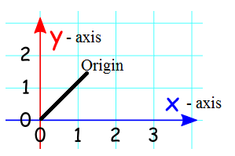

Slide 31
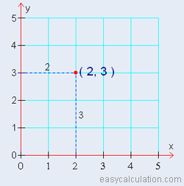
Coordinates tell you exactly where a point is on a graph.
For example, the coordinates(2, 3) represent the point 2 across and then 3 up from where the axes meet (origin).

Slide 32
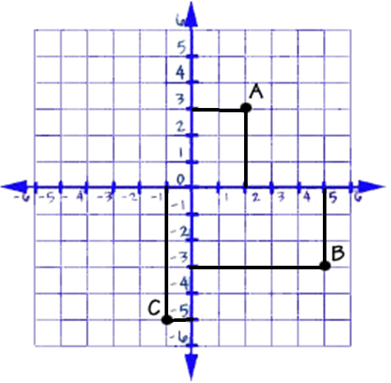
Example:
Write the coordinates of each point
Point A: (2, 3)
Point B: (5, -3)
Point C: (-1, -5)

Slide 33
To review watch the video below:
https://www.youtube.com/watch?v=vvv-tATwdTA
Page 125, Ex. 8E
Q1 + 3 + 4 + 5 + 6 + 8

Slide 34
The End

