Slide 1
Functions and graphs
Chapter 14

Slide 2
Objectives:
Learn about graphs of linear functions.
Learn about equations of a line in the form y=mx+c.
Learn about functions and their inverses

Slide 3
Functions:
You learned in chapter 7 what a function machine is.
Below are examples of function machines:
Algebra Basics: What Are Functions? - Math Antics - YouTube

Slide 4
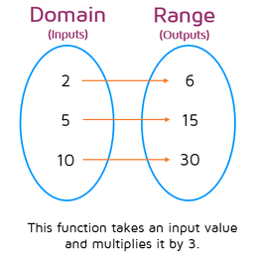
We can also use a mapping diagram to show what outputs go with particular inputs. Here’s an example of a mapping diagram where all inputs are multiplied by 3.
$$x$$
$$y$$
We usually write the function this way: $f\left(x\right)=3x$

Slide 5
Here is another an example of a mapping diagram where all inputs are multiplied by 2 then 4 is subtracted from the product.
$$x$$
$$y$$
We write the function this way: $f\left(x\right)=2x−4$
x$2−4$
-6
0
8
2n-4
-1
2
6
n

Slide 6
P. 214 Ex. 14A:
Q1
Q2
Q3 (a,b,c)
Q4(a)
Q6(a)

Slide 7
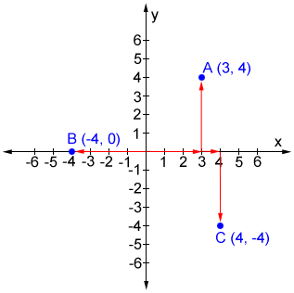
Linear graphs
On a graph, the horizonal axis is called the $x$-axis and the vertical axis is called the $y$-axis.
Coordinates of a point, are ordered pairs written in the form ($x$, $y$).
Can you write the coordinates of A, B and C?

Slide 8
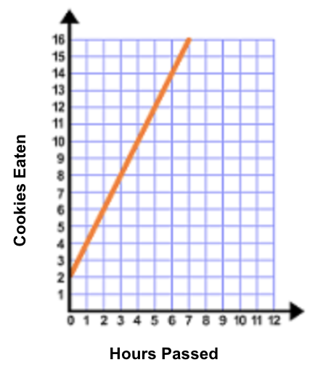
Finding a rule from a graph
To find the rule for the mapping: do the following:
Write the coordinates of at least three points.
Derive the rule for the mapping.
For example: from the graph pick three coordinates.
x | y
1 | 4
2 | 6
3 | 8
You have to find the rule that changes the “x” to “y”, which in this case is x2+2
So $y=2x+2$

Slide 9
P. 216 Ex. 14B:
Q1
Q2
Q3
Q4

Slide 10
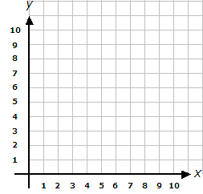
1) Plotting Points on a Coordinate Plane | All 4 Quadrants - YouTube
2) Algebra Basics: Graphing On The Coordinate Plane - Math Antics - YouTube
You can also draw a graph if you have the rule.
For example:
For input 1,2, 3, 4 draw a graph of the mapping $4x−3.$
Construct a table for the “x” and “y” coordinates.
X (input) | Y (output)
1 | 1
2 | 5
3 | 9
4 | 13
Once you′ve found your coordinates, plot them on a grid.
Draw a line connecting the points.

Slide 11
P. 216 Ex. 14C:
Q3
Q5
Q6
P. 218 Ex. 14D:
Q1
Q2(b)
Q6
Q7 (b, d, f)
Q9
Q11
Q12 (a)

Slide 12
End of chapter 14 ☺

