Slide 1
plants

Slide 3
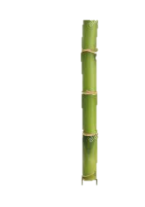
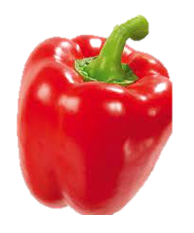
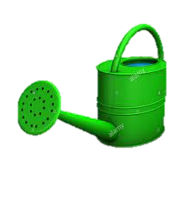
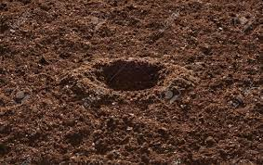

Slide 5
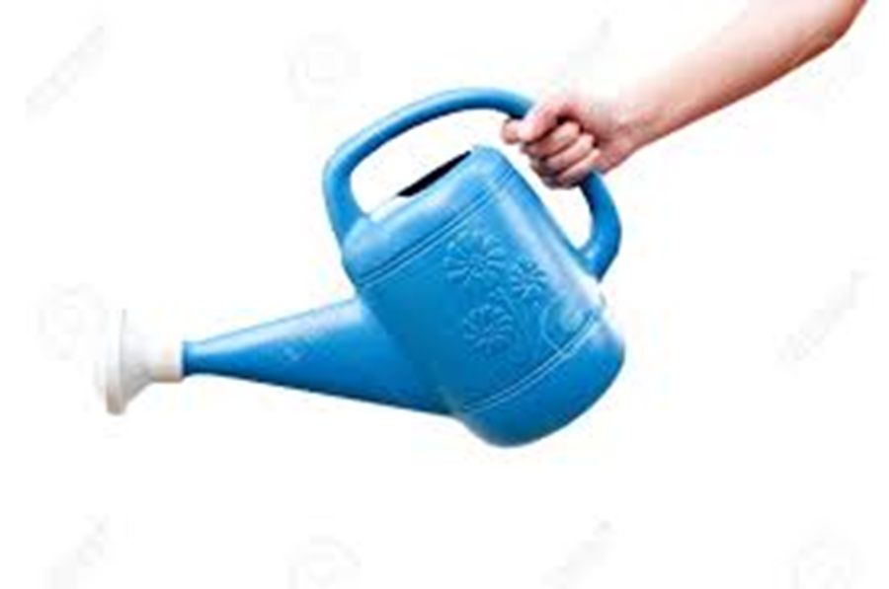
Plants need water.

Slide 6
Plants do not need air.

Slide 7
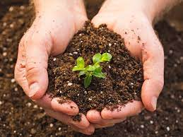
Plants do not need soil.

Slide 8
Plants need sunlight.

Slide 9
Plants need soil.

Slide 10
Plants do not need sunlight.

Slide 11
Plants need air.

Slide 12
Plants are non- living things.

Slide 13
Plants do not need water.

Slide 14
Plants are living things.

Slide 15
Plants can move.

Slide 16
