Slide 1
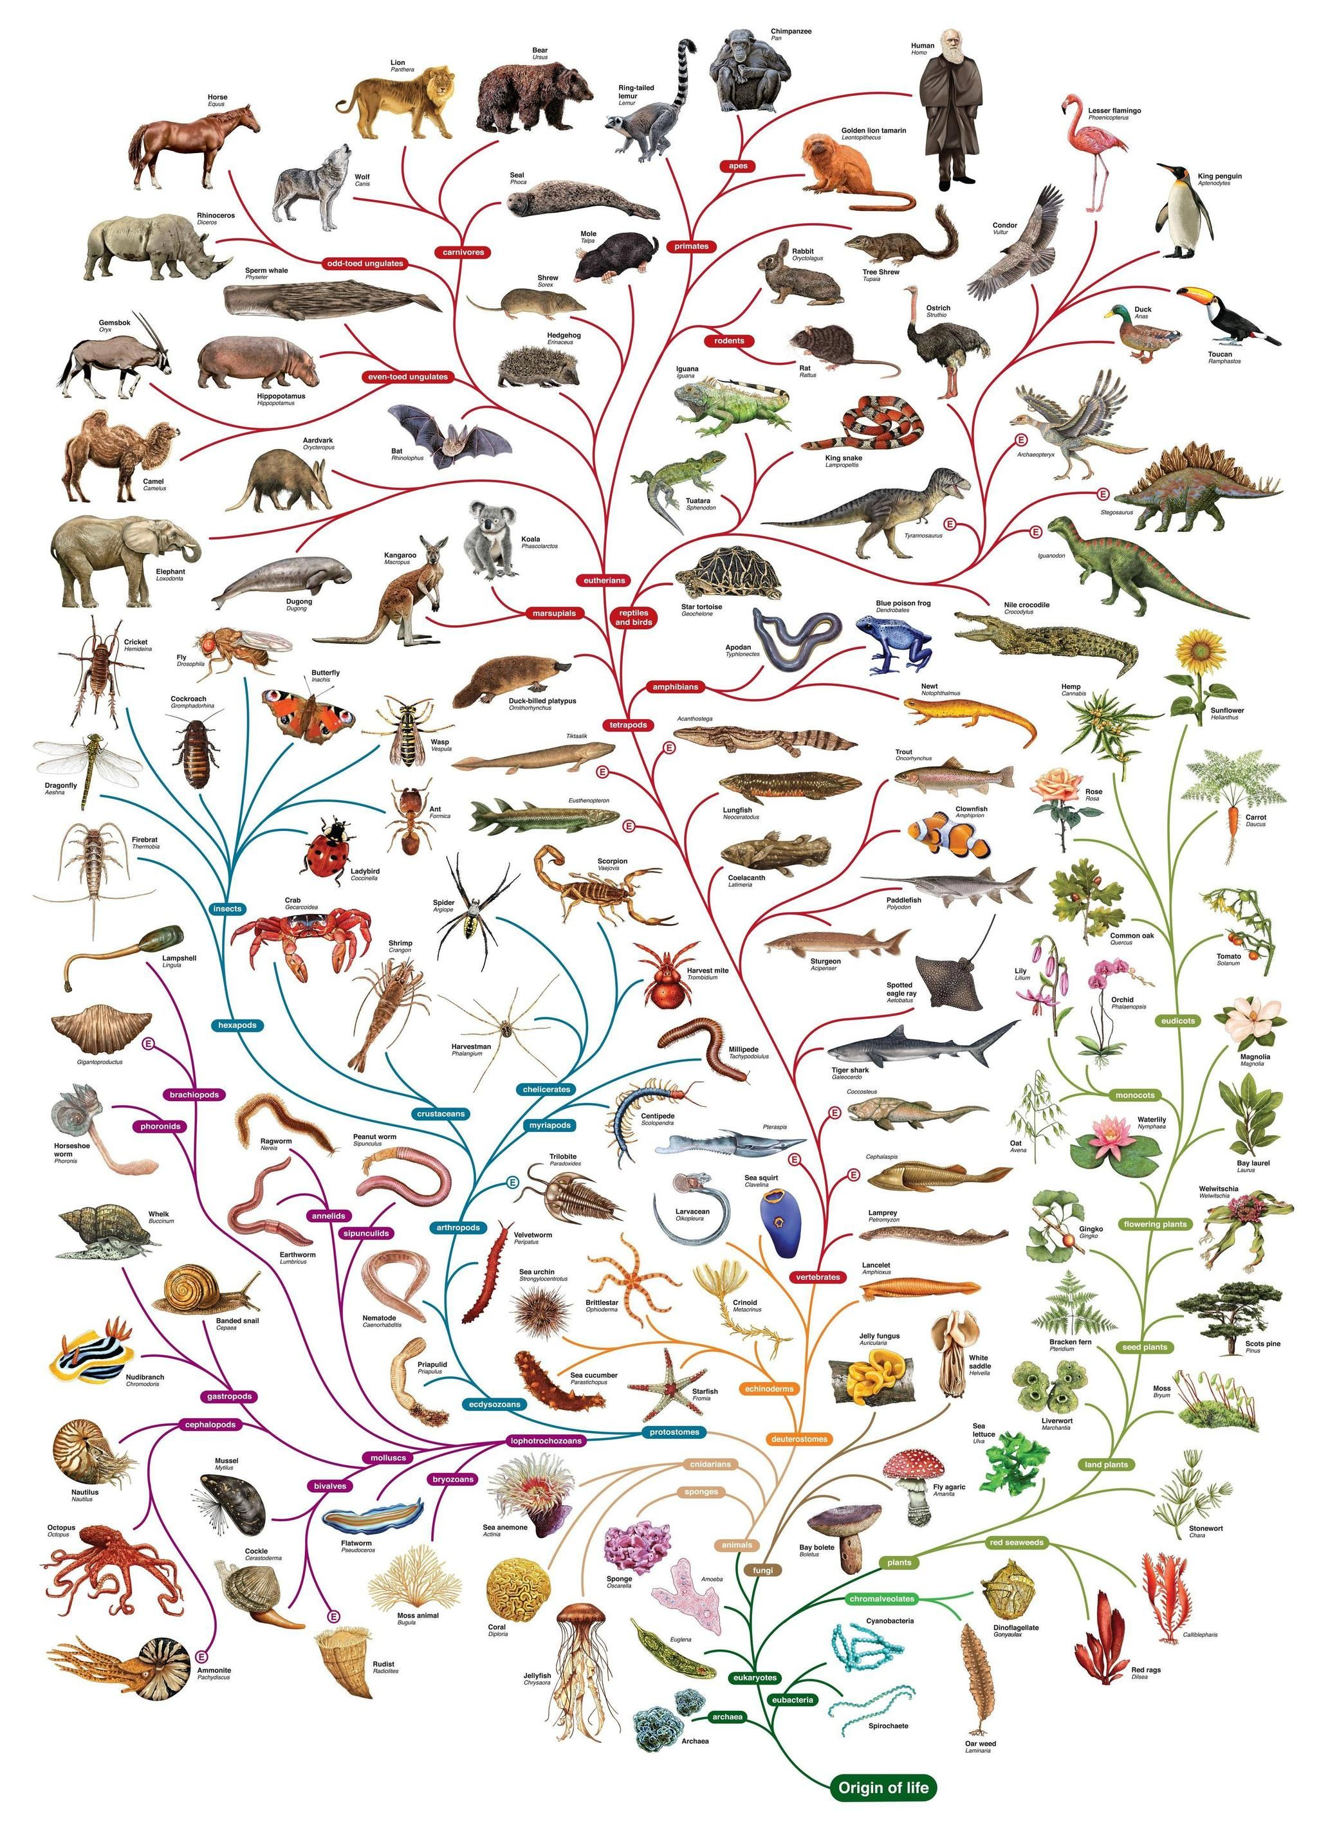
Species
https://www.youtube.com/watch?v=OBXtQnCAfxs

Slide 2
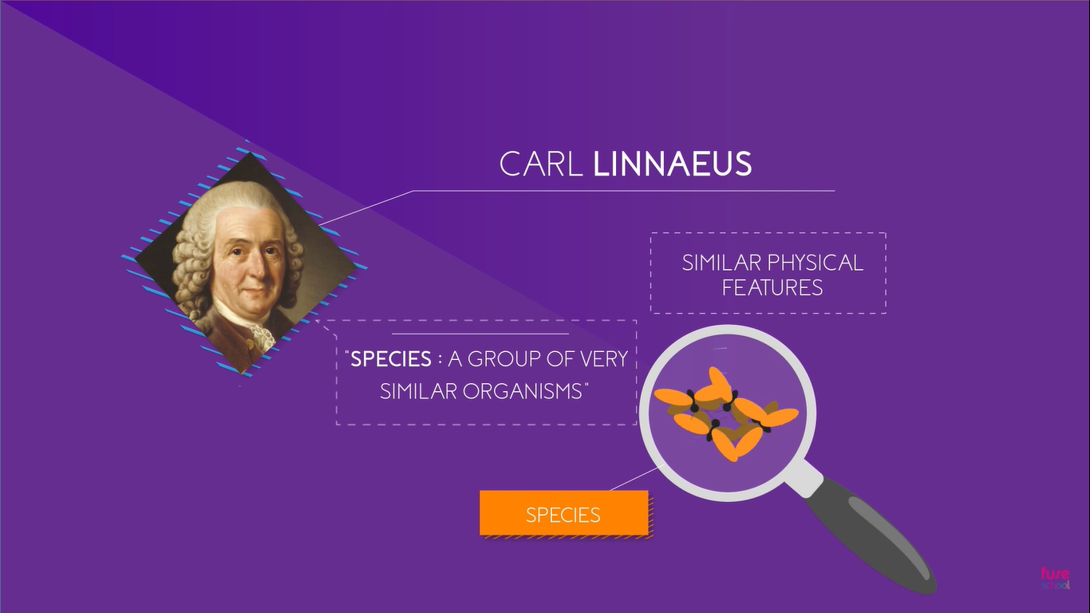

Slide 3
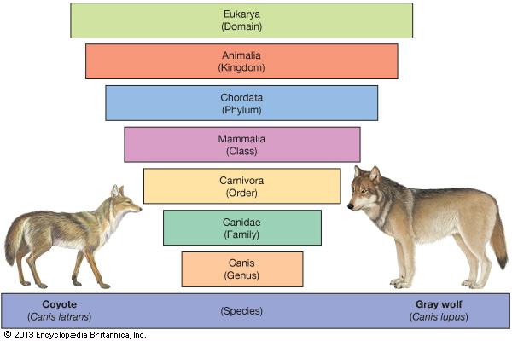

Slide 4
Distinguishing species
Distinguishing species on the basis of structure can be difficult. Members of the same species can look very different and vary in structure.
So how can we decide which animals belong to the same species?
A species is defined as a group of organisms that can reproduce naturally with one another and create fertile offspring.

Slide 5
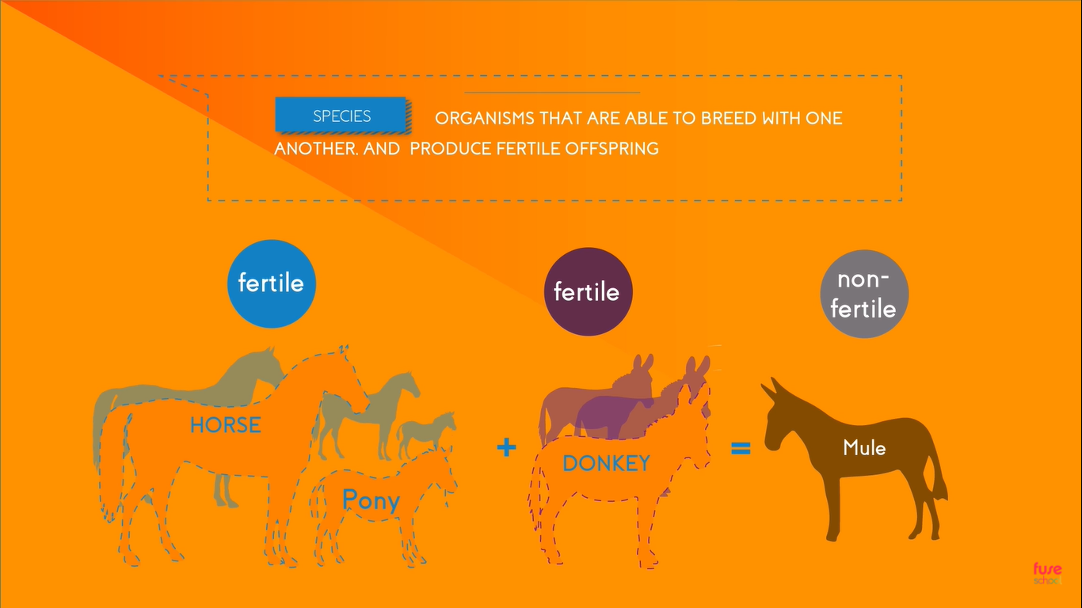

Slide 6
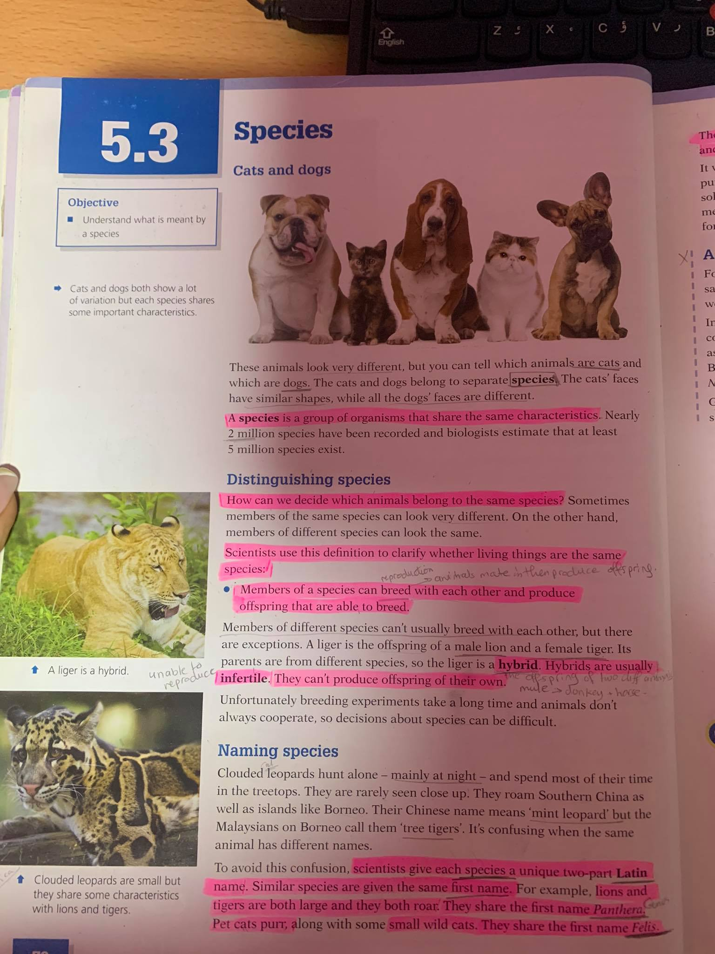

Slide 7
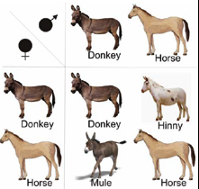
What is the offspring of two different species called?
A hybrid
Why is it important to produce hybrids?
To produce improved animals that have some of the characteristics of each of the parent species.

Slide 8
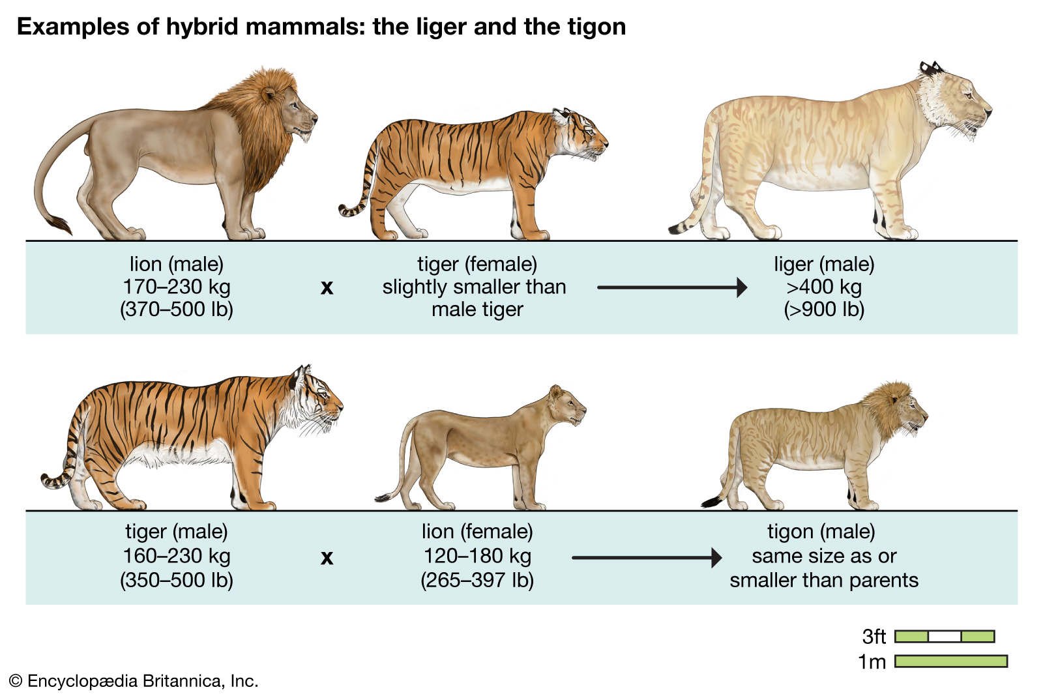

Slide 9
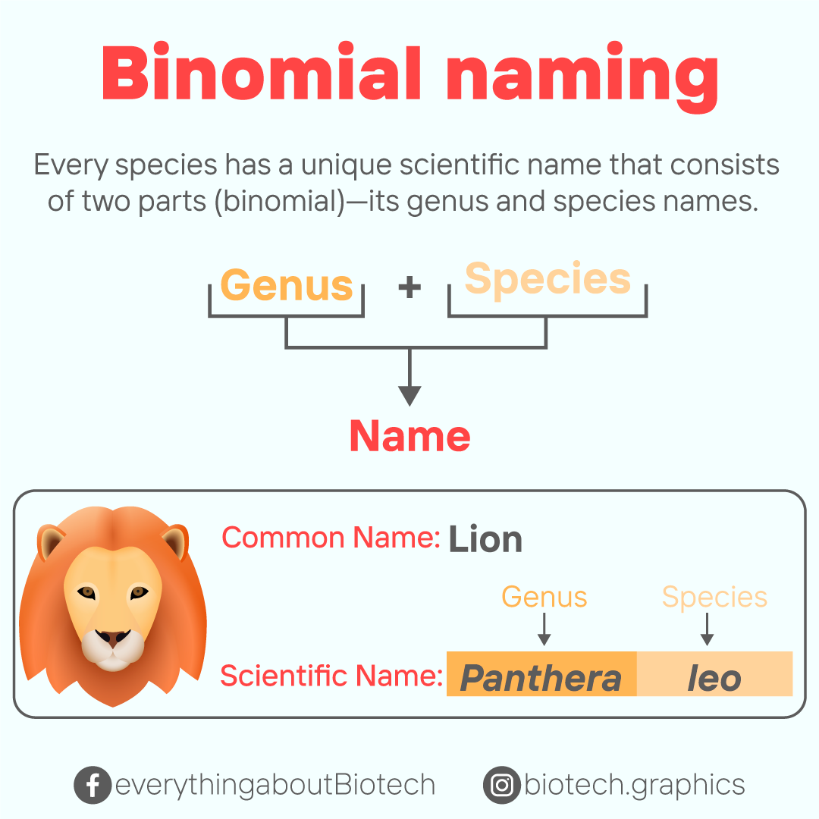
The binomial naming system
It is the system used to name species. Each species is given a name that consists of two parts.
The first part is the Genus to which the species belongs and the second part is the species name.
Large cats that roars – Panthera
Small cat that purrs – Felis

Slide 10
Naming species
Species are given scientific names to avoid confusion.
These names are important because they allow people throughout the world to communicate about animal species.

