Slide 1
Describing a Vegetable or Flower Garden
Year One

Slide 3
Aim
To write a short paragraph describing a vegetable or flower garden you planted in your imagination or for real.
Success Criteria
I can write a short paragraph describing a vegetable or flower garden .
I can make polite offers.
I can use prepositional phrases for location.
I can use different connections.

Slide 4
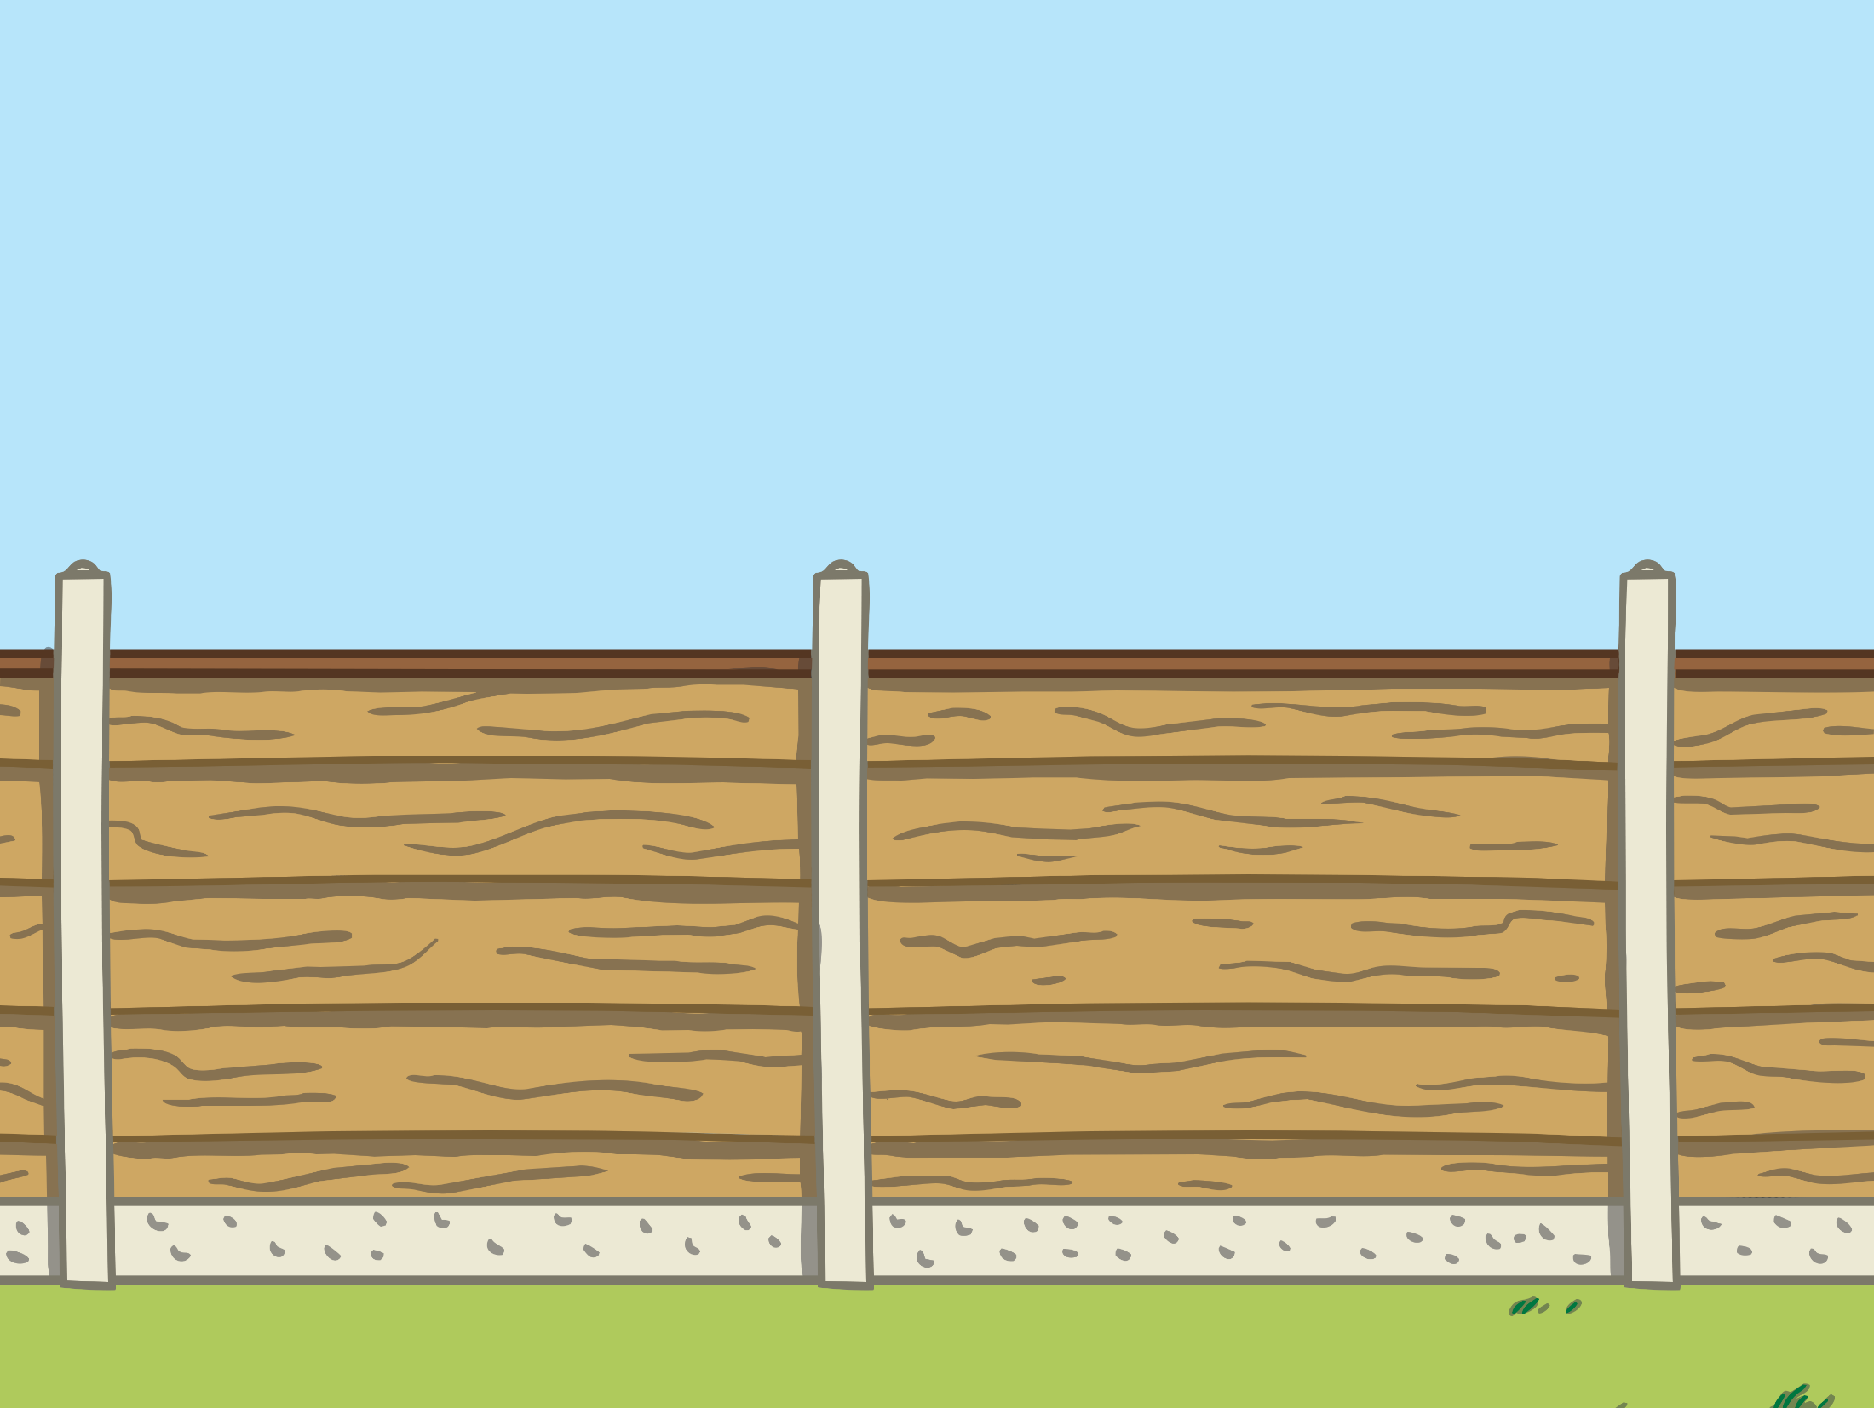
Let’s Get Ready

Slide 5
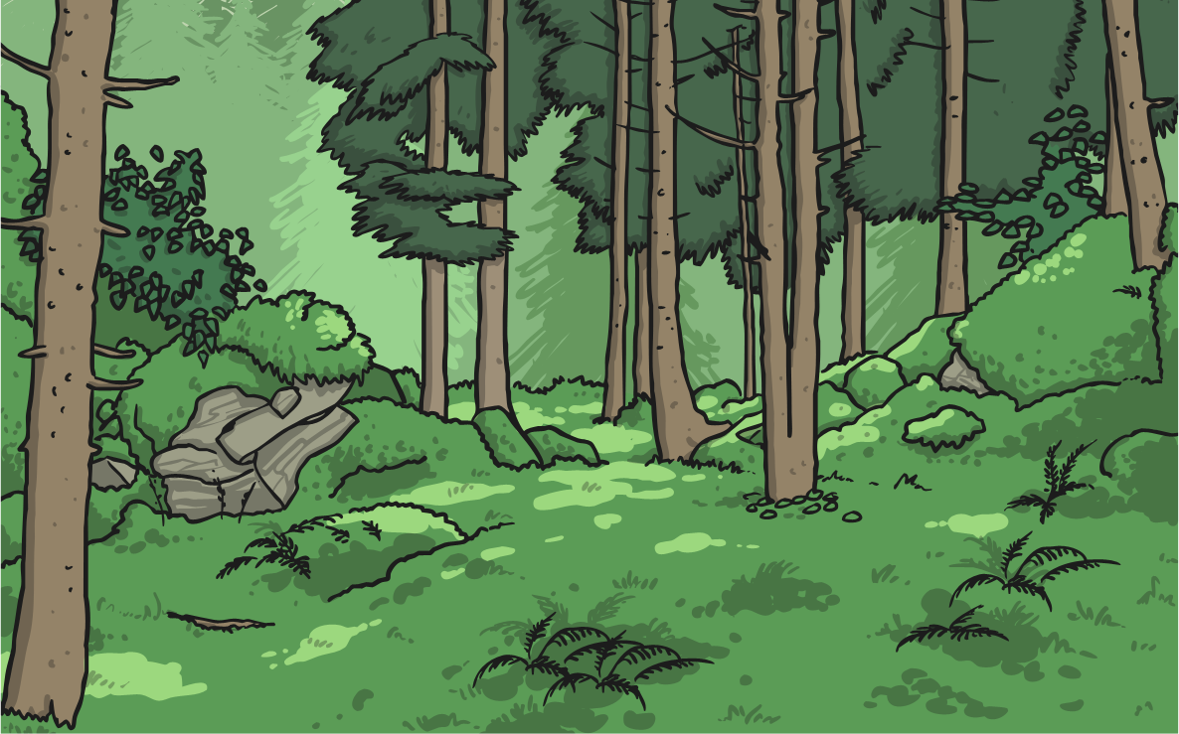
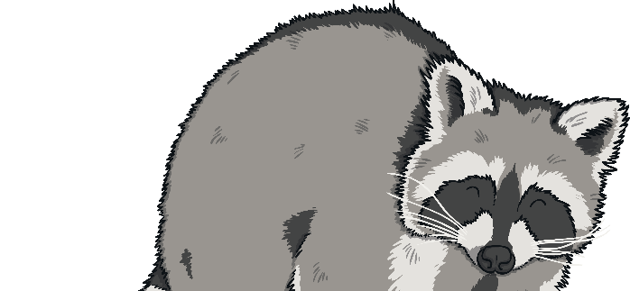
1. Title
1. Choose an eye catching title.
My Beautiful Garden
Share your ideas with a partner.

Slide 6
1. The Topic Sentence
1. Start your paragraph with a polite offer.
Would you like to drop by/ see my beautiful garden?
Share your ideas with a partner.

Slide 7
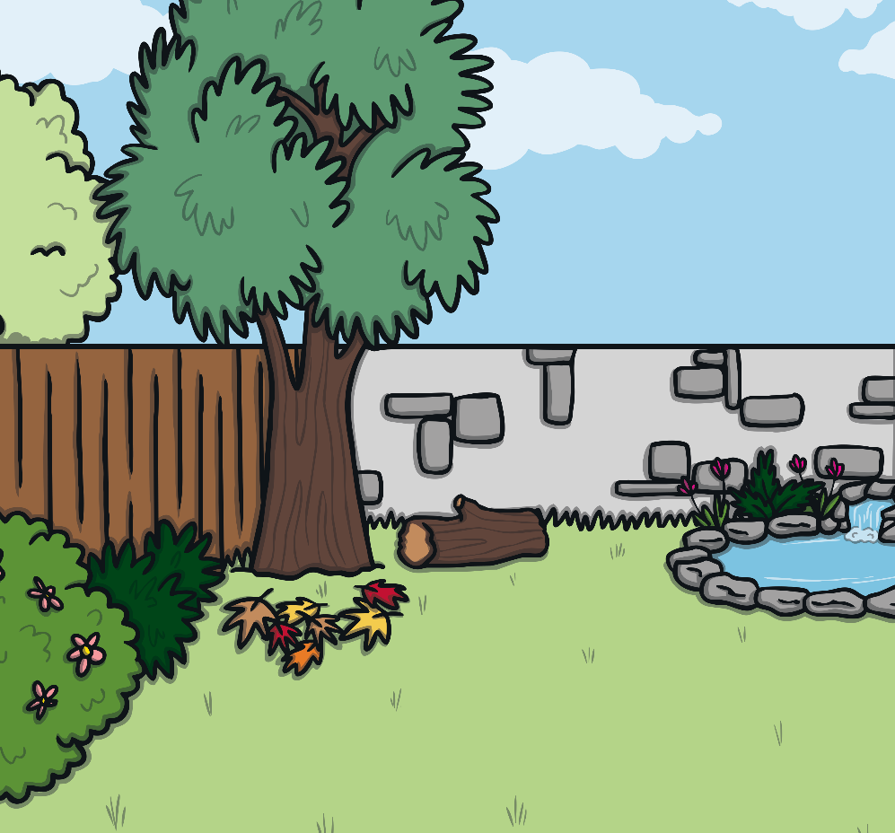
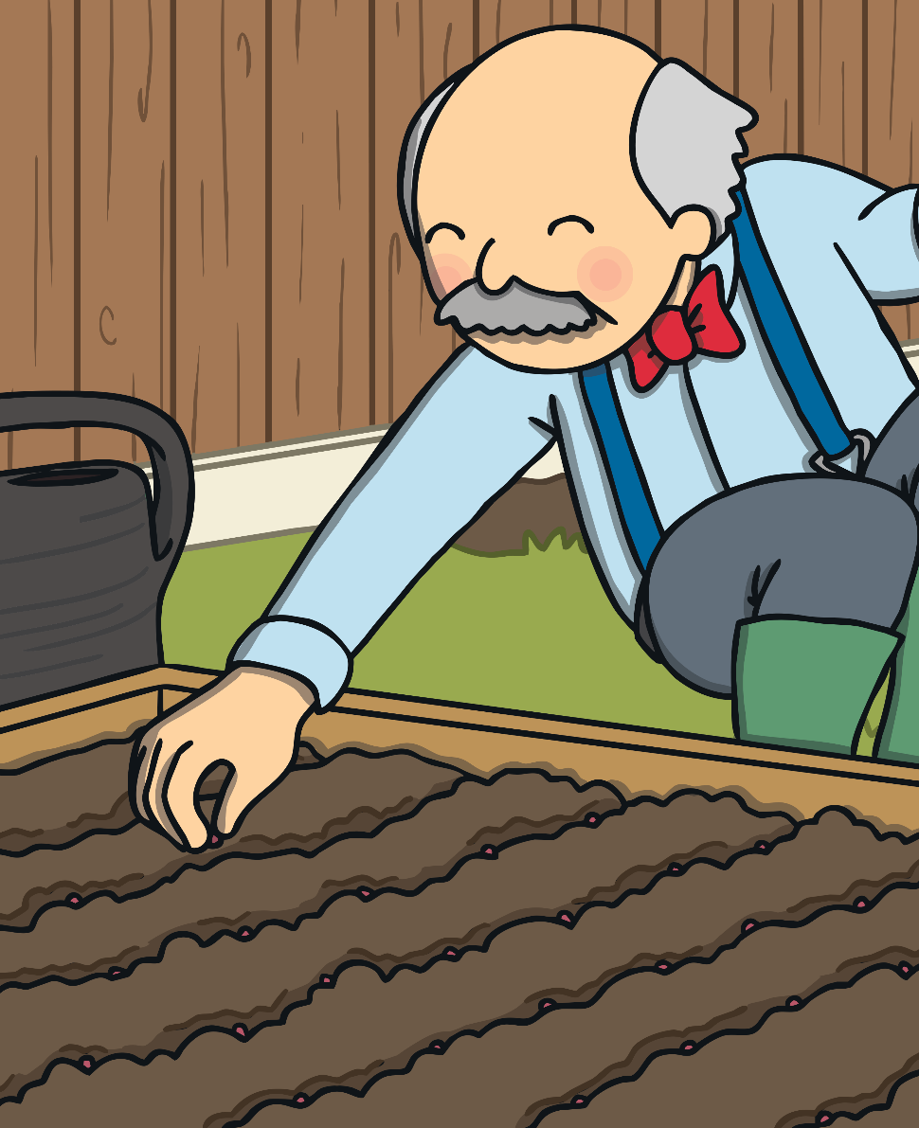
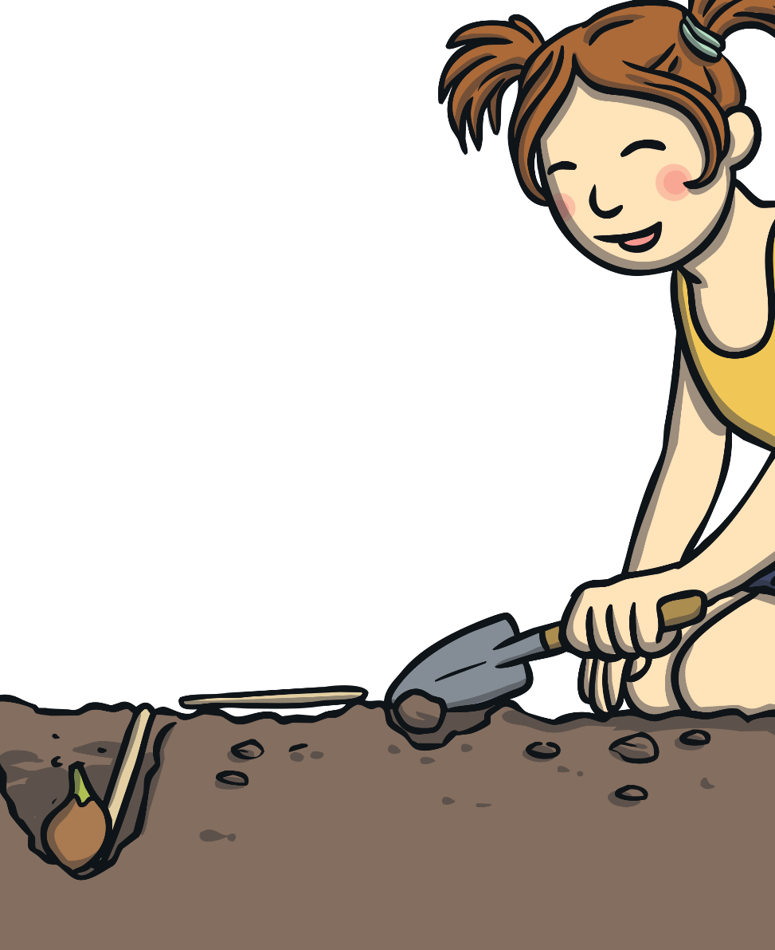
2. Write more details about your garden?
What did you plant in your garden?
I planted three rows of …

Slide 8
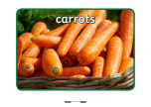
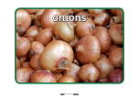
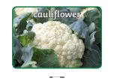
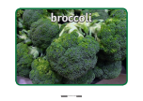
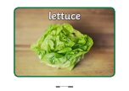
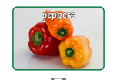
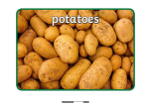
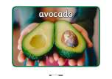
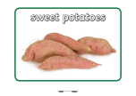
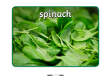
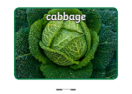

Slide 9
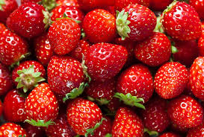
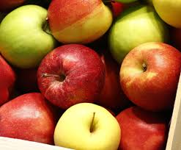
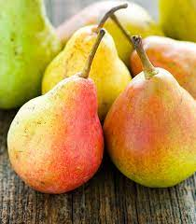
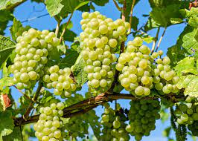
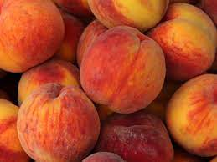
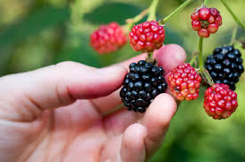
Strawberries
Apples
Pears
Grapes
Peaches
Berries

Slide 10
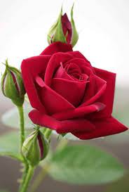
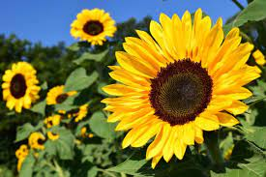
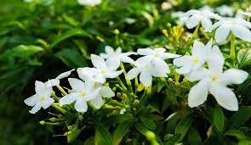
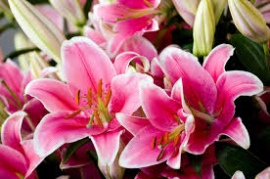
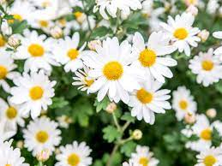
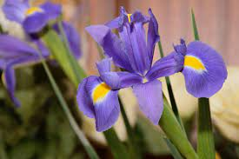
Roses
Sunflowers
Jasmine
Lilies
Daisies
Iris

Slide 11
Use Prepositional Phrases of Location
in the garden
between the green beans and the spinach
behind those three rows
around the garden
I planted three rows of vegetables in the garden.
The carrots are between the green beans and the spinach.
I planted potatoes and tomatoes behind those three rows.
I planted colourful flowers around the garden.

Slide 12
Use Different Connectives
Firstly,
Secondly,
Also,
Finally,
Last,
Later,
In addition,
As well as,
And
First, I planted three rows of vegetables in the garden.
Then, I planted two rows of carrots. The carrots are between the green beans and the spinach.
I also planted potatoes and tomatoes behind those three rows.
Finally, I planted colourful flowers around the garden.

Slide 13
Write a Closing Sentence
You can describe your garden.
You can say how you feel about your garden
My garden is the best garden ever!
I really love my garden and love taking care of it.

Slide 14
Let’s Get Moving

Slide 15
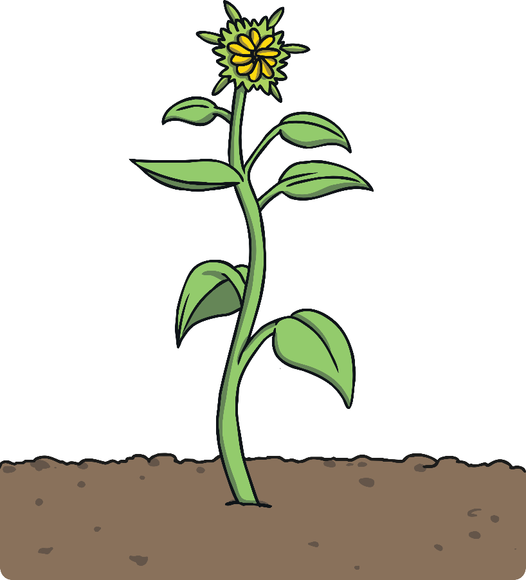
My Beautiful Garden
Would you like to drop by and see my beautiful garden? In my amazing garden, I planted so many delicious vegetables and colourful flowers. Firstly, I planted three rows of vegetables in the garden. I planted three rows of carrots, beans and spinach. The carrots are between the green beans and the spinach. I also planted potatoes and tomatoes behind those three rows. Finally, I planted some yellow sunflowers around the garden.
My garden is the best garden! I really love my garden and love taking care of it.

Slide 16
My Peaceful Garden
Would you like to drop by and see my gorgeous garden? In my pretty garden, I planted so many delicious vegetables and colourful flowers. Firstly, I planted five rows of vegetables in the garden. I planted three rows of cauliflowers, carrots and potatoes. The cauliflowers are between the orange carrots and the potatoes. In addition, I planted some spinach behind the tomatoes. Lastly, I planted some amazing pink lilies around the garden.
My garden is so peaceful and the flowers are so fragrant ! I love to sit in my garden and relax.

Slide 17
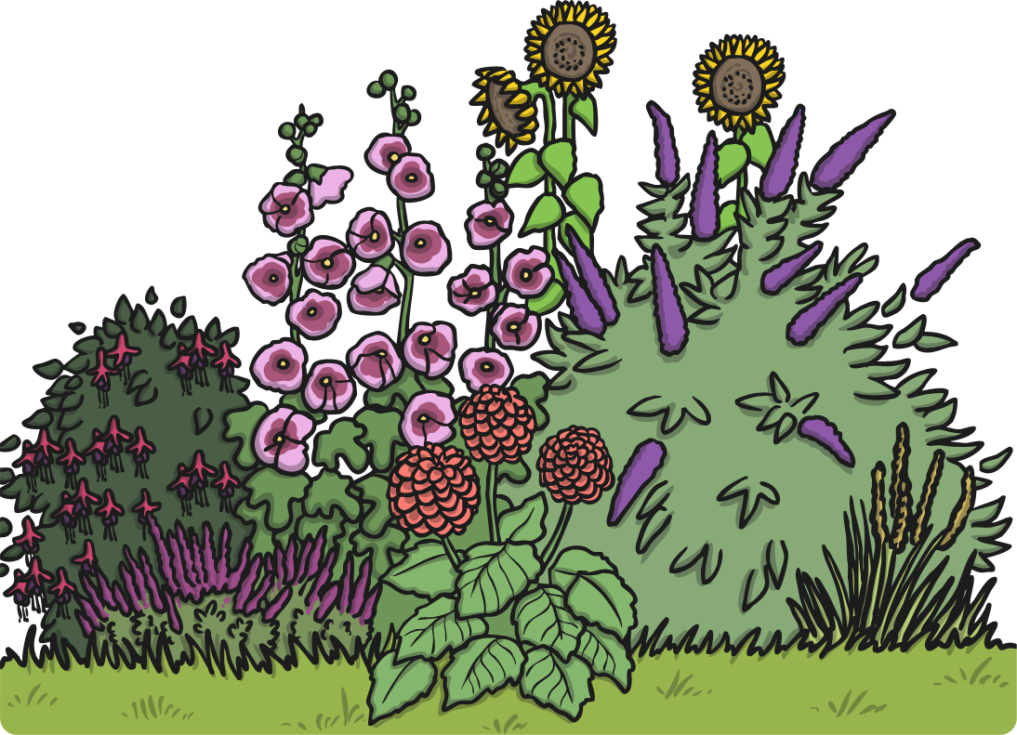
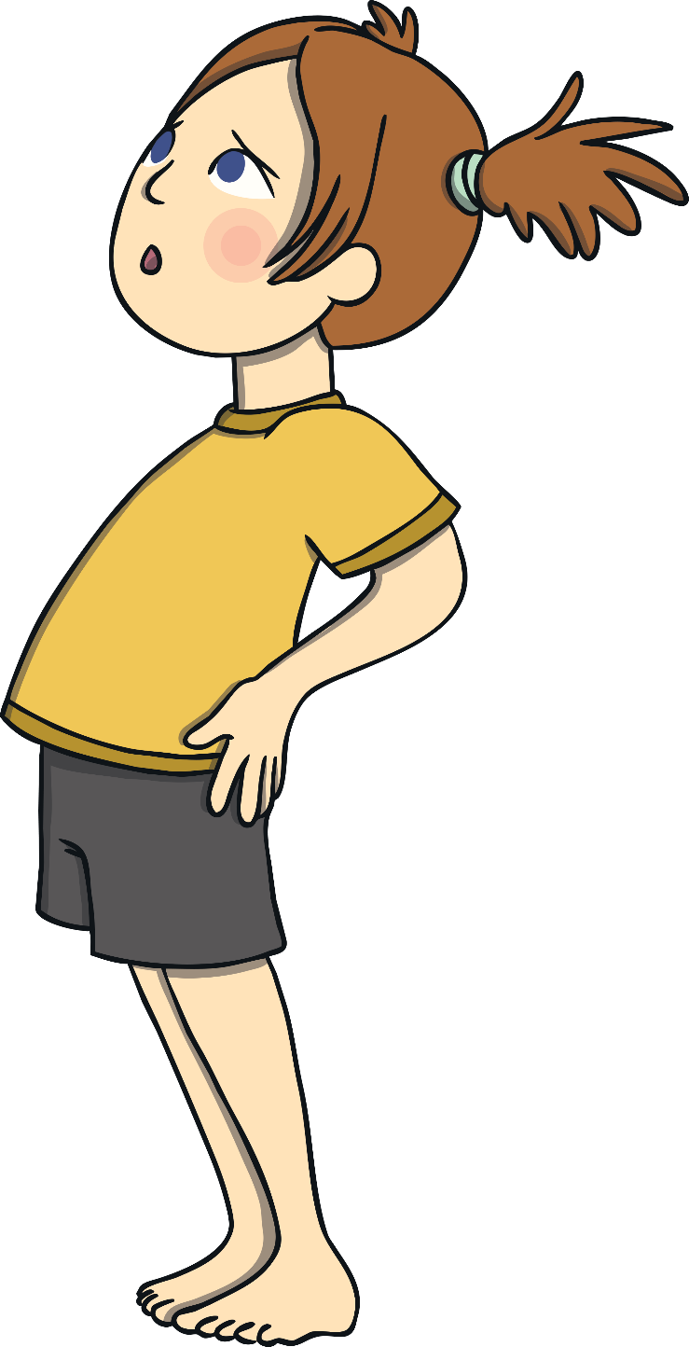
Let’s Review

Slide 18
I started my paragraph with a polite offer. √
I mentioned what vegetables, fruits and flowers I planted in details. √
I used prepositional phrases of location. √
I used different connections. √
I wrote a closing sentence. √

