Slide 1
plants

Slide 2
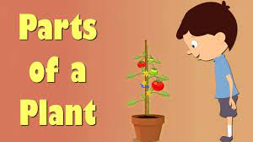

Slide 3
