Slide 1
Daily message
Today we are going to learn a new sound.

Slide 2
oa
.

Slide 3
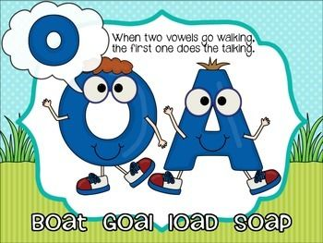

Slide 4
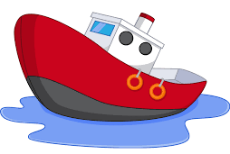
boat
. . .

Slide 5
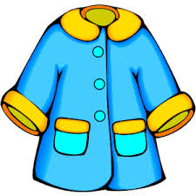
coat
. . .

Slide 6
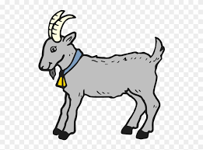
goat
. . .

Slide 7

road
. . .

Slide 8

toad
. . .

Slide 9

loaf
. . .

Slide 10
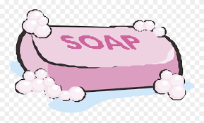
soap
. . .

Slide 11
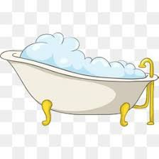
foam
. . .

Slide 12

oak
. .

Slide 13

oat
. .

Slide 14
foam
. . .

Slide 15
soap
. . .

Slide 16
toast
. . . .

Slide 17
loaf
. . .

Slide 18
toad
. . .

Slide 19
goal
. . .

Slide 20
oak oat
. . . .

Slide 21
road coat
. . . . . .

Slide 22
goat toad
. . . . . .

Slide 23
aid
. .

Slide 24
aim
. .

Slide 25
nail
. . .

Slide 26
rain
. . .

Slide 27


Slide 28
pain
. . .

Slide 29
maid
. . .

Slide 30
paid
. . .

Slide 31
strain
.. . . .

Slide 32
grain
. . . .

