Slide 1
Unit 8: Geometry

Slide 2
Types of angles
1) Acute angle
2) Obtuse angle
3) Right angle
4) Straight angle
5) Reflex angle

Slide 3
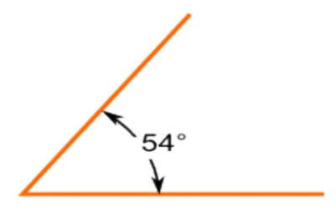
Acute angle
The measure of the acute angle is less than 90 ͦ

Slide 4
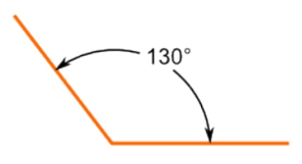
Obtuse angle
The measure of the obtuse angle is more than 90 ͦ but less than 180 ͦ

Slide 5
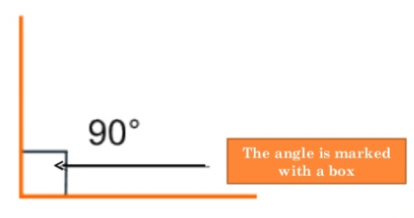
Right angle
The measure of this angle is exactly 90 ͦ

Slide 6
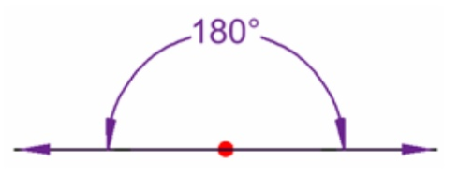
Straight angle
The measure of this angle is exactly 180 ͦ

Slide 7
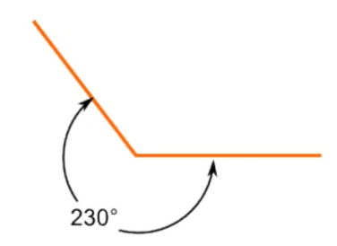
Reflex angle
The measure of the reflex angle is more then 180 ͦ but less than 360 ͦ

Slide 8
Video
To review watch the video below:
https://www.youtube.com/watch?v=UgfSwlqi4Qg

Slide 9
Remember the following:
A corner measures 90 ͦ (complementary)

Slide 10
A straight angle measures 180 ͦ (Supplementary)

Slide 11
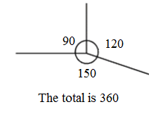
Angles at a point add up to 360 ͦ

Slide 12
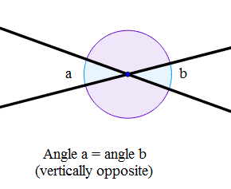
Vertically opposite angles are equal

Slide 13
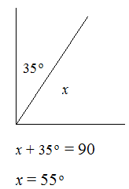
Examples:
Without measuring, find the missing angles.
1)

Slide 14
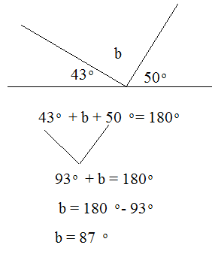
2)

Slide 15
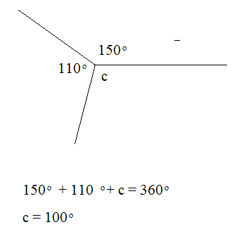
3)

Slide 16
To review, watch the video below:
https://www.youtube.com/watch?v=_n3KZR1DSEo
Page 117, Ex. 8A
Q1 + Q2 + Q5 + Q7

Slide 17
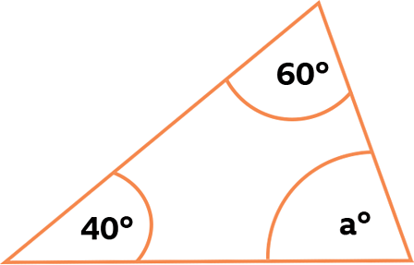
Angles in triangles and quadrilaterals
Angles in triangles.
The angles in a triangle add up to 180 ͦ
Example: find the missing angle a.
We know that:
60° + 40° + a = 180°
100° + a = 180°(use algebra)
-100 = -100
a = 80°

Slide 18
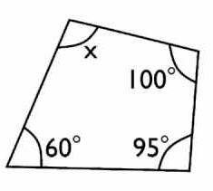
Angles in quadrilaterals.
Angles in quadrilaterals add up to 360º.
Example: find the missing angles.
We know that:
100° + 95° + 60° + x = 360°
255° + x = 360°(use algebra)
-255 = -255
x= 105°

Slide 19
To review watch the video below:
https://www.youtube.com/watch?v=IhPLCCZKzw0
Page 120, Ex. 8B
Q1 (a, b, c, d) + Q2 + Q5 + Q7

Slide 20
The End

