Slide 1
Oxford Discover
Student Book 4
Second Assessment

Slide 2
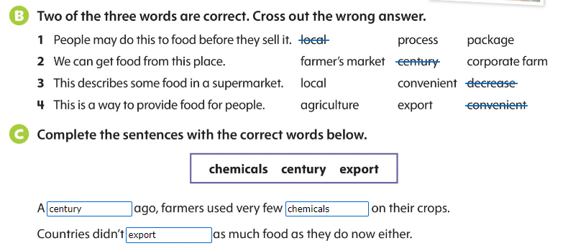
Page 56

Slide 3
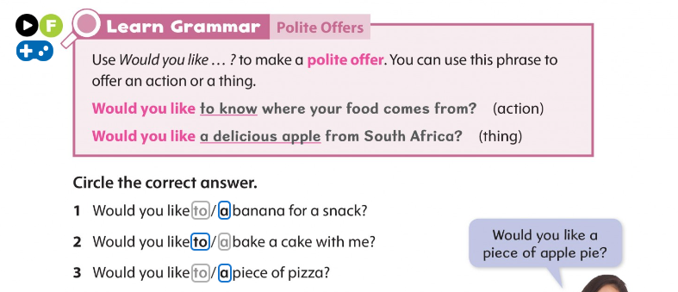
Page 61

Slide 4
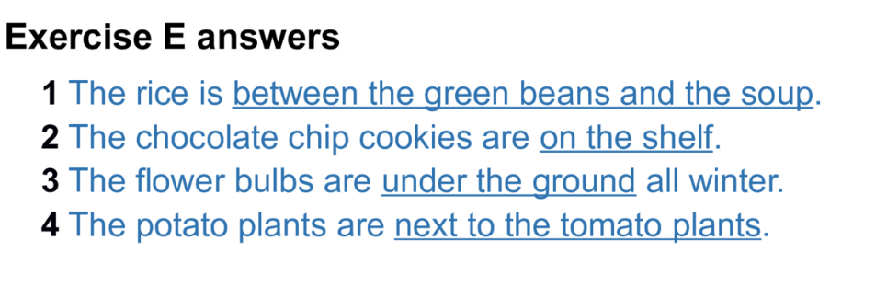
Page 63

Slide 5
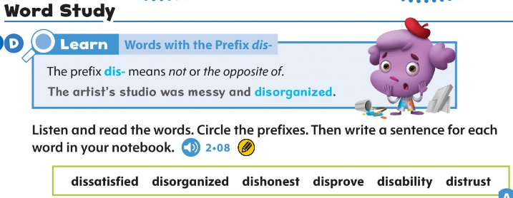
Page 75

