Slide 1
Daily message
We are going to learn a new colour.

Slide 2
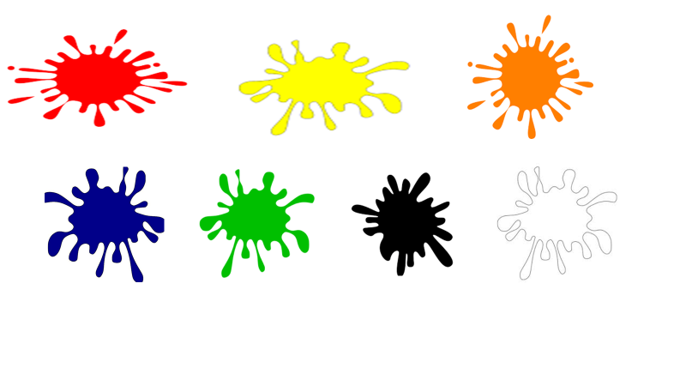


Slide 3







gray

Slide 4
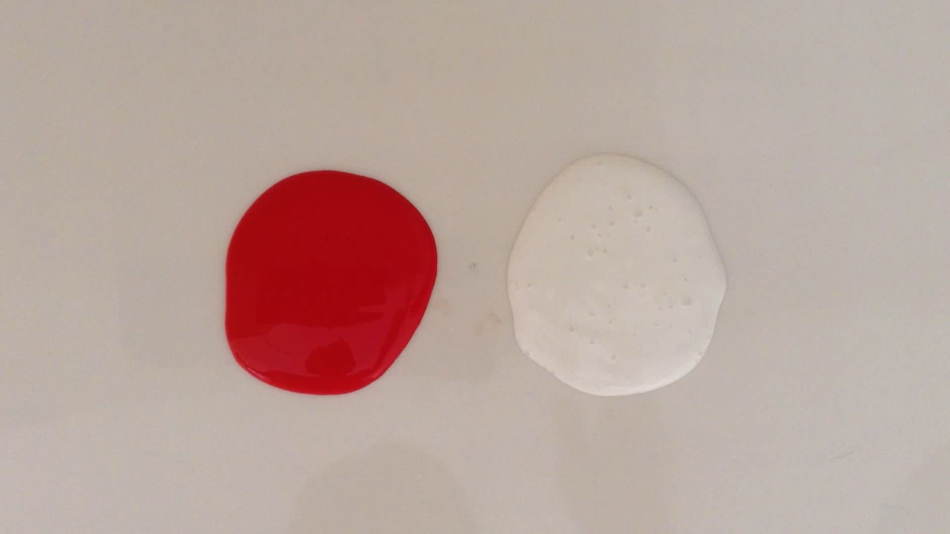

Slide 5
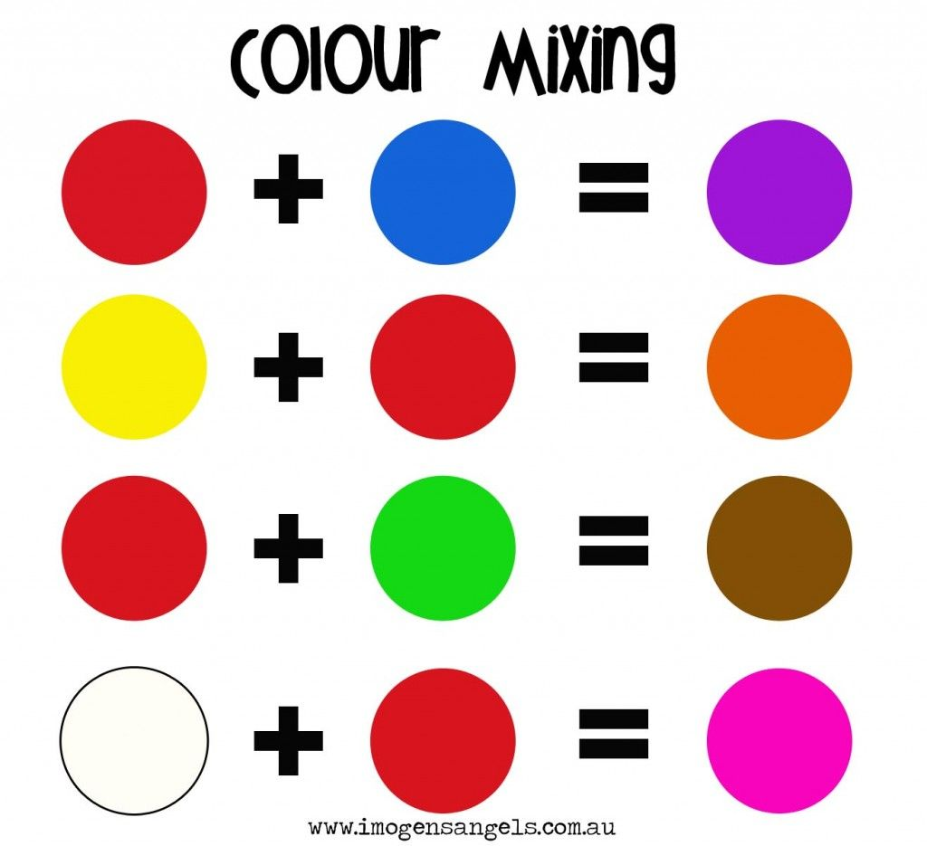

Slide 6
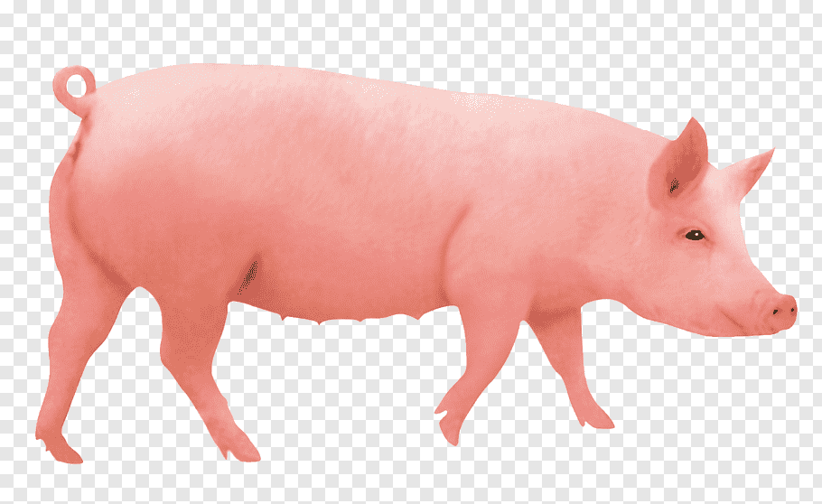

Slide 7


Slide 8
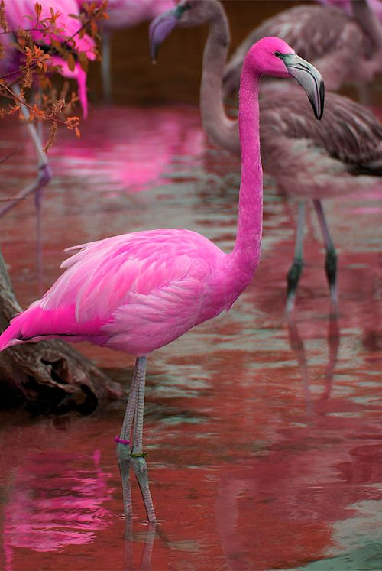

Slide 9
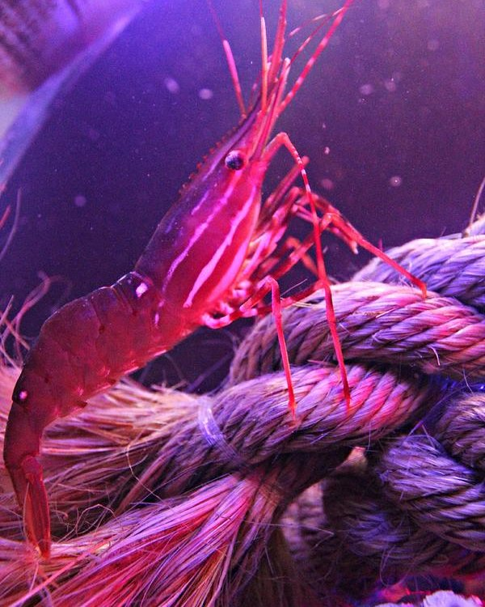

Slide 10
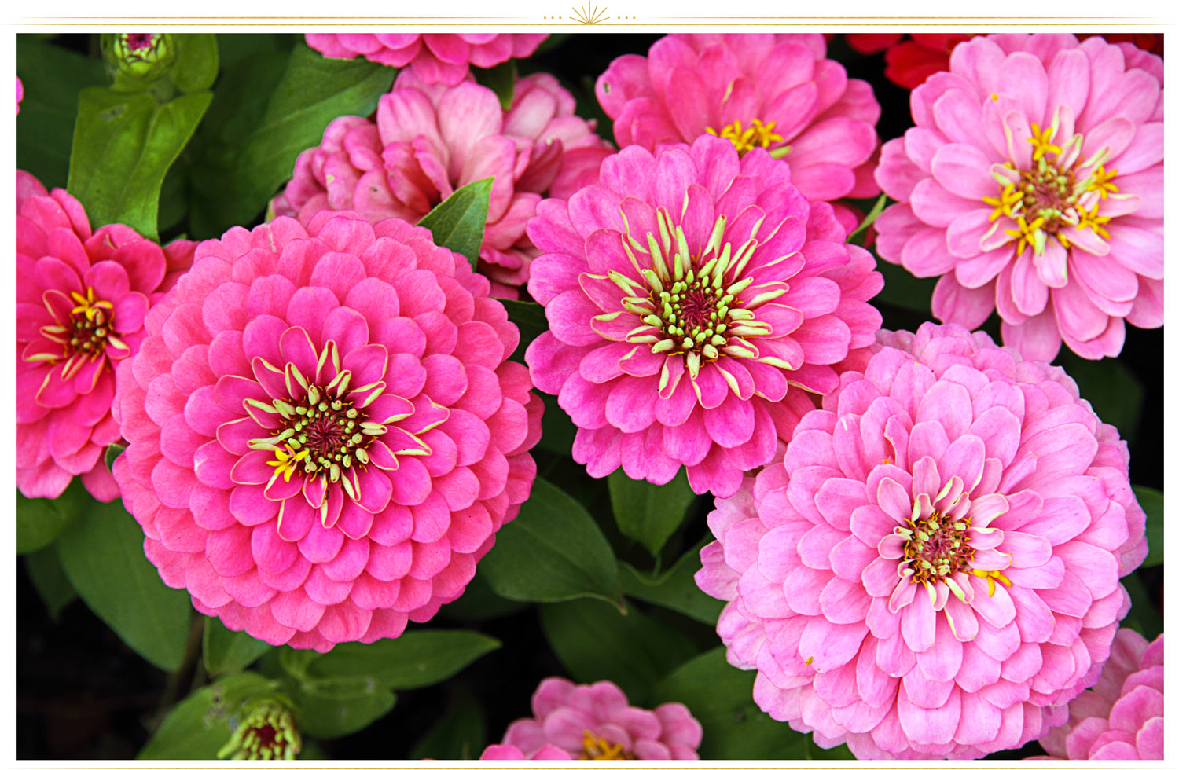

Slide 11
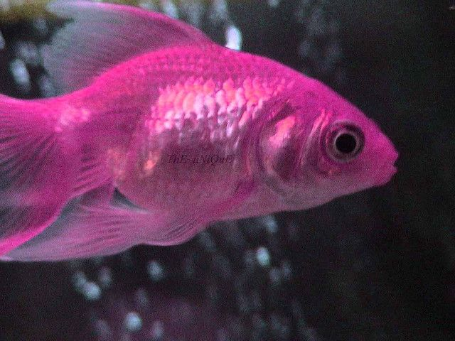

Slide 12
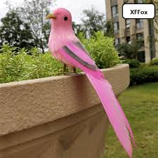

Slide 13
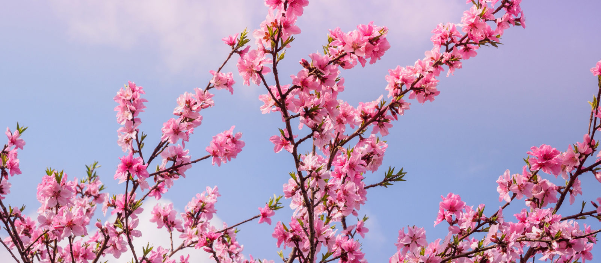

Slide 14
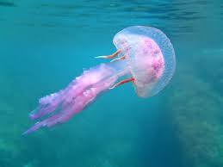

Slide 15
pink

Slide 16
red

Slide 17
blue

Slide 18
pink

Slide 19
yellow

Slide 20
pink

Slide 21
orange

Slide 22
white

Slide 23
gray

Slide 24
pink

