Slide 1
Oxford Grammar Book 5
Unit 8
Pages 44+45+46+47+48

Slide 2
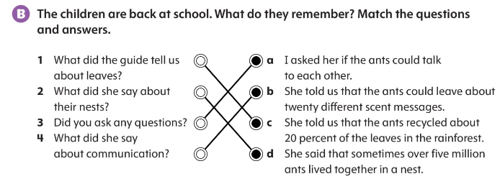


Slide 3
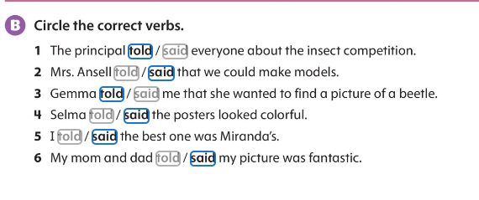
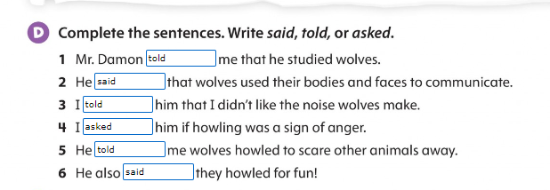

Slide 4
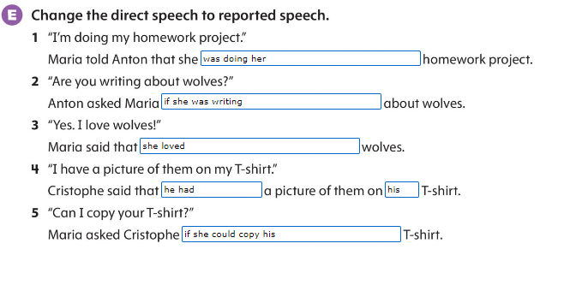

Slide 5


Slide 6
