Slide 1
Oxford Discover Student Book
Units 7 +8

Slide 2
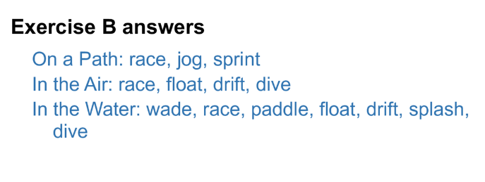
Oxford Discover Student Book
Unit 7 page 70

Slide 3
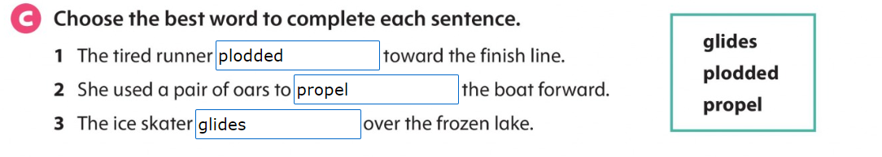

Slide 4
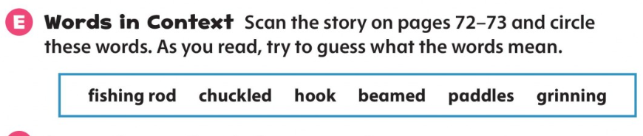

Slide 5
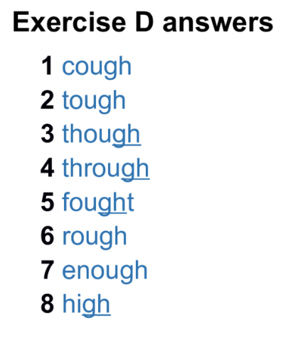
Page 77

Slide 6
