Slide 1
Unit 6 Polite Offers
Grammar Book p. 36+37+38

Slide 2
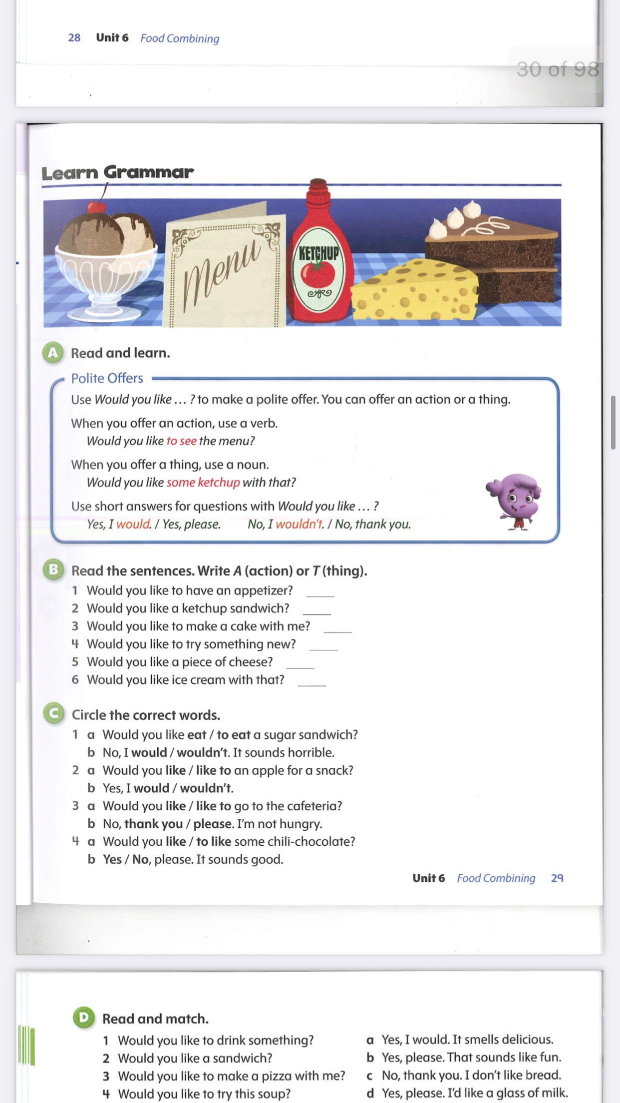
Page 36

Slide 3
Page 36
A
T
A
A
T
T

Slide 4
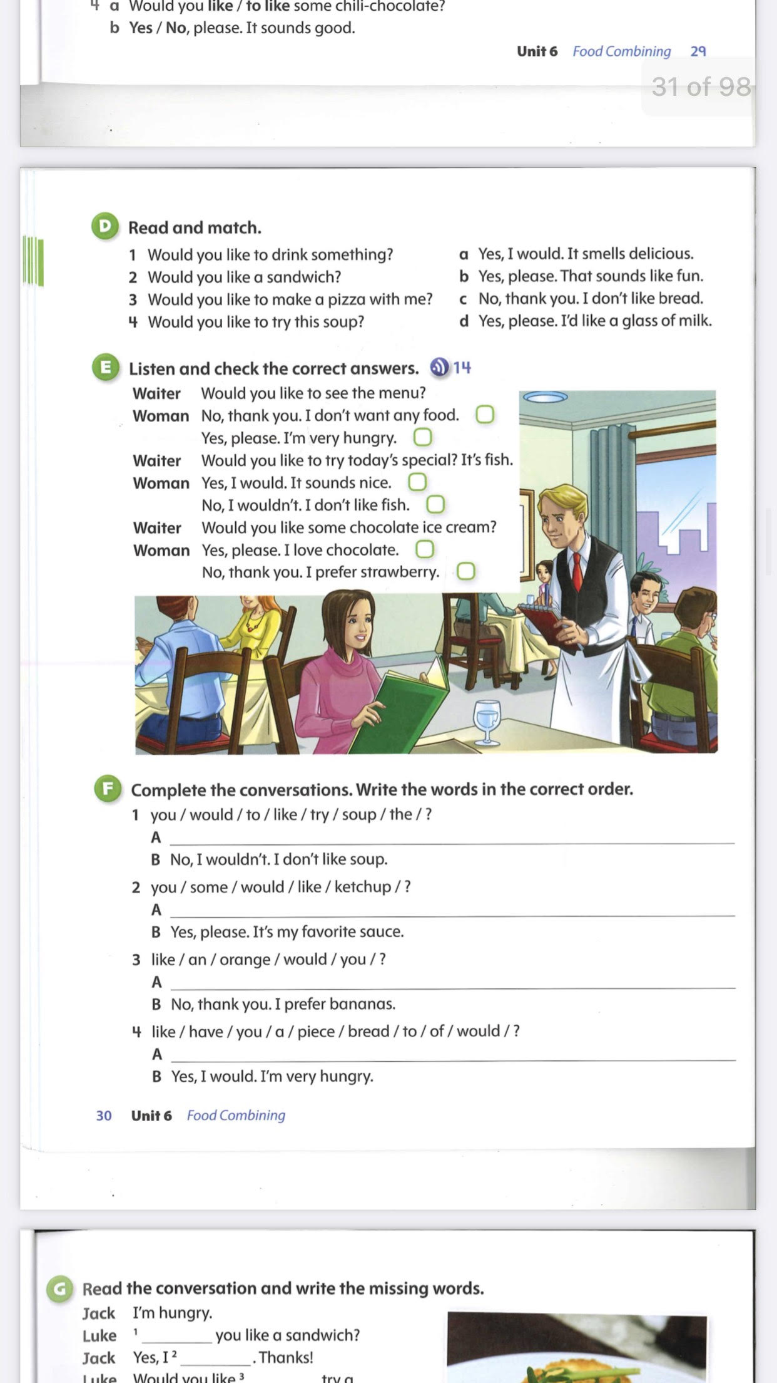
Page 37
d
c
b
a
Notes:
4

Slide 5
Page 37
Would you like to try the soup?
Would you like some ketchup?
Would you like an orange?
Would you like to have a piece of bread ?

Slide 6
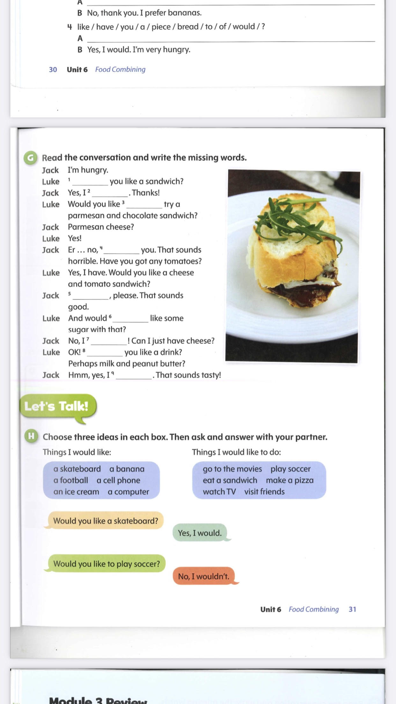
Page 38
Would
would
to
thank
Yes
you
wouldn’t
Would
would

Slide 7
Page 38
Notes:
7

