Slide 1
Oxford Discover Student Book Units 7 +8

Slide 2
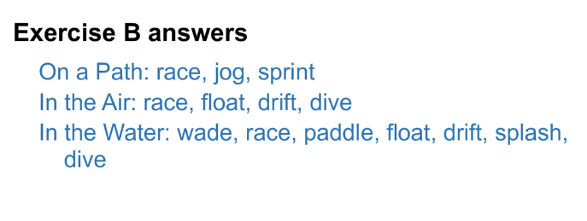
Oxford Discover Student Book Unit 7 page 70

Slide 5
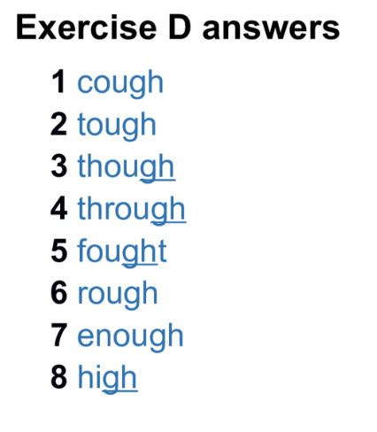
Page 77

