Slide 1
Oxford Grammar Book 5 Unit 8 Pages 44+45+46+47+48

Slide 2
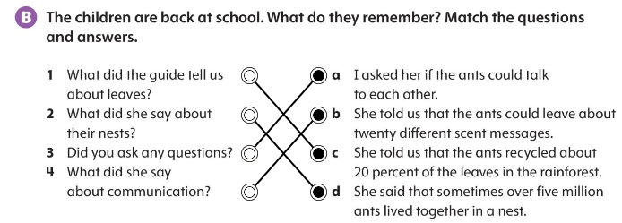

Slide 3
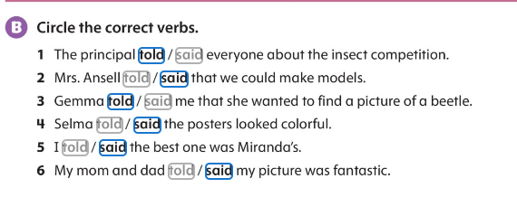
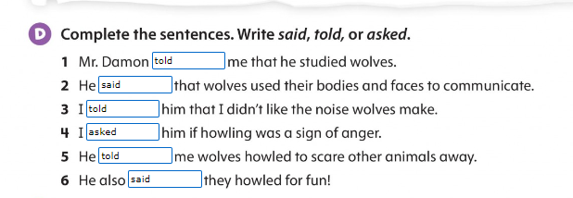

Slide 4
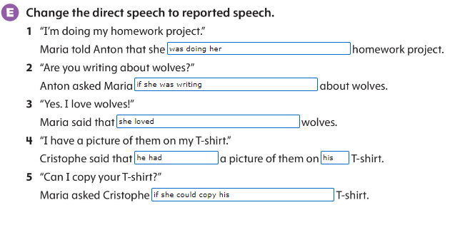

Slide 6
