Slide 1
Persuasive letters
Student’s book page 142

Slide 2
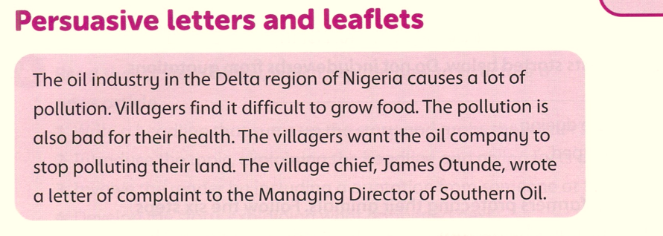
Student’s book page 142

Slide 3
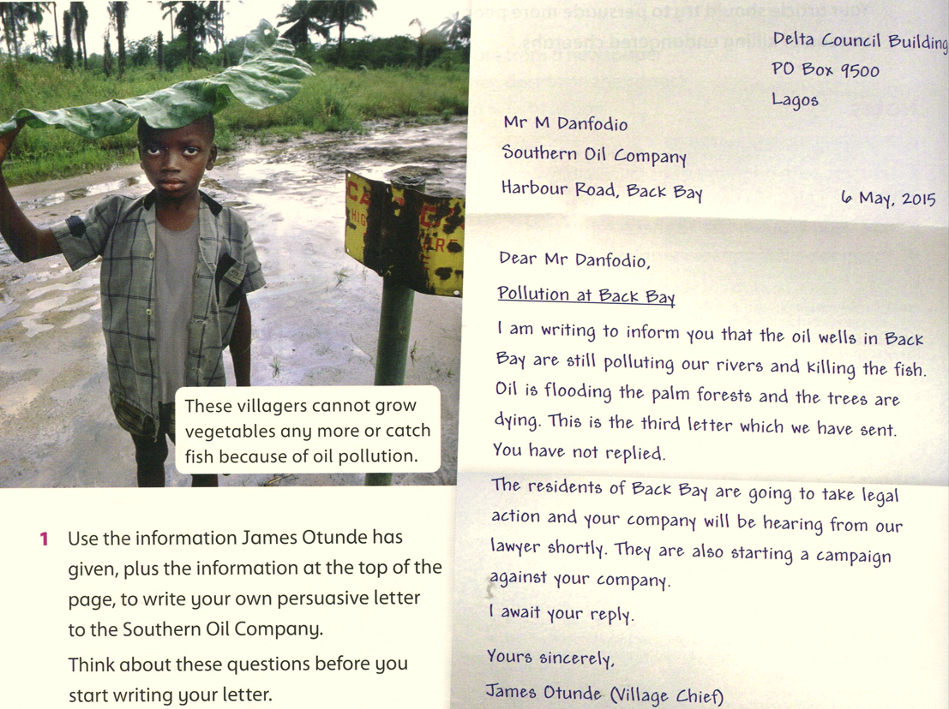
Student book page 142

Slide 4
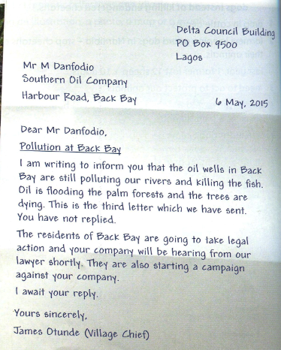
What is the style of this letter?
Formal
How do you know?
Greetings and sign off are formal; introduction; it is factual and direct.
What persuasion features does the letter contain?
Opinion, evidence, forceful language

Slide 5
You should add statements the reader can't disagree with:
" You can't want these people to starve."
Include a rhetorical question:
" Do you want these people to starve?"

Slide 6
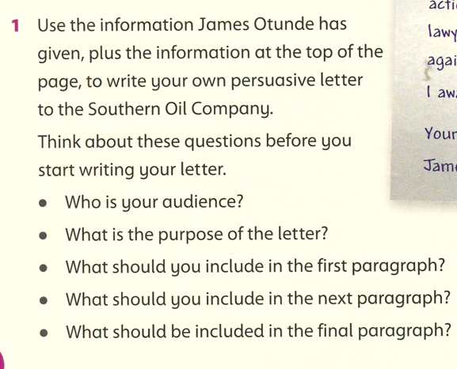
Mr Danfodio.
The purpose of persuasive letters is to bring the audience round to your point. The purpose of this letter is to get the audience to end the pollution of rivers to save the trees and fish.

Slide 7
In the first paragraph we include the purpose of the letter and opinion of the writer.
The next paragraph contains the main argument with evidence.
In the final paragraph we include a strong summary of the argument. It should repeat and reinforce your opinion.
letters are normally written in the present tense & contain emotive language.

