Slide 1
Unit 8
Student's book Page 126-127
https://www.youtube.com/watch?v=hD9arWXIddM
Persuasive Writing for Kids: Brainstorming Topics – YouTube
Persuasive Writing for Kids: Planning & Pre-writing – YouTube
Persuasive Writing for Kids: Developing Reasons – YouTube
Persuasive Writing for Kids: Writing an Introduction – YouTube
Persuasive Writing for Kids: Writing a Rough Draft and Closing - YouTube

Slide 2
Leaflets
Letters
Television
Newspapers

Slide 3
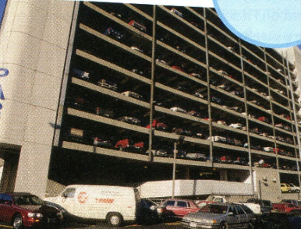

Slide 4
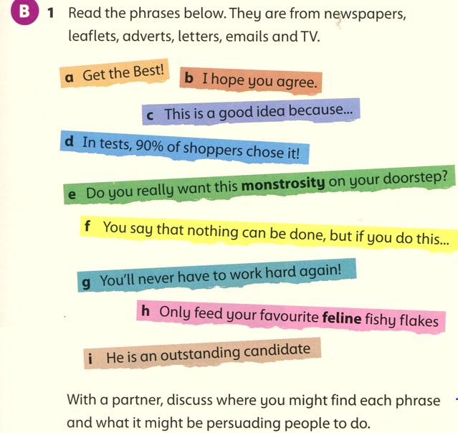
e
(b,c,d,e,f,i)
(a,d,g)
(a,d,h)
(a,d,g,e,h)
(b,c,f,i)

Slide 5
f
b
d
h
g
a
i
e
c

