Slide 1
FirstNews
Student Book p.129
http://fdslive.oup.com/www.oup.com/oxed/international/online-content/oecp-audio/level-5/unit-8/L5U8_1_Non_Fiction_Newspaper.mp3?region=uk

Slide 2
Give the opposite of “ current events”.
Historical events.
What are tabloids?
Tabloids are smaller than broadsheet newspapers.
This makes them easier to read in crowded places.
List the articles and features offered to the reader
as mentioned in the first text.
Current events, entertainment, sports, computer games,
world and home affairs, the environment, puzzles.
List the articles and features offered to the reader
as mentioned in the second text.
entertainment, politics, sports, science.

Slide 3
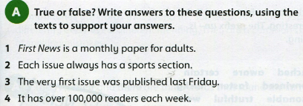
Student Book p. 129 A:
False. It is a weekly newspaper for young people.
True.
False. The newspaper was launched in May 2006.
False. It has over 2 million readers every week.

Slide 4
Remember:
Facts can be proved.
Opinions are based on personal judgment.
With advertising, the opinions of the writer are replaced by the need to sell the product.
How can we distinguish between facts and opinions?
Facts are usually given as statements: A million people read this paper every day.
Opinions often include statements that sound like facts but cannot be checked: It’s an exciting film – you’ll love it.

Slide 5
Fact Example:
First News is a weekly newspaper.
How can you prove this?
By checking the newsstands every Friday for a while, looking up internet references, or checking dates on back issues at the library.
This is what good reporters do- they check their facts.
Opinion Example:
Stories…… all selected to engage and inspire.
Does everything you read in a magazine interest you?
Do you feel inspired by every article?
So is this statement fact or opinion?

Slide 6
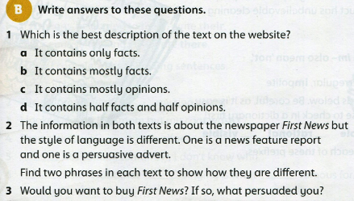
,but also a few opinions
2 The adverts often contain:
Superlatives ( the widest-read).
Exaggeration ( with over 2 million readers every week!).
Imperative ( Don’t miss out- subscribe now).

Slide 7
Reports contain:
Statements: (The newspaper was started in May 2006.)
Statistics and facts: (aimed at 7-14 year olds)

