Slide 1
Opposites and prefixes
Student Book Page 130 and Workbook page 60

Slide 2
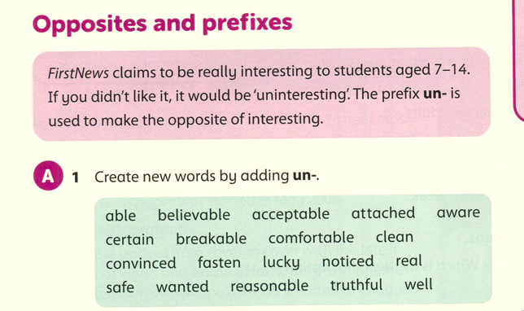
unable, unbelievable, unacceptable, unattached, unaware, uncertain, unbreakable, uncomfortable, unclean, unconvinced, unfasten, unlucky, unnoticed, unreal, unsafe, unwanted, unreasonable, untruthful, unwell.

Slide 3
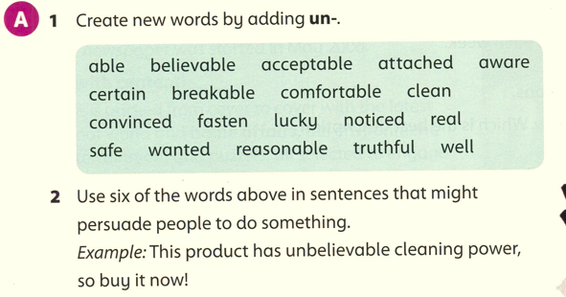

Slide 4
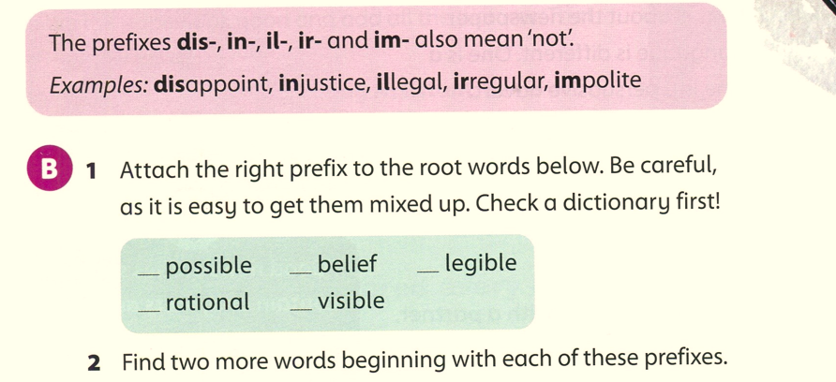
impossible
disbelief
illegible
irrational
invisible

Slide 5
immovable , imperfect
dislike, disobey
illegal, illogical
irreparable, irresistible
inappropriate, inaudible

Slide 6
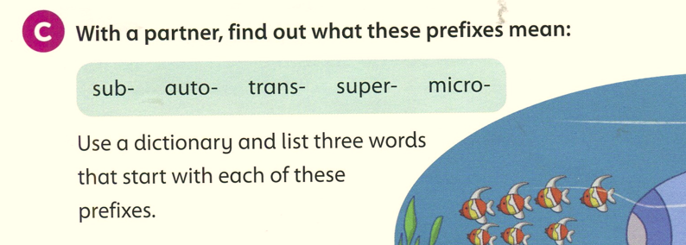
sub: under, below
submarine, submerge, subconscious.
Auto: not controlled by humans
automatic, autopilot, automobile
Trans: across
transport, transfer, translate
Super: better, bigger
supernatural, superman, supercomputer
Micro: very small
microchip, microscope, microphone
Saturday 11/3/2023
Student Book p. 130 C

Slide 7
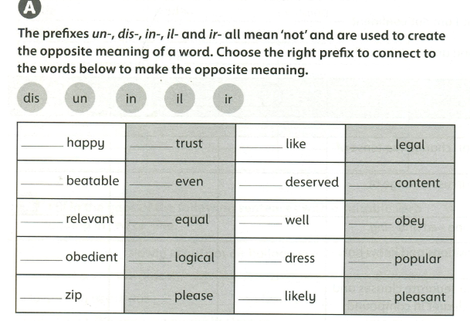
workbook page 60
un
dis
dis
il
un
un
un
dis
ir
un
un
dis
dis
il
un
un
un
dis
un
un

