Slide 1
Daily message
Today , we are going to read new tricky words.

Slide 2

Tricky words

Slide 3
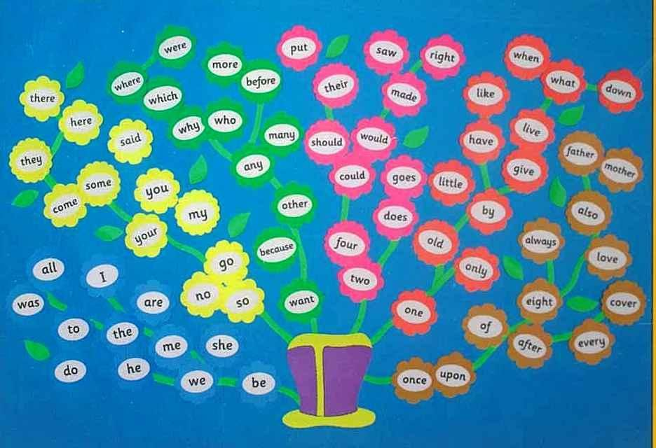

Slide 4


he

Slide 5
be

Slide 6
we

Slide 7
me

Slide 8
she

Slide 9
the

Slide 10
I

Slide 11

to

Slide 12
do

Slide 13
all
o

Slide 14

was

Slide 15

are

Slide 16


come
u

Slide 17
some
u

Slide 18

here

Slide 19
there

Slide 20
they
a

Slide 21
said
a

Slide 22

no
Say my name

Slide 23

go

Slide 24
so

Slide 25
You
.
.

Slide 26
Your
. .
.

Slide 27
my
i

Slide 28


where

Slide 29
when

Slide 30


why

Slide 31
which

Slide 32
who

Slide 33
what

Slide 34


who
which

Slide 35

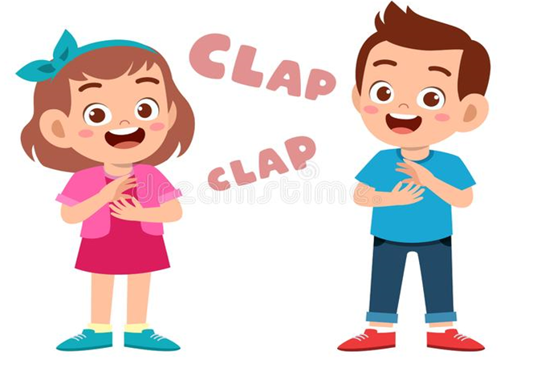
no
why
what

Slide 36


where
who

Slide 37


why
which

Slide 38

when
want

Slide 39

who
which

Slide 40

where

Slide 41

when

Slide 42

who

Slide 43

which

Slide 44

why

Slide 45

what

Slide 46
where
when
who
which
what
why

