Slide 1
Daily message
Today , we are going to read new tricky words.

Slide 2
Tricky words

Slide 4
he

Slide 5
be

Slide 6
we

Slide 7
me

Slide 8
she

Slide 9
the

Slide 10
I

Slide 11
to

Slide 12
do

Slide 13
all
o

Slide 14
was

Slide 15
are

Slide 16
come
u

Slide 17
some
u

Slide 18
here

Slide 19
there

Slide 20
they
a

Slide 21
said
a

Slide 22
no
Say my name

Slide 23
go

Slide 24
so

Slide 25
You

Slide 26
Your

Slide 27
my
i

Slide 28
where

Slide 29
were

Slide 30
why

Slide 31
which

Slide 32
who

Slide 33
want
u

Slide 34
who
which

Slide 35
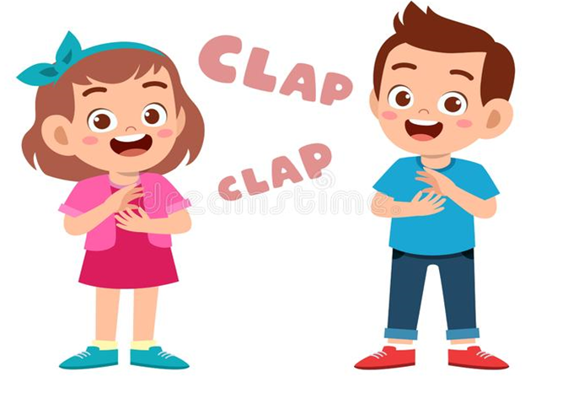
no
why
want

Slide 36
where
who

Slide 37
why
which

Slide 38
were
want

Slide 39
who
which

Slide 40
where

Slide 41
were

Slide 42
who

Slide 43
which

Slide 44
why

Slide 45
want

Slide 46
where
were
who
which
want
why

