Slide 1
Daily message
Today, we are going to learn a new sound.

Slide 2
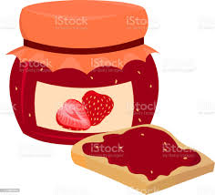
jam
. . .

Slide 3
jug
. . .

Slide 4
jet
. . .

Slide 5
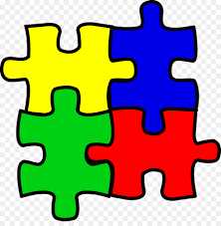
jigsaw
. . . . .

Slide 6
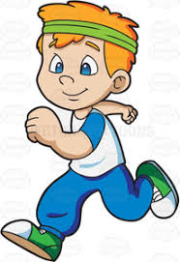
jog
. . .

Slide 7
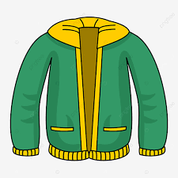
jacket
. . . . .

Slide 8
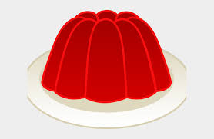
jelly
. . . .

Slide 9
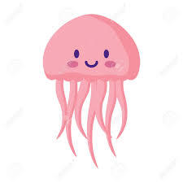
jellyfish
. . . . .. .

Slide 10
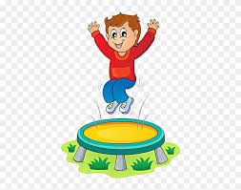
jump
. . . .

Slide 11
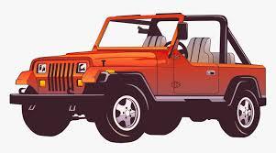
jeep
. . .

Slide 12
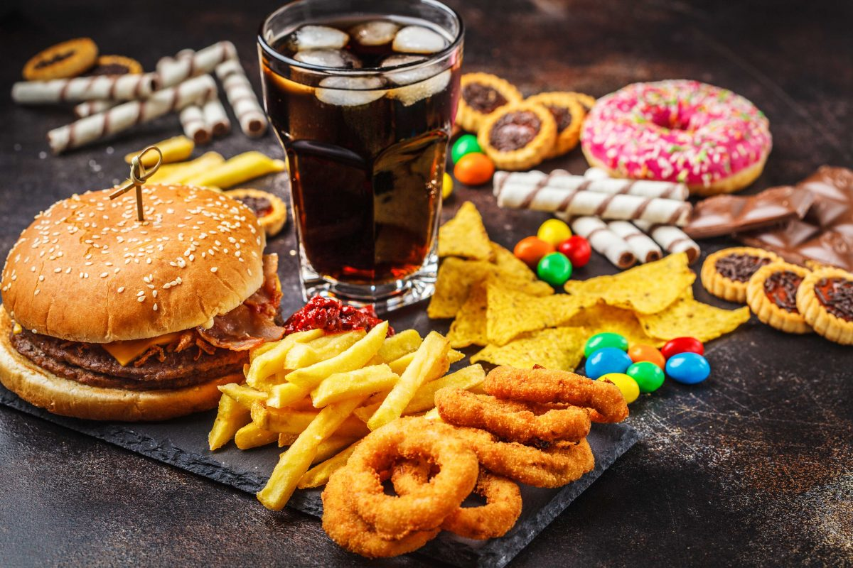
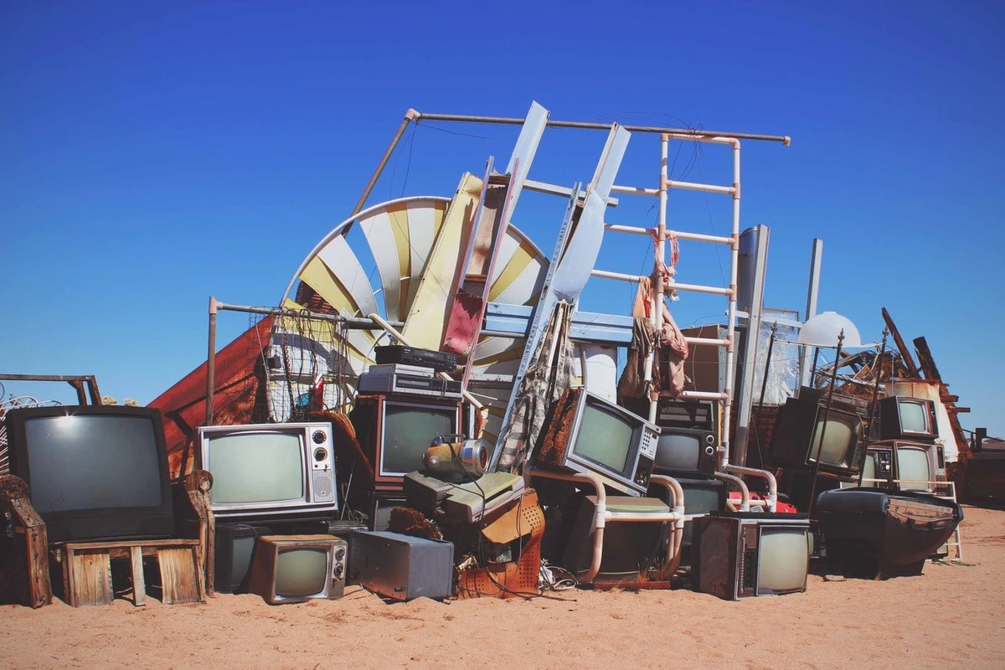
junk
. . . .

Slide 13
Jam jug
. . . . . .

Slide 14
Jet job
. . . . . .

Slide 15
Jog jig
. . . .. .

Slide 16
jump
. . . .

Slide 17
jelly
. . . .

Slide 18
jacket
. . . . .

Slide 19
junk
. . . .

Slide 20
just
. . . .

Slide 21
joker
. . . .

Slide 22
jester
. . .. .

