Slide 1
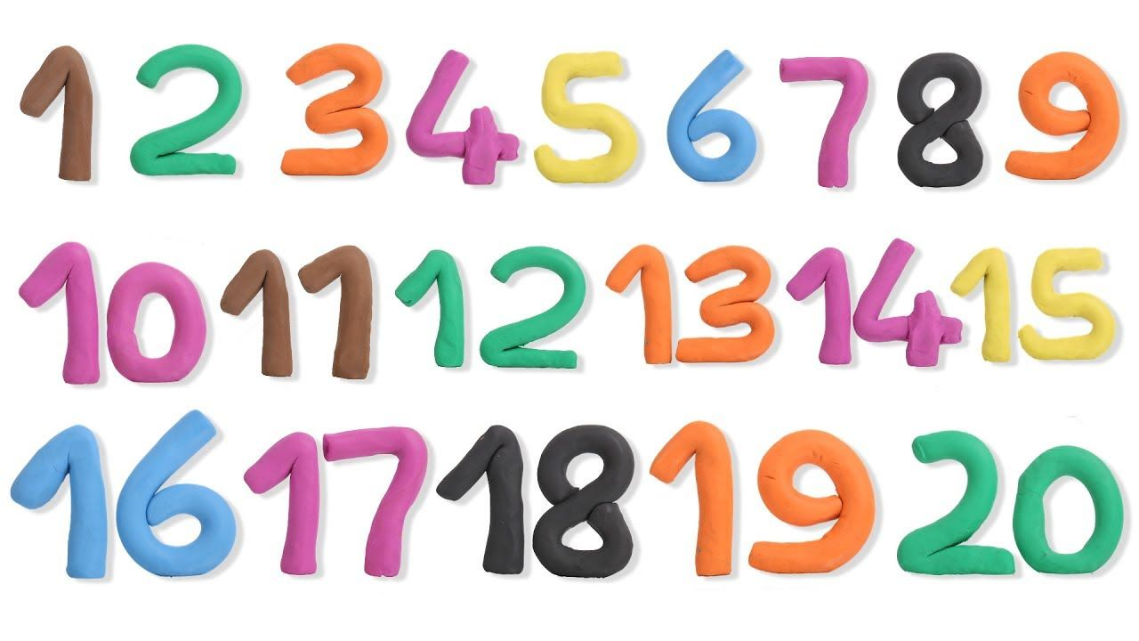
Daily message :
Today, our lesson is about numbers.

Slide 2
Counting backwards from 10-0
10
9
8
7
6
5
4
3
2
1
0

Slide 3
Counting by tens
10
20
30
40
50
60
70
80
90
100

Slide 4
Counting from 0-20
0 1 2 3 4 5 6 7 8 9 10 11 12 13 14 15 16 17 18 19 20

Slide 5
Numbers from 0-15
0
1
2
3
4
5
6
7
8
9
10
11
15
12
13
14

Slide 6

16

Slide 7

17

Slide 8

18

Slide 9
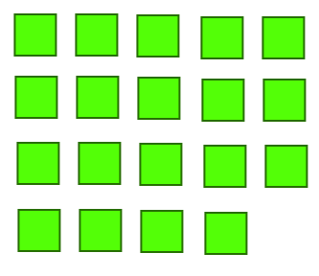
19

Slide 10

20

Slide 11
Our new numbers are
16
17
18
19
20

Slide 12


16
17

Slide 13



18
19
20

Slide 14
1
4
7
8
0 _ 2 3 _ 5 6 _ _ 9 __ 11 12 __ __ 15 16 __ 18 __ 20
10
13
14
17
19

Slide 15
18

