Slide 1
Grammar Book Grade 5 National unit 7
Pages 40+41+42+43

Slide 3
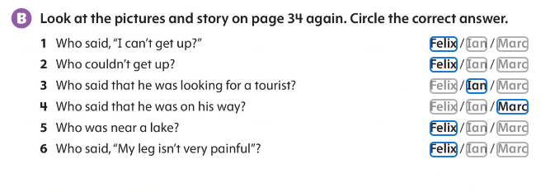

Slide 5
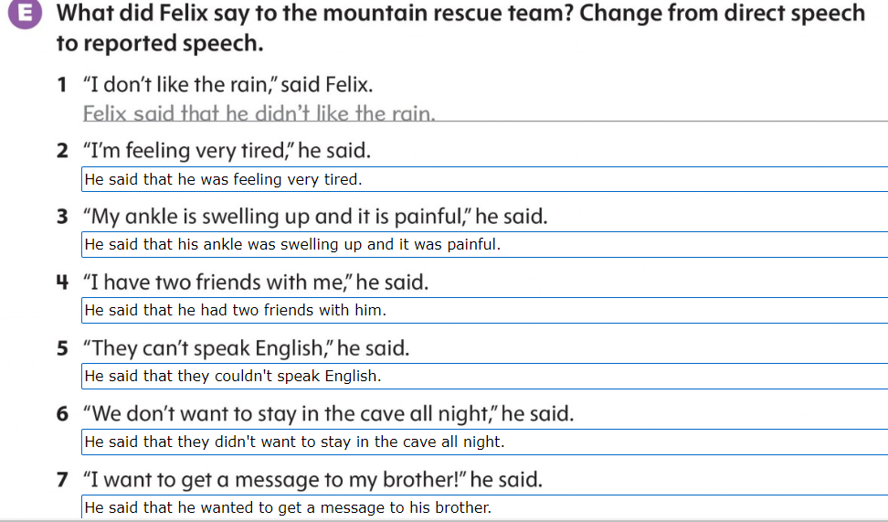

Slide 6
