Slide 1
https://wordwall.net/ar/resource/26519684
https://wordwall.net/ar/resource/6779025

Slide 3
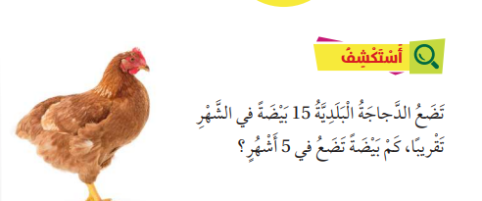

Slide 8
