Slide 1

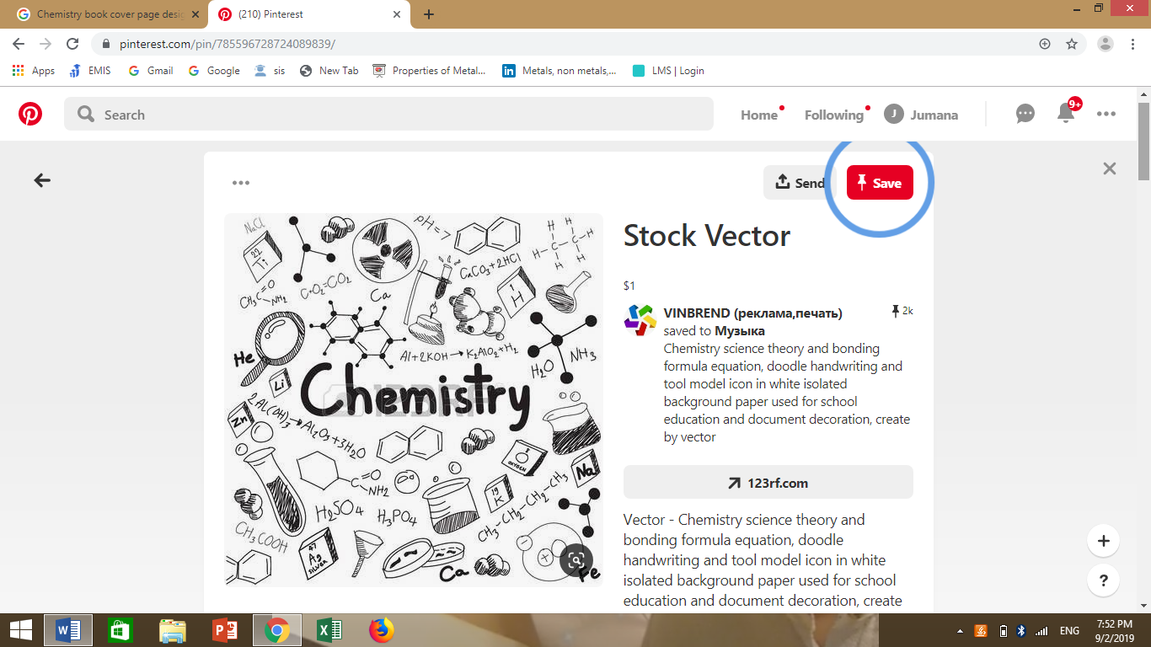
Lesson: (Acids & Bases)
Grade: 6 CS

Slide 2
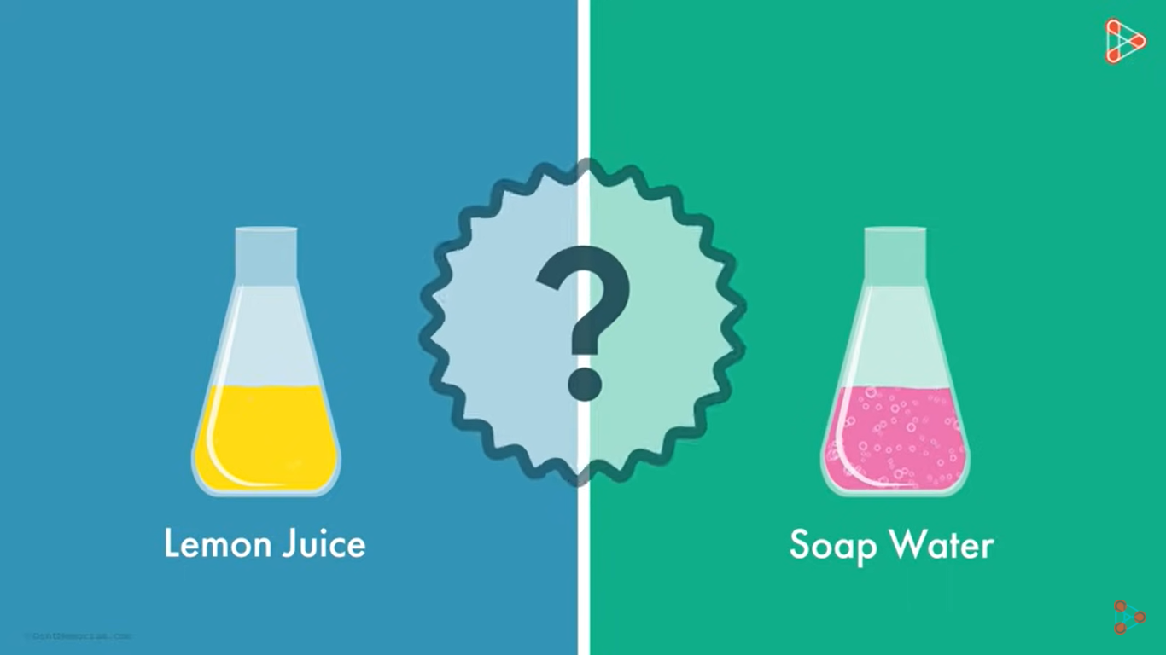
List the differences between lemon juice and soap water.
https://www.youtube.com/watch?v=i2x4foEuRcI

Slide 3
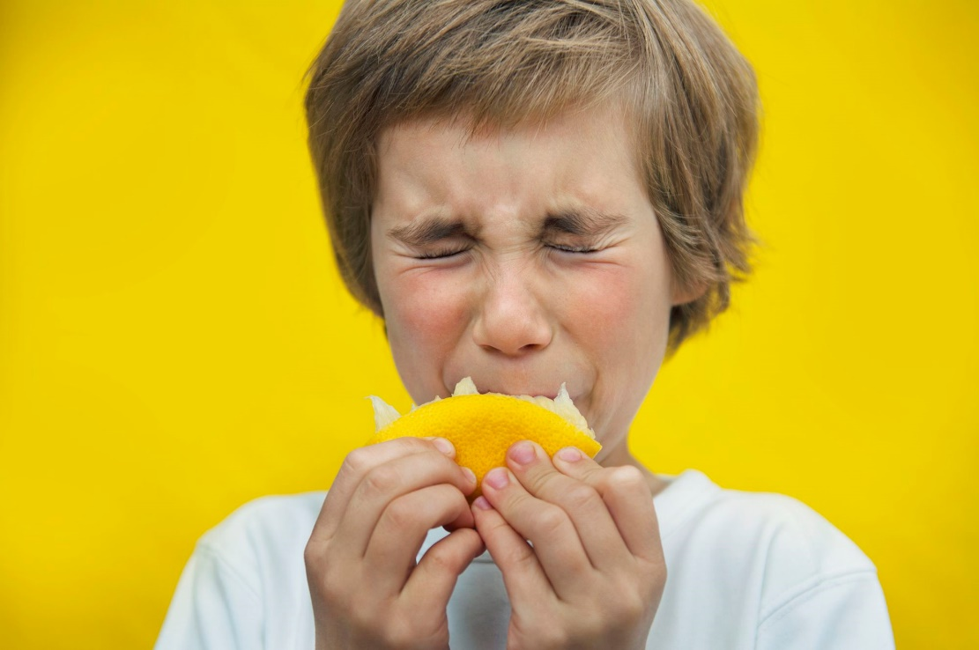
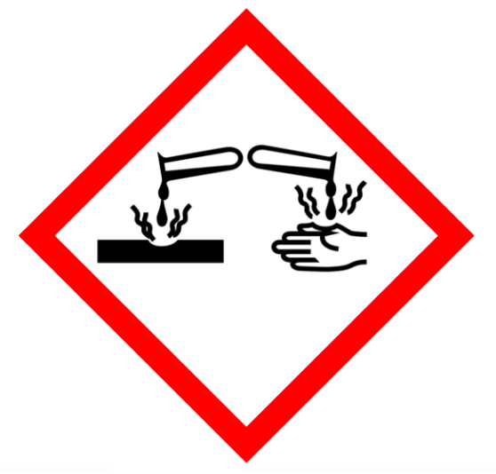
Acids
The term Acid comes from the Latin word (acidus) which means sour.
Acids taste sour.
We are familiar with some acids – citrus fruits, tomatoes and vinegar are acidic.
Acids are corrosive substances.
Danger – corrosive materials
This pictogram signals that a substance is corrosive and can harm materials and/or skin if contact happens.

Slide 4
Danger – corrosive materials
This pictogram signals that a substance is corrosive and can harm materials and/or skin if contact happens.
What safety precautions should be taken when using corrosive acid?
eye/face protection should be worn in the form of goggles or a face shield.
Gloves should be worn when handling corrosive chemicals.

Slide 5
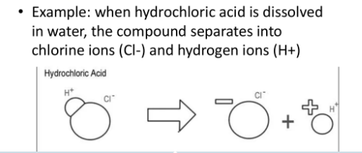
Acids
An acid is a substance that produces hydrogen ions (H⁺) when it is added to water.
If we look at the formulas of different acids, we can see that they all contain at least one H (hydrogen) – for example:
  HCl – hydrochloric acid/ H₂SO₄ – sulfuric acid/ HNO₃ – nitric acid.

Slide 6
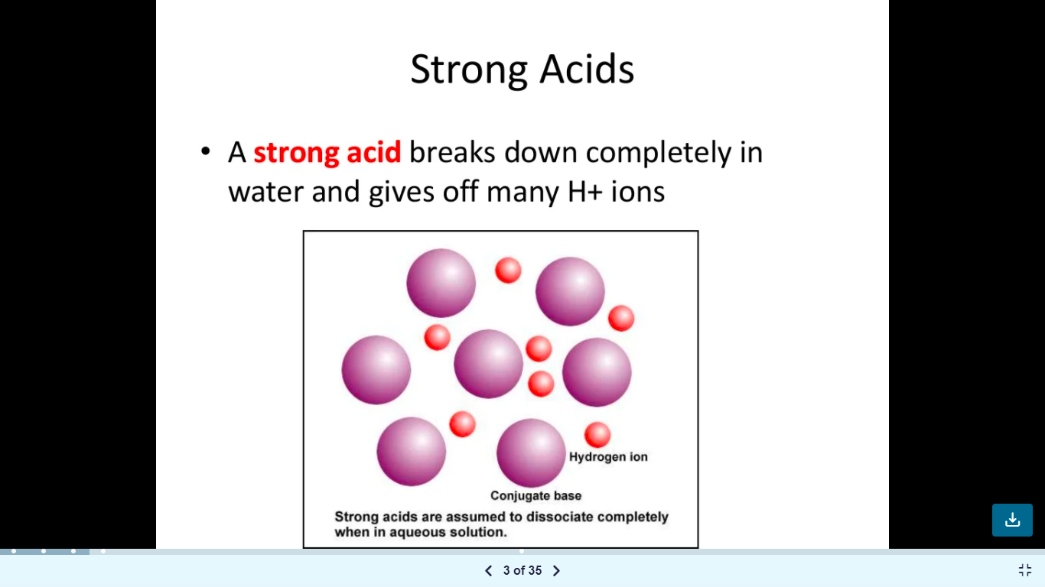
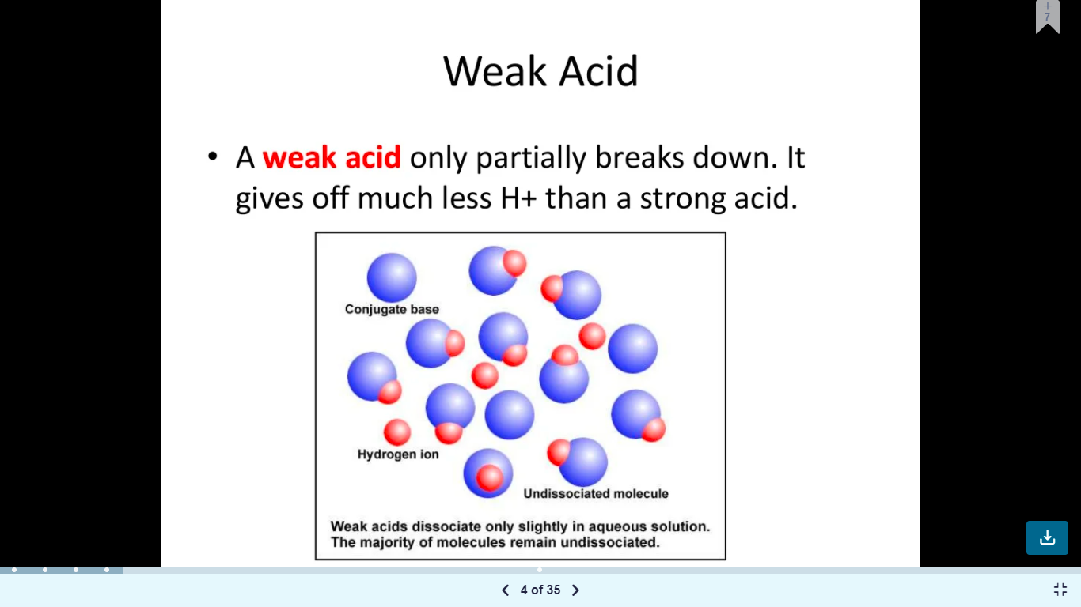

Slide 7
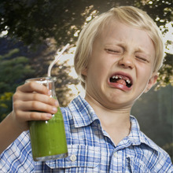
Bases
Bases are also called alkalis.
Bases feel slippery to touch.
A strong base can cause severe chemical burns. Basic substances are used in many cleaning products.
Examples: baking soda, toothpaste, bleach and household cleaners.

Slide 8
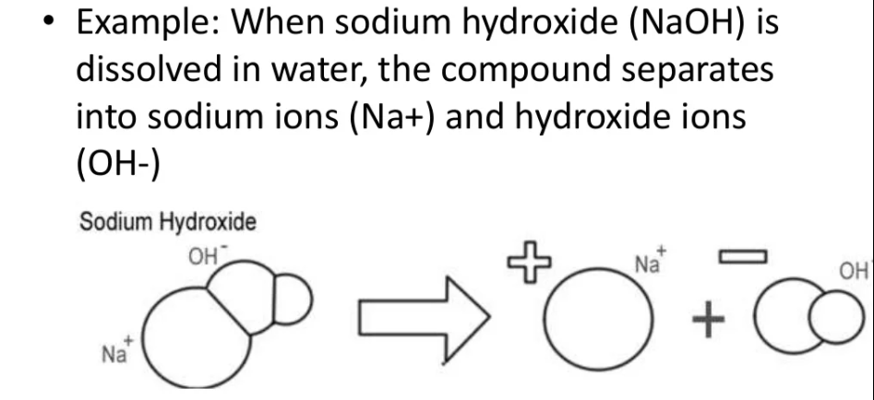
Bases
A base is a substance that releases hydroxide ions (OH⁻) when dissolved in water.
If we look at some formulas for bases, we can see that they all contain hydroxide (OH⁻) ions – for example:
  NaOH – sodium hydroxide / Ca(OH)₂ – calcium hydroxide

Slide 9
What are acids?
What are Bases?
Acids are those chemical substances which have a sour taste.
They have hydrogen in their structure
Ex: HCl ( hydrochloric acid)
H2SO4 ( sulfuric acid)
Bases are those chemical substance which have a bitter taste and feel soapy to touch.
They have hydroxide in their structure.
Ex: NaOH ( sodium hydroxide)
KOH ( potassium hydroxide)

Slide 10
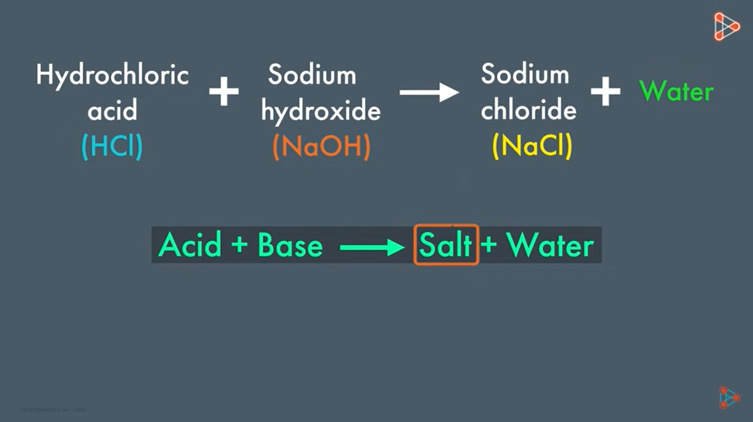
Salts
If an acid and a base are added together, they react to form water (H₂O) and a salt.

Slide 11
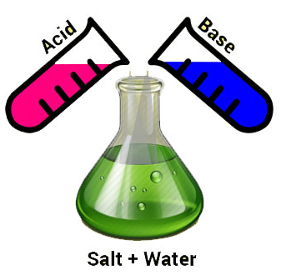
ACIDS, BASES & SALTS
On the basis of their chemical properties, all the compounds can be classified into three groups:
1. Acids
2. Bases
3. Salts
https://www.youtube.com/watch?v=V5Mq_cL9Bck

Slide 12
Group 1 | Group 2 | Group 3
BASES KOH Potassium hydroxide Ca(OH)2 calcium hydroxide | ACIDS H2SO4 sulfuric acid HNO3 nitric acid HCl hydrochloric acid | SALTS NaCl MgBr2 CaCl2 CuSO4 CaCO3

Slide 13

Learning Check
Acid, Base or Salt
CaCl₂ ______
KOH ______
Ba(OH)₂ ______
HBr ______
H₂SO₄ ______

Slide 14
Answers
Acid,Base Name
or Salt
CaCl₂ salt calcium chloride
KOH base potassium hydroxide
Ba(OH)₂ base barium hydroxide
HCl acid hydrochloric acid
H₂SO₄ acid sulfuric acid

Slide 15
Identifying and measuring acids and bases
pH stands for “Potential hydrogen” and is a measure of how many (H⁺) ions there are in a solution.
A pH meter measures how acidic or basic a solution is.
The numbers of the pH scale usually range from 0–14. This is a pH scale, and it can be used to compare substances.

Slide 16
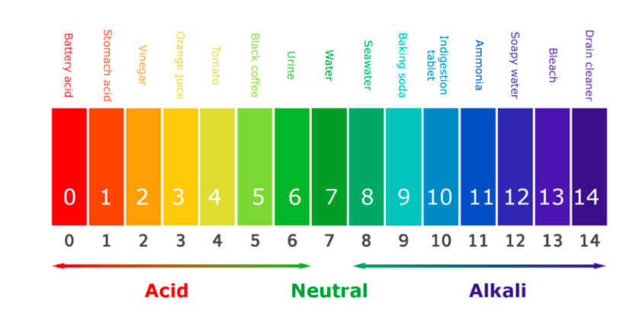
Acid-Base strength
Acids have a pH below 7. The more H⁺ ions, the more acidic it is and the lower the pH will be.
Bases have a pH above 7.
pH 7 is said to be neutral – this means there is a balance of H⁺ and OH⁻ ions.

Slide 17
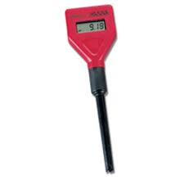
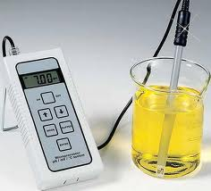
  Use an electronic pH meter is a precise way to determine pH.

Slide 18
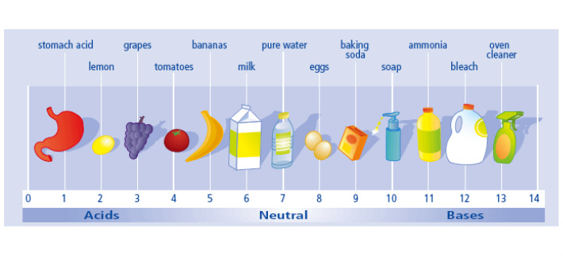
Examples of pH

Slide 19
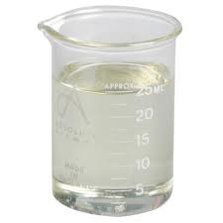
How to Classify acids and bases?
How can you tell if something is acidic or basic?
In order to determine whether a substance is an acid or base you must use an indicator.
Indicators are substances whose solutions change color due to changes in pH.
https://www.youtube.com/watch?v=ckbsHM2igT0
https://www.youtube.com/watch?v=NoZmrwf1I_w

Slide 20
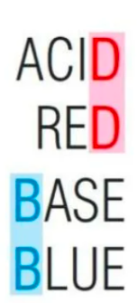
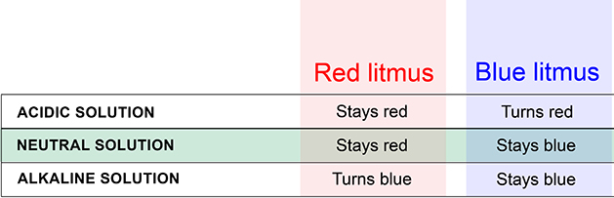
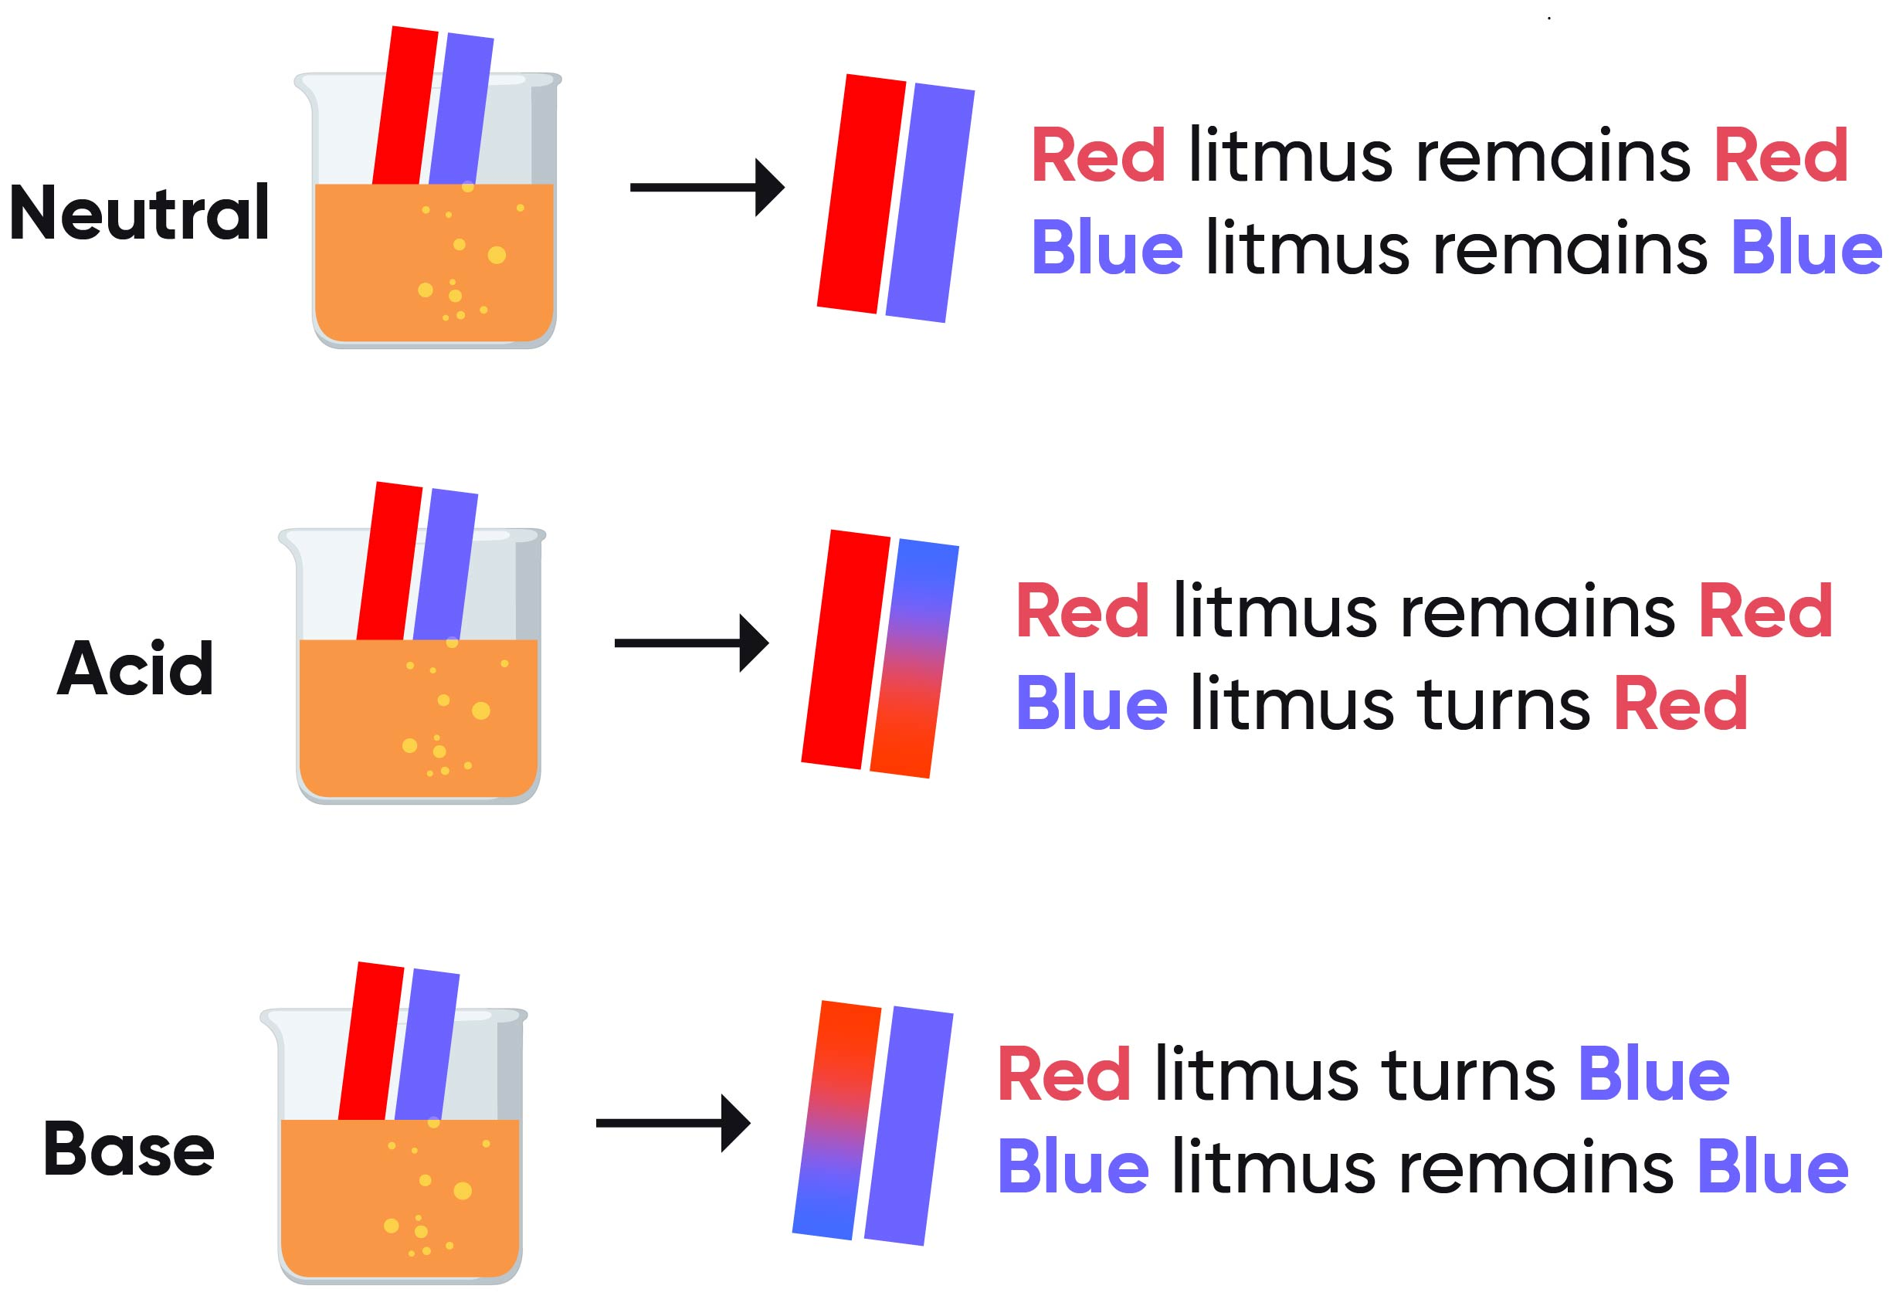
Types of indicators
Litmus paper
The word "litmus" comes from the old word for "dye" or "color.“
The litmus test is performed by placing a small drop of the sample onto the colored paper.
Usually, litmus paper is either red or blue.
Red paper turns blue when the pH is alkaline, while blue paper turns red when the pH turns acidic.
Red/ blue litmus paper doesn’t change with neutral solutions.

Slide 21
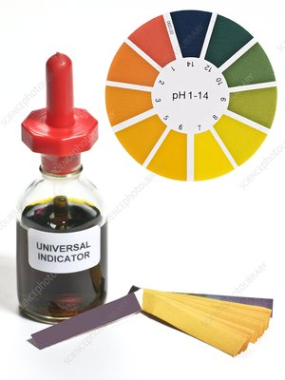
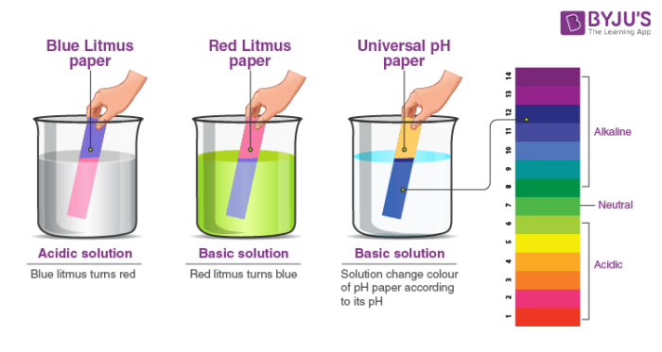
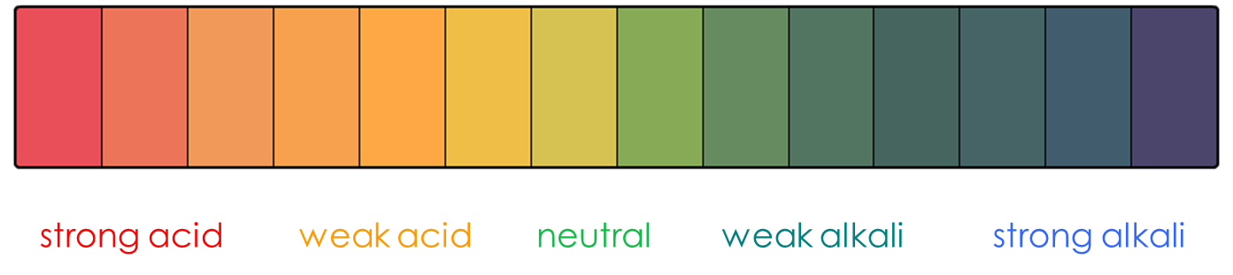
Types of indicators
https://www.youtube.com/watch?v=GRNslAaXu9k
2. Universal indicator
A Universal indicator has a range of colours that show how weak or strong the acid or alkali is.
It is made from a mixture of indicators. Each indicator changes colour over part of the range of the scale.

Slide 22
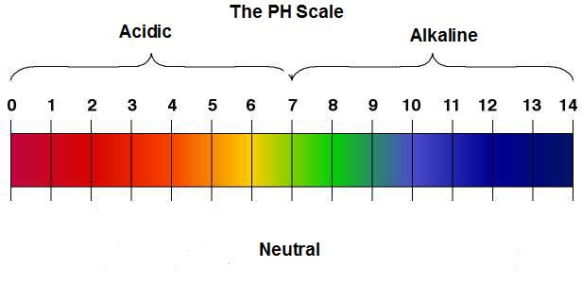
Neutralisation
When an acid and alkali are mixed together, they undergo a CHEMICAL REACTION to form a new NEUTRAL SUBSTANCE.
A strong acid will neutralise a strong alkali,
and a weak acid will neutralise a weak alkali –
THEY CANCEL EACH OTHER OUT
https://youtu.be/TS-I9KrUjB0
Add Alkali
Add Acid
Acids
Alkalis
https://www.youtube.com/watch?v=tV9T-HZ13Tc
Notes:
Talk them through the slide, get them to fill in the blanks on the worksheet provided. Pause at the end and ask if anyone has any questions/ doesn’t understand

Slide 23
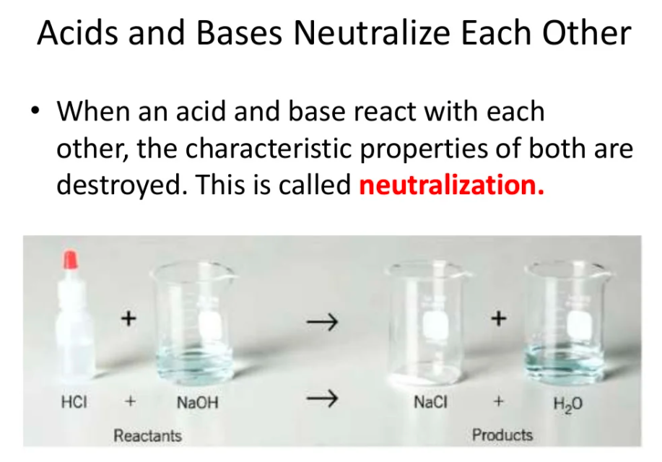
Mixing a strong acid and a strong base in solution results in a neutral solution.
https://www.youtube.com/watch?v=RmnT9jwX4gQ&t=3s

Slide 24
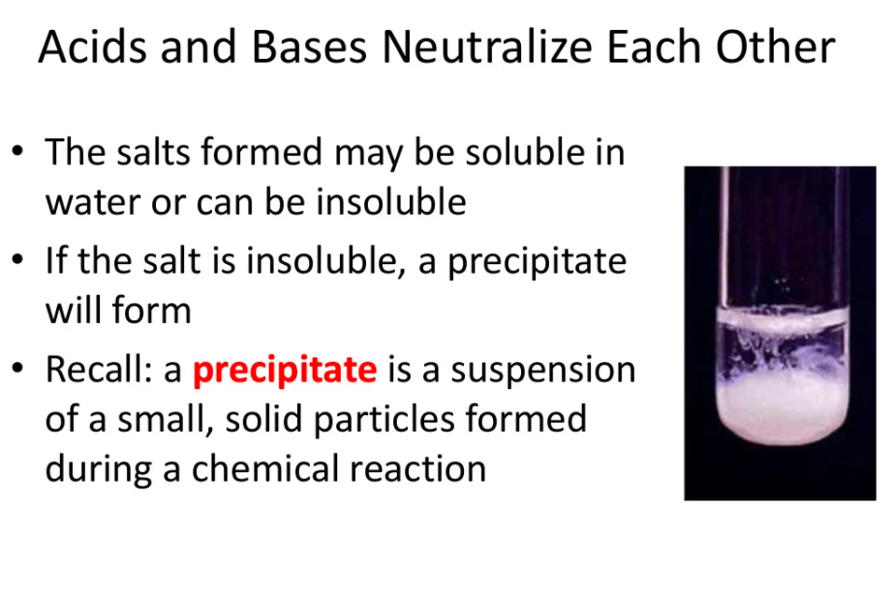

Slide 25
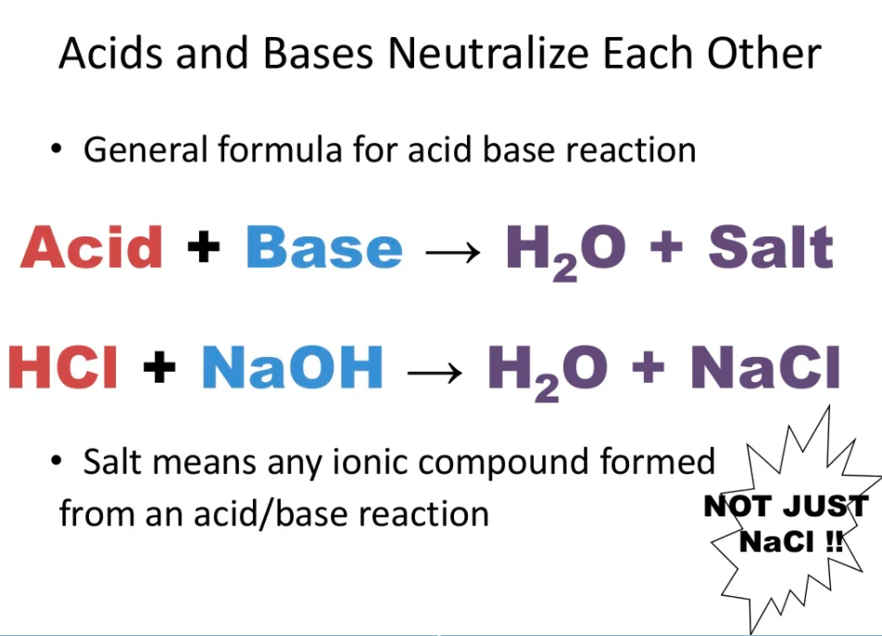

Slide 26
Question
Is neutralization reaction the same as acid-base reaction?
No. An acid-base reaction is a reaction when any acid reacts with any base, regardless of their strength. A neutralization reaction is a reaction when a strong acid reacts with an equally strong base or when a weak acid reacts with an equally weak base.
The product of neutralization reactions is a neutral salt and water solution. The products of acid-base reactions vary in acidity and basicity.

Slide 27
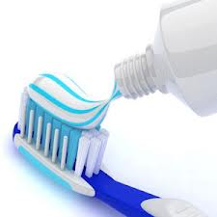
Uses of Neutralisation
Do you think toothpaste is an acid or an alkali?
Why?
During the day we eat a lot of food and drink that is acidic. This acid builds up on our teeth and could cause tooth decay. Toothpaste is an alkali as it neutralises the acid on our teeth, preventing decay.

Slide 28
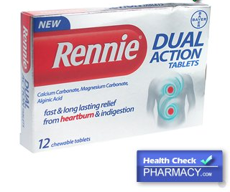
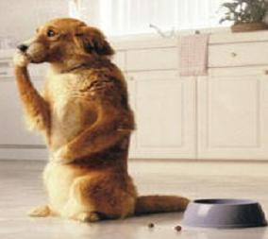
Uses of Neutralisation
When you have indigestion, it is because too much acid is being produced in your stomach.
Hydrochloric acid in the stomach is around pH 1
Lemon Juice (pH2)
Black Coffee (pH5)
Water (pH7)
Antacids (pH10)
Notes:
Why would we have acid in our stomachs?

Slide 29

Uses of Neutralisation
You have been stung by a bee! Which substance would you use to neutralise the sting and stop it from hurting?
Bee stings are around pH 3 so are acidic
Bicarbonate of soda (pH9)
Black Coffee (pH5)
Lemon Juice (pH2)
Water (pH7)
Notes:
So lets look at some of the uses of neutralisation, why is it important? How many of you have been stung by a bee? Did you put anything on it to stop it hurting? Looking at whats on the board, which of these things do you think would be the best to put on a bee sting?

Slide 30
Glossary
Acid – A chemical that has a pH less than 7.
Alkali – A chemical that has a pH greater than 7.
Indicator – A special chemical that changes into different colours in acid and alkali solutions.
Neutral – A chemical with a pH of 7 that is not an acid or an alkali.
Neutralization – The chemical reaction between an acid and an alkali.
pH scale – The range of values that shows how strong or weak an acid or alkali is.
Universal indicator – The indicator that shows the pH value of a chemical.

