Slide 1

Movie review
Hints on how to write one

Slide 2



Paragraph 1
You will need to include the following: name of the film, prominent stars of the film, basic setting ( time and place), and type of film ( comedy, adventure, drama, etc.)

Slide 3
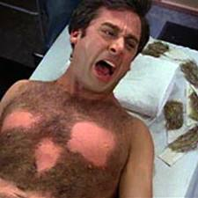
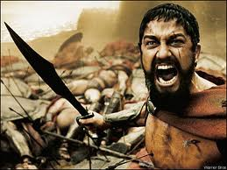

Paragraph 2
You will need to write a plot summary for the movie. Do not reveal the ending. Discuss at least 5 events and be sure to cover the entire scope of the movie, except the very end.

Slide 4

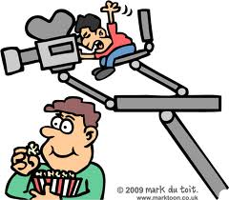
Paragraph 3
Discuss one aspect of filmmaking. You may choose from acting, direction, editing, costume design, set design, photography, background music, or anything else you may think of. Be sure that you are specific and cite examples from the movie.

Slide 5



Paragraph 5
Give your overall reaction to the film as well as your opinion on the quality of the film. also include your recommendations for potential viewers.

