Slide 1
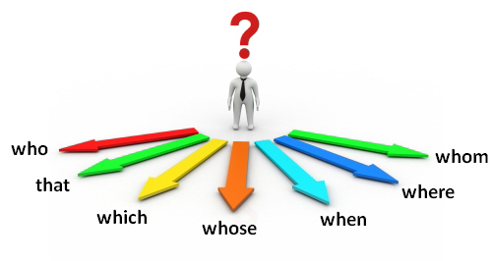
Relative Pronouns

Slide 2
The difference between Defining and Non-Defining Relative clauses https://www.youtube.com/watch?v=7AfKYUwlClo Gameshow Oxford book Explanation https://www.youtube.com/watch?v=-JLmXIcIEvQ What is a Relative Pronoun and how to use it? (who, that) this one https://www.youtube.com/watch?v=uwOPABZ9TZw Game show https://www.youtube.com/watch?v=bpYTihB4bqc

Slide 3
RELATIVE CLAUSES Revision who, that and which https://www.youtube.com/watch?v=nGNvzbM0LmM https://www.youtube.com/watch?v=ftZr1_Ny8L8 SlideShare https://www.slideshare.net/alinaemma/relative-clauses-relative-pronouns-who-which-that-when-and-where song https://www.youtube.com/watch?v=b2iW7lAEwr0

Slide 4
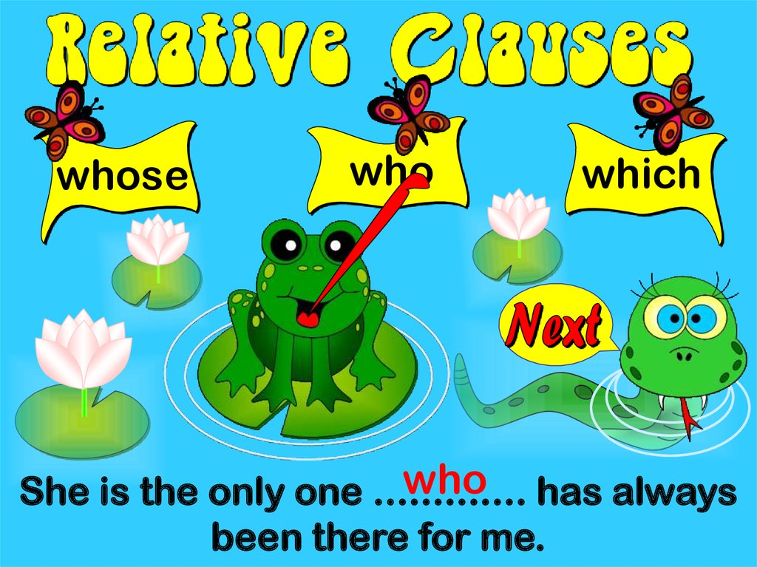
(Who, whom, which, whose, that) introduce relative clauses . Defining Relative clauses for people, give important information about the noun in the sentence. The man who lives in the flat above is an actor.

Slide 5
We use who , that to refer to people. I know a man. He is a lawyer. I know a man who/ that is a lawyer.

Slide 6
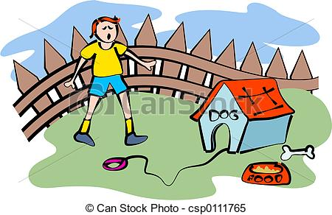
We use which , that to refer to objects or animals. The dog is mine. It ran away. The dog which/ that ran away is mine.

Slide 7
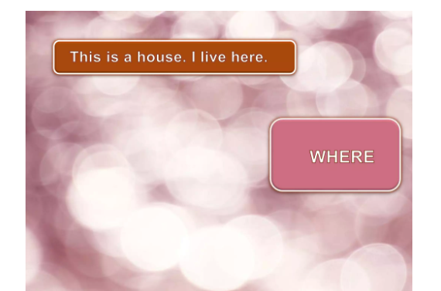
Where

Slide 11
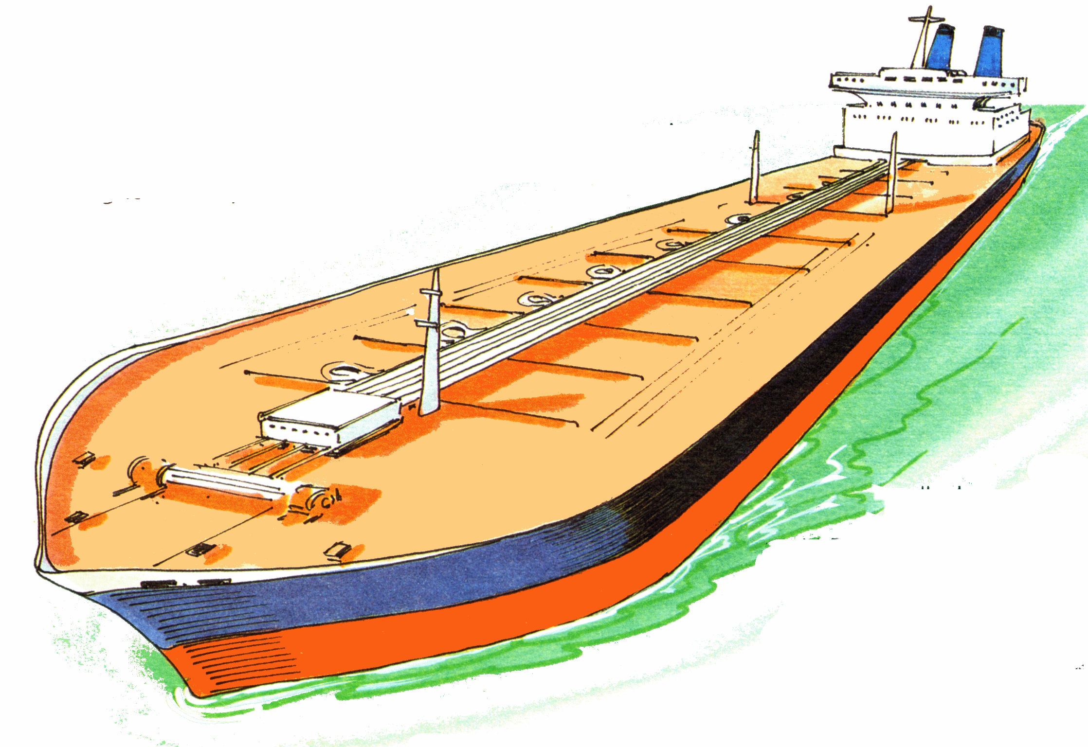
We usually avoid using prepositions before relative pronouns. She is a woman in who teaches me math.X

Slide 12
A relative pronoun is not used with another pronoun( I, you, me, him, etc.) I know a girl who works in a library. (NOT) I know a girl who she works in a library. X

Slide 14
Picasso was an artist. He collected masks. ……………………………………………………………..

Slide 15
Here’s the man. He directed the play. ……………………………………………………………………..

Slide 16
Sara is a student. She went to my school. …………………………………………………………………….

Slide 17
Mr. Sami is a man. He bought my car. ………………………………………………………………..

Slide 18
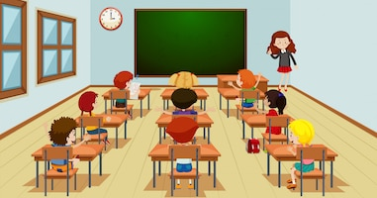
That’s the girl. She joined our class this year. ……………………………………………………………………

Slide 19
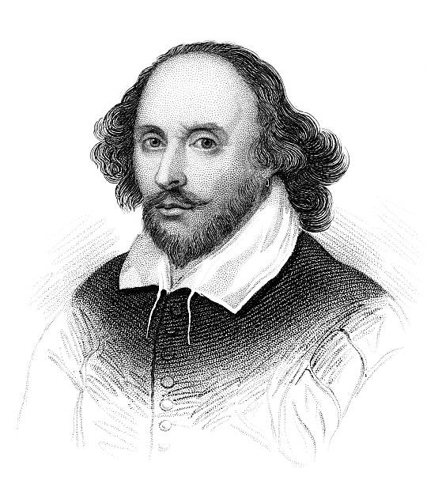
Shakespeare is a playwright. He wrote Hamlet. ……………………………………………………………………….

Slide 20
