Slide 1
Word Study Page 77 Ex.

Slide 2
Trans, prefix https://www.youtube.com/watch?v=hf7ESlEJBVU Prefix Inter https://www.youtube.com/watch?v=19XlF7XCzFA

Slide 3
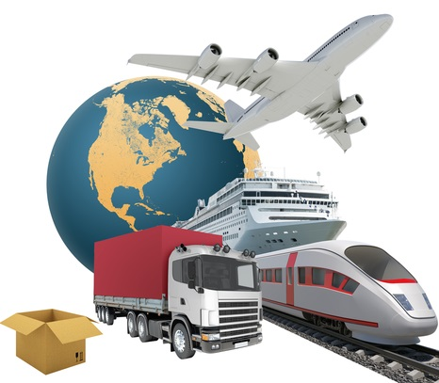

Slide 4
Transport Verb: to move someone or something from one place to another in a vehicle

Slide 6
Translation Noun: a text that has been changed from one language into another.

Slide 7
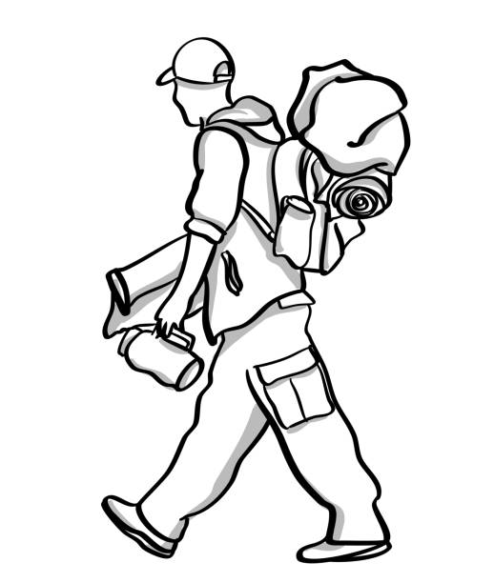

Slide 8
Transient Adj: continuing for only a short time.

Slide 9
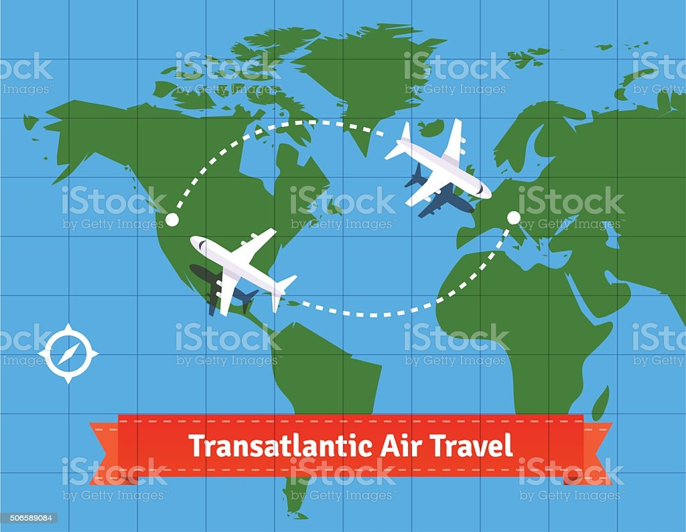

Slide 10
Transatlantic Adj: to or from the other side of the Atlantic Ocean; across the Atlantic Ocean

Slide 11
translational symmetry

Slide 12
translational symmetry moving and repeating identical objects in an identical way

Slide 13
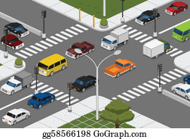

Slide 14
Intersection noun: The place where two or more roads , lines etc. meet and cross each other.

Slide 16
Intermission Noun: a break during a play.

Slide 17
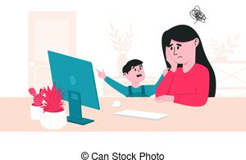

Slide 18
Interfere Verb: Slow down the progress that someone or sth makes

Slide 19
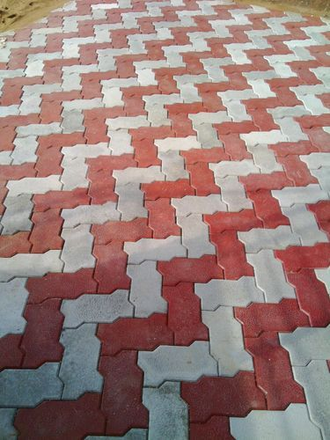

Slide 20
Interlocking Adj: fitting firmly together.

