Slide 1

Vocabulary
Page 98
Ex. A

Slide 2

Advertisement : it gives information about something for sale.
( the other two ( headline and title) are written above an article to show what it is about.

Slide 3
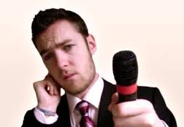
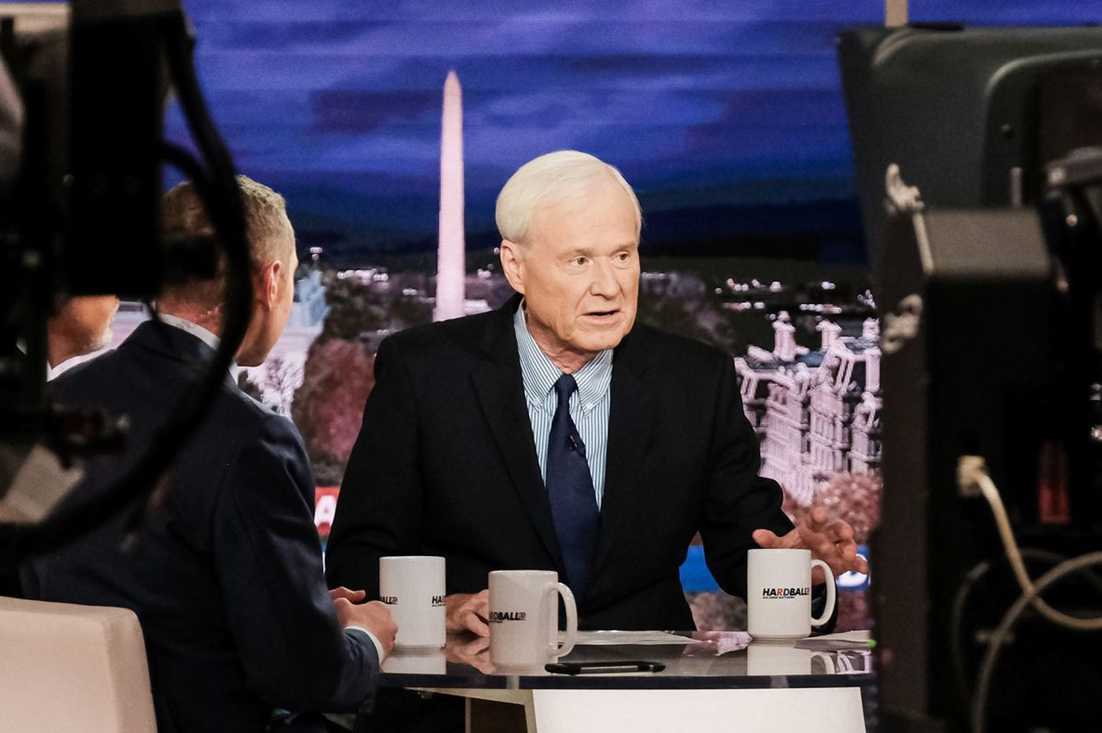
Reporter: gives information about what is happening in the world and interviews people on TV or radio.
The other two ( host and presenter) present programmes on TV and are usually the key person on the programme.

Slide 4

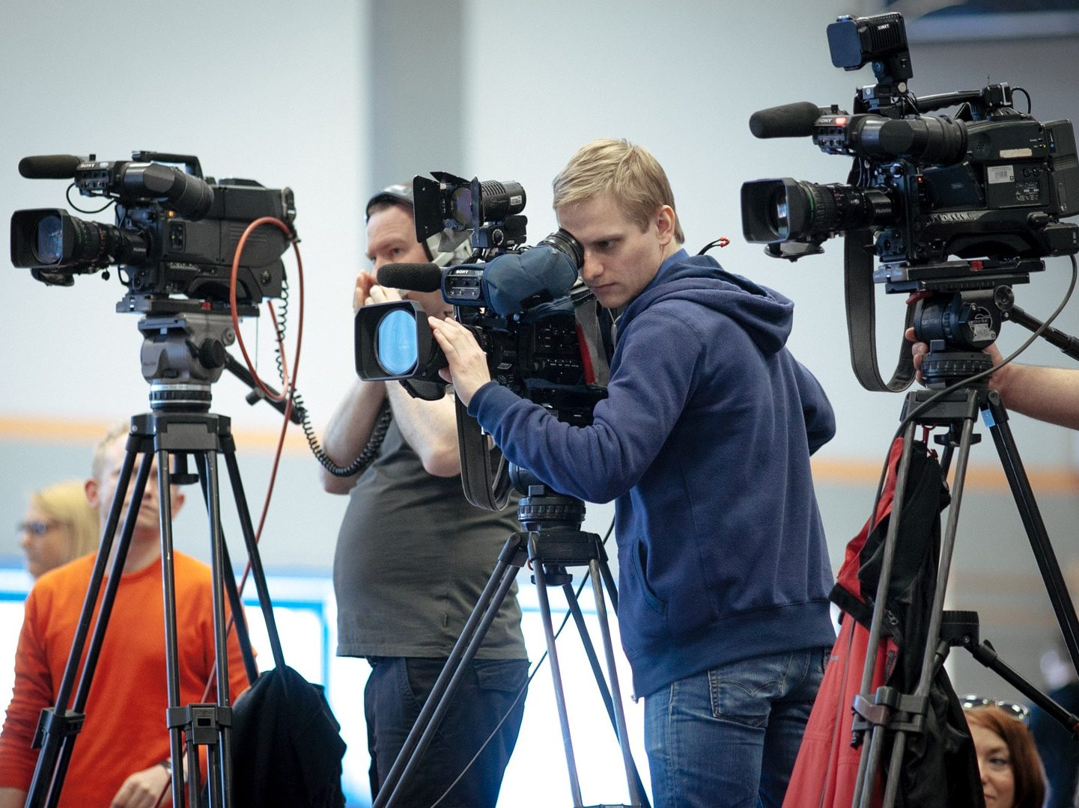
Critic: writes reviews of films, books, etc., in the newspaper or magazine.
The other two ( cameraman and sound engineer) are people who work behind the scenes in a TV or radio station

Slide 5
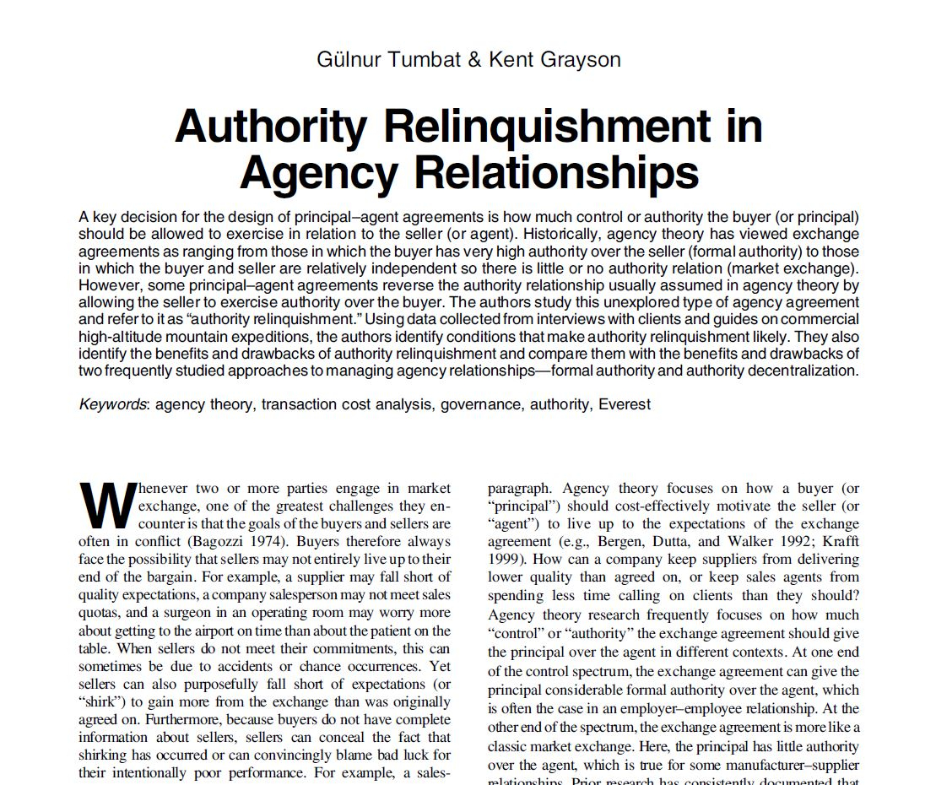
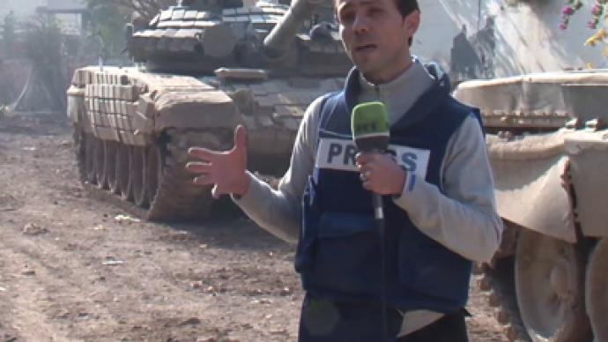
Correspondent: is a person who reports on a specific type of news, sport.
The other two( report and article) are written or spoken information in the media.

Slide 6


Episode: is one programme which is part of a longer series.
The other two ( documentary and drama series) are types of TV programmes.

