Slide 2
I can't wait till they bring out the new model.

Slide 4
Have you picked out a dress for the party?

Slide 5
To choose

Slide 6
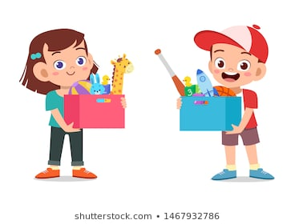
I’ve already asked them to pick their toys up.

Slide 7
To collect

Slide 8
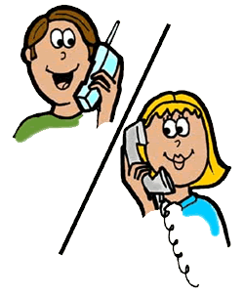
"He's not here. Can I take a message?" "No, that's OK. I'll ring back later

Slide 9
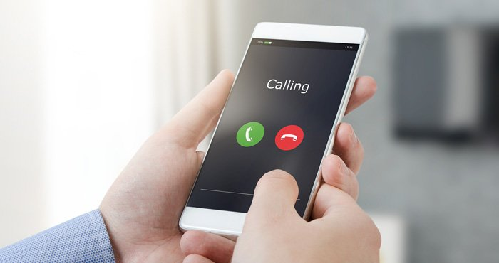
To return a call phone

Slide 10
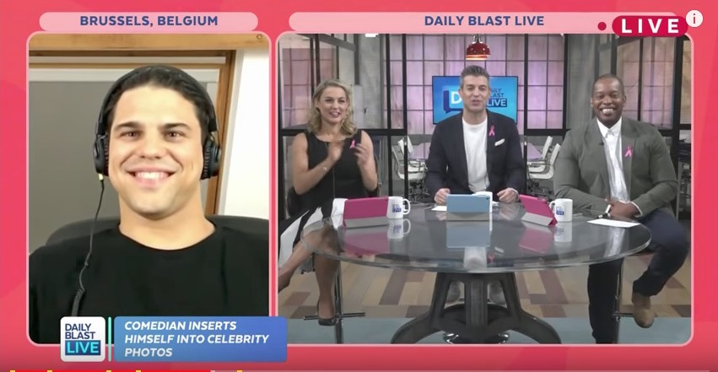
Hundreds of people rang in to complain about his remarks.

Slide 11
To phone a TV or radio station

Slide 12
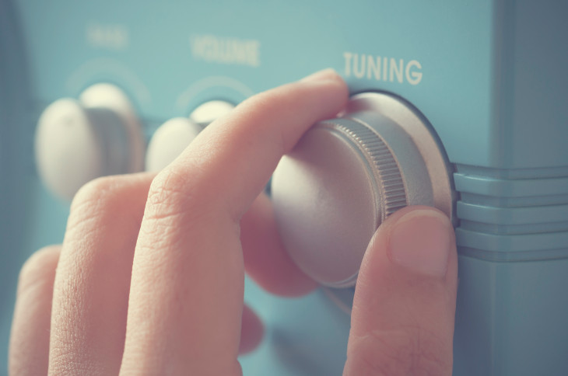
Be sure to tune in to next week's show.

Slide 13
To choose a particular radio station.

Slide 14
Maria always tunes out in the middle of her music lesson.

Slide 15
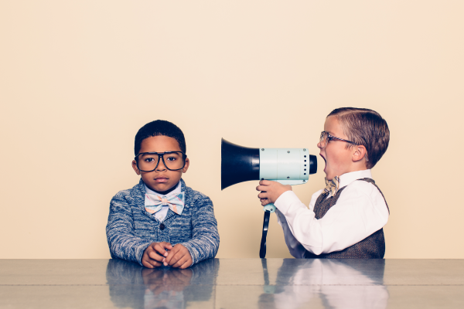
To stop being attention to something

Slide 16
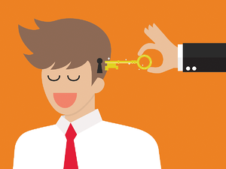
Sam was sure he could bring them round to the deal.

Slide 17
To convince someone your opinion is correct.

