Slide 1
Chapter 12
Lesson: (Temperature and rate of reaction)
Scholastic Year: 2022-2023
Grade: 8CS

Slide 2
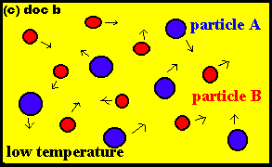
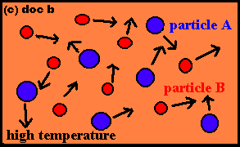
The greater the temperature of the reactants, the greater the average kinetic energy of the particles.
Therefore, the more chance of a successful collisions between the particles.
The frequency of collision increases too.
As the temperature increases, the particles gain energy and move faster. The faster the particles move, the more likely they are to collide with each other.

Slide 3
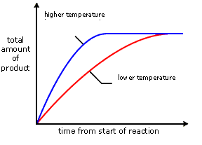
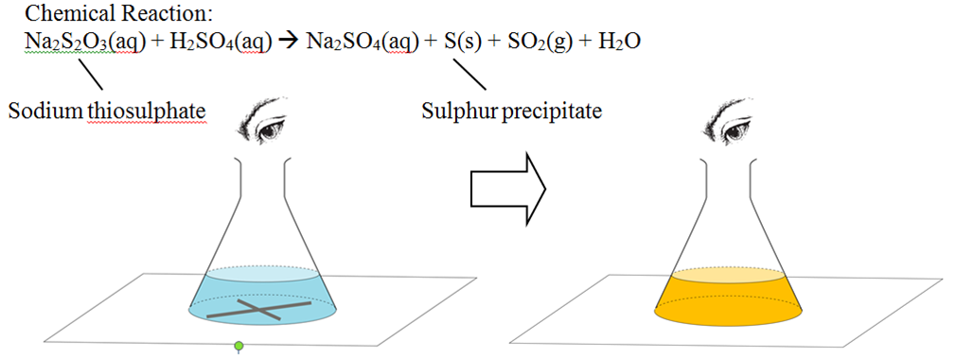
The graph shows the differences in the rate of reaction at different temperatures.
The steeper the line, the greater the rate of reaction. Reactions are usually fastest at the beginning, when the amount of reactants is greatest. When the line becomes horizontal, the reaction has stopped.
The graph shows that at higher temperature it will take less time for the product to be produced (The production of sulfur that causes the X to disappear).

