Slide 2



What Is Narrative Writing?
Narrative writing is generally thought of as story writing. The main purpose of a narrative is to entertain the reader, viewer or listener.
Sometimes, narratives can also be
used to inform the audience or to
teach a moral or a lesson.

Slide 3
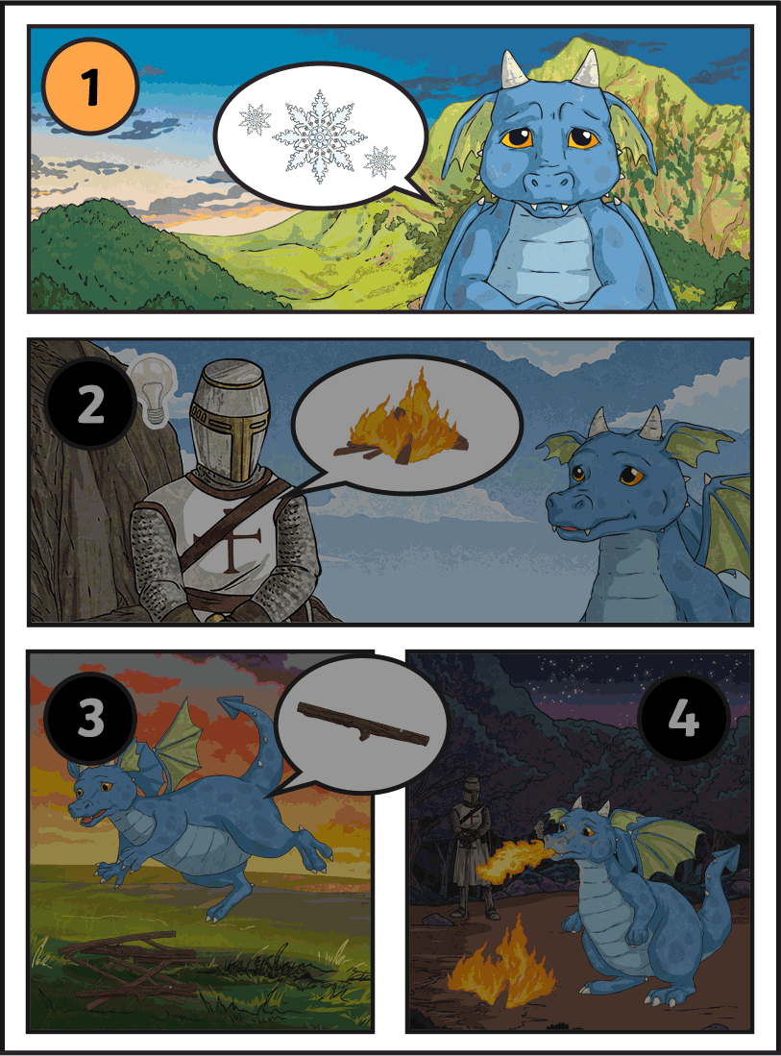
What Is Narrative Writing?
Usually, narratives will follow a very specific structure which includes an opening, a build-up, a dilemma, a resolution and a closing.
They will often be written chronologically but they can
be set at any point in the past, present or future.
chronologically: In a way
that follows the order in
which events occurred.

Slide 4
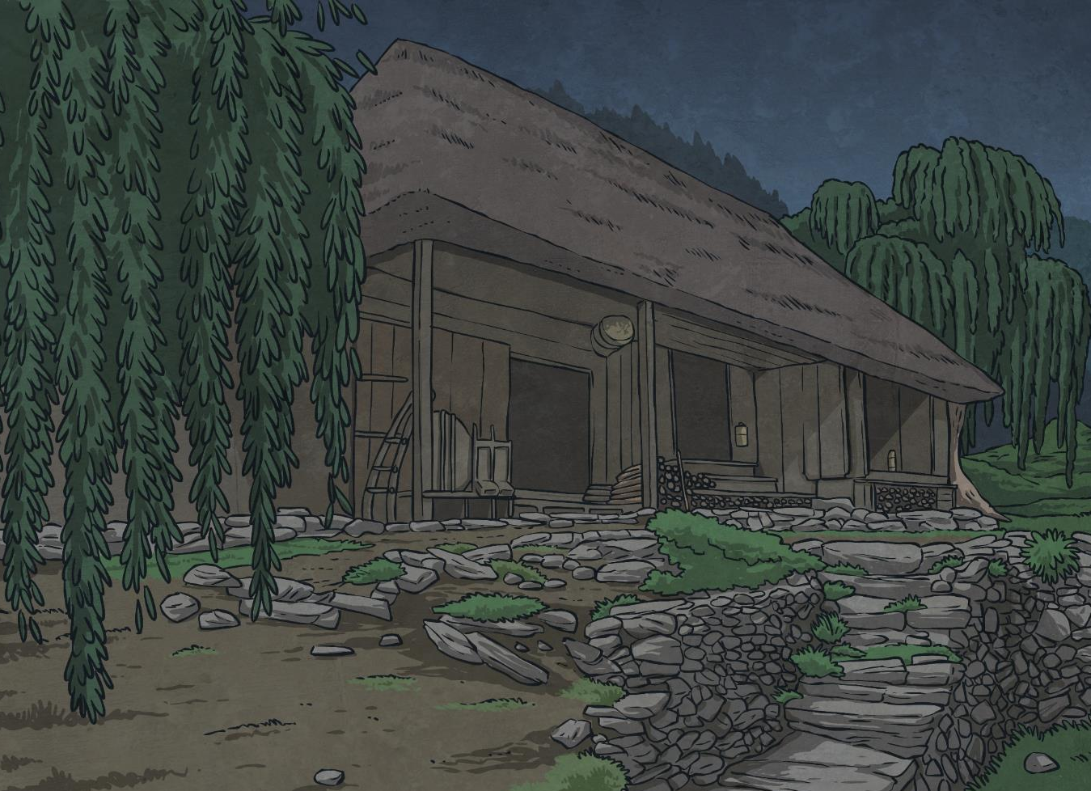
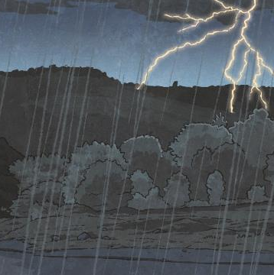
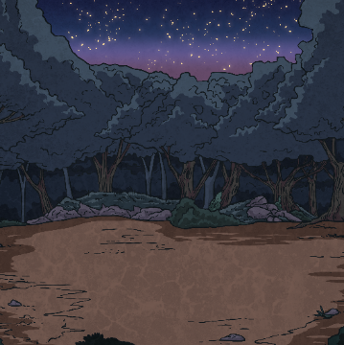
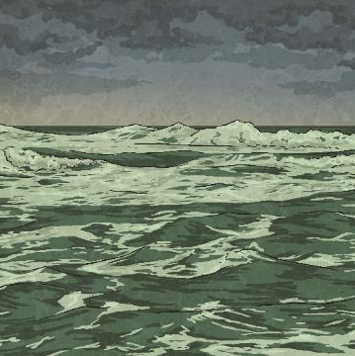

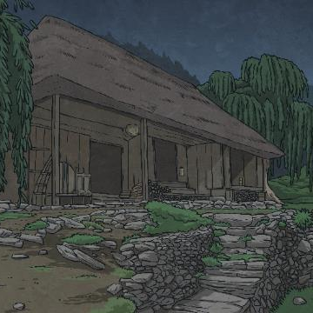








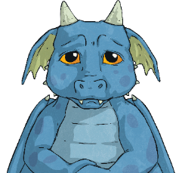

Features of a Narrative Text
A narrative text usually…
?
Contains lots of description to allow the reader or listener to imagine things vividly and accurately.
Includes a resolution to the dilemma.
Involves a dilemma where a problem arises that cannot be avoided.
tells a story in chronological order
Begins with an opening that introduces the characters and the setting.
Has a build-up which hints towards an upcoming problem.
Closes with an ending which may sometimes be a cliffhanger.

Slide 5
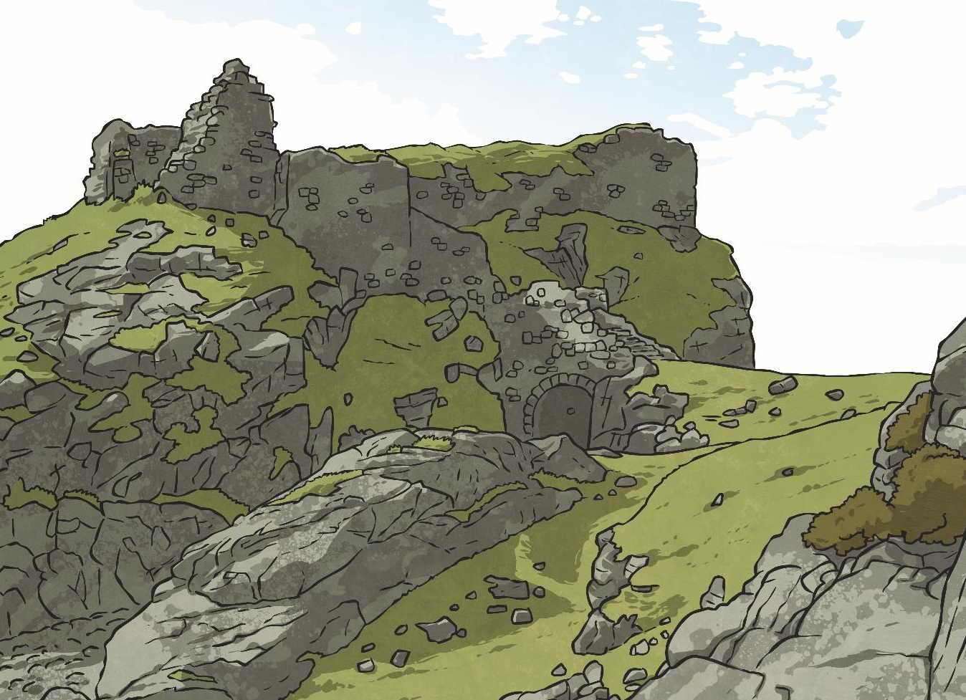

Amazing Openings
There are many ways to do this but you may want to try:
All narratives must have an opening (beginning).
The purpose of an opening is to ‘hook’ the audience and to make them want to carry on reading, watching or listening to the story.
action, such as opening the story in the middle of an ongoing battle;
dialogue, such as opening the story with a conversation between characters;
character description, which gives the reader someone to connect with;
setting description, which gives the reader something to imagine.

Slide 6
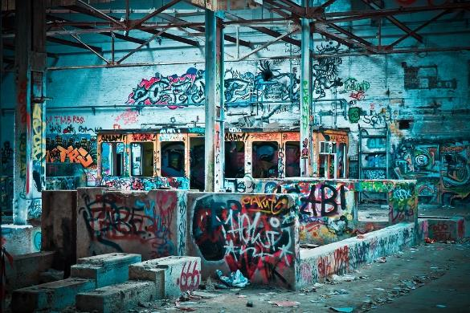
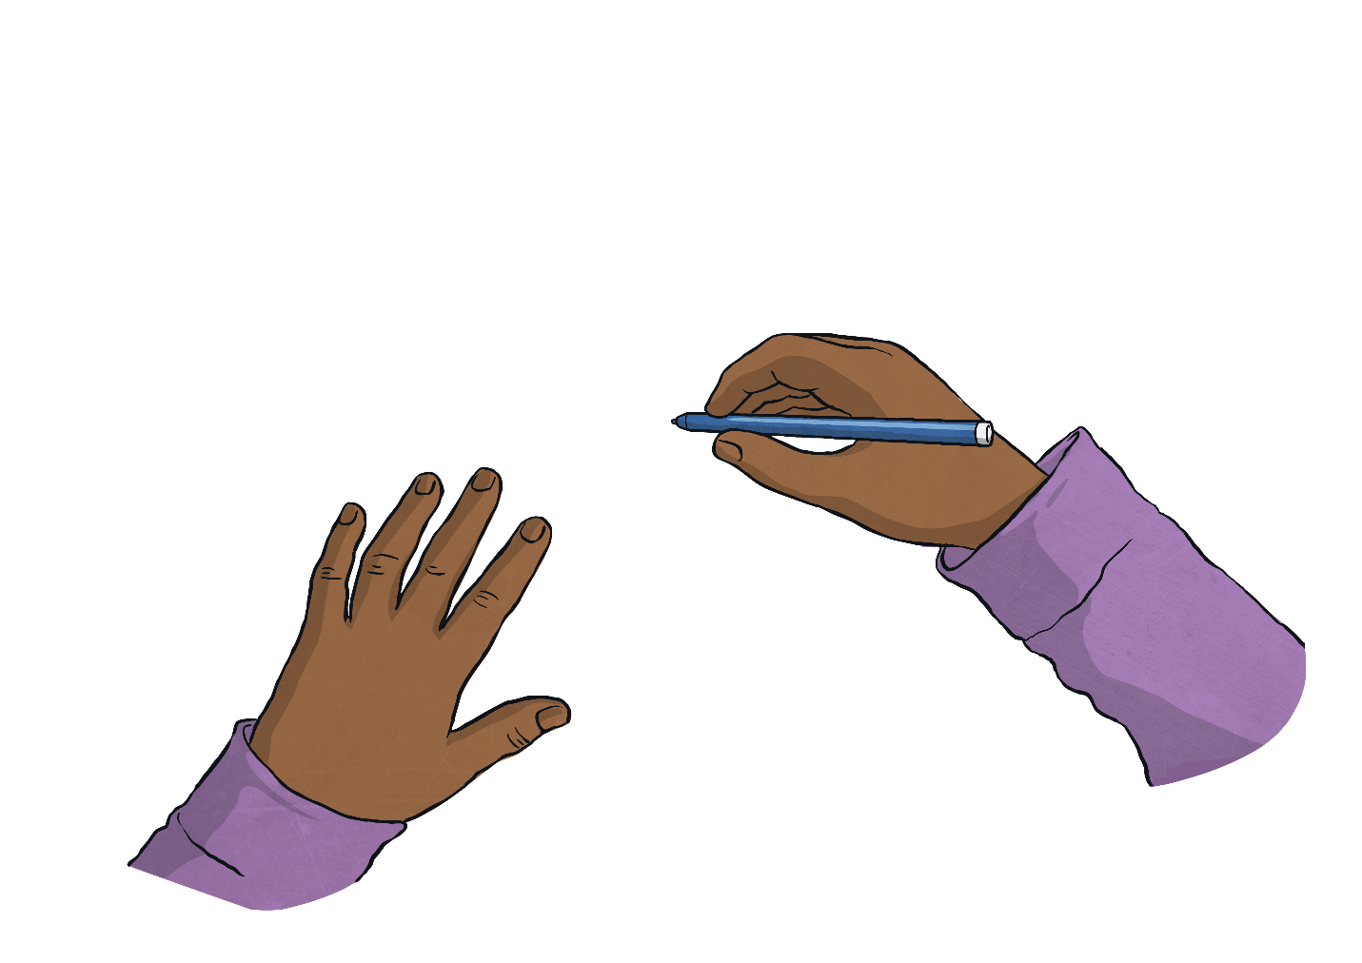

Brilliant Beginnings
Imagine that this is the setting for the narrative that you are about to create.
?
How are you going to open this story?
?
How will you hook your audience right from the beginning?

Slide 7


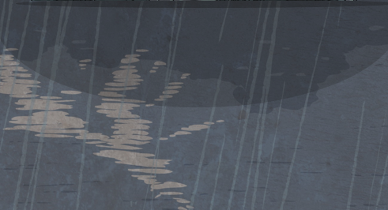
Identify the Dilemma
In almost every story you read, there will be a dilemma (problem).
Think of five stories that you have read or films that you have seen. What were the dilemmas in each
of them?
Why do you think that narratives need a dilemma?
What would happen if everything just went well?

Slide 8

Picture the Problem
How many different dilemmas could there be in your narrative based on just this picture?
?
Try to think outside of the box and really look at all of the small details of the picture to find a problem that the audience won’t be able to see coming.

Slide 9
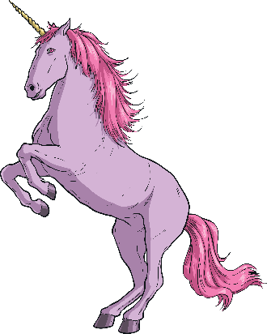

Realistic Resolutions
When trying to resolve the dilemma in a narrative, it is crucial that the resolution is believable and possible.
?
?
?
Imagine that your main character has been chased by a hungry dragon and has been cornered.
In what logical or possible way could this dilemma be resolved?
?
?
What sort of resolution would be absurd,
illogical or impossible and could disappoint your audience?

Slide 10
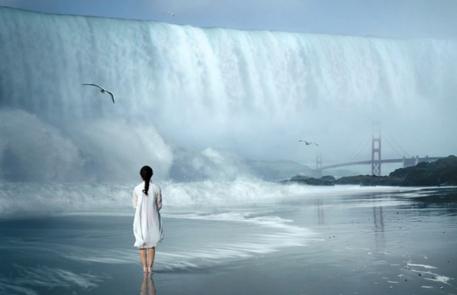
Believable Not Boring
The dilemma here is that the girl is stuck on the beach and an enormous, powerful wave is coming towards her.
How could this situation
be resolved?
?
Remember: You can’t introduce a new character or prop at this point without their being a logical explanation for them being there.

