Slide 1
Daily message
Today we are going to learn a new sound.

Slide 2
ai
.

Slide 3
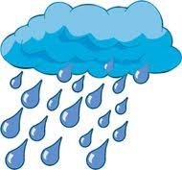
rain
. . .

Slide 4
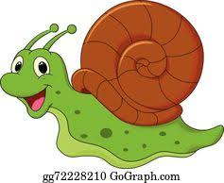
snail
. . . .

Slide 5
tail
. . .

Slide 6
nail
. . .

Slide 7
train
. . . .

Slide 8
sail
. . .

Slide 9
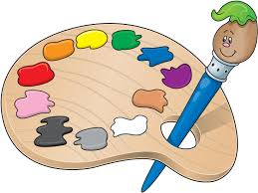
paint
. . . .

Slide 10
aid
. .

Slide 11
aim
. .

Slide 12
sail
. . .

Slide 13
train
. . . .

Slide 14
nail
. . .

Slide 15
rain
. . .

Slide 17
brain
. . . .

Slide 18
paint
. . . .

Slide 19
pain
. . .

Slide 20
maid
. . .

Slide 21
plain
. . . .

Slide 22
paid
. . .

Slide 23
strain
.. . . .

Slide 24
grain
. . . .

