Slide 1
Prepositions
Student Book page 68+ Workbook page 33

Slide 2
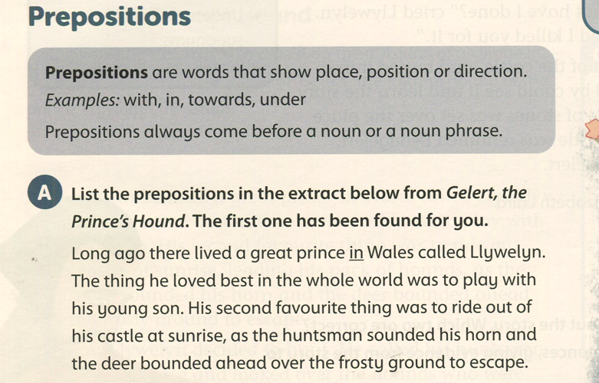
Student Book page 68

Slide 3
Student Book page 68

Slide 4
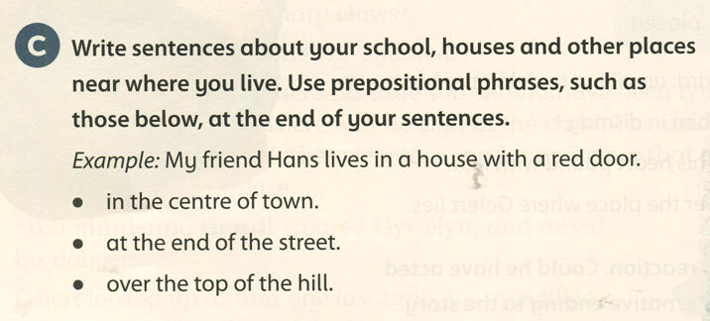
Student Book page 68
There are many shops in the centre of town.
There is a haunted house at the end of the street..
The helicopter flew over the top of the hill.

Slide 5
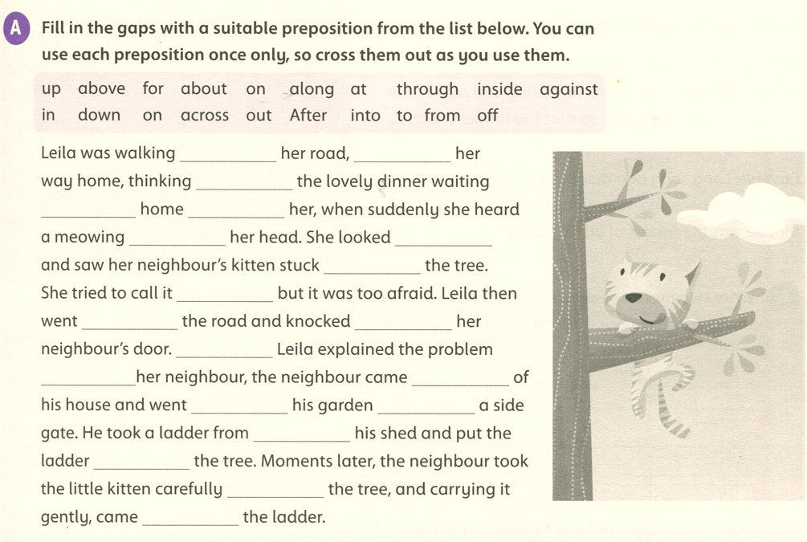
Workbook page 33
along
on
about
at
for
above
up
in
down
across
on
After
to
out
into
through
inside
against
from
off

Slide 6
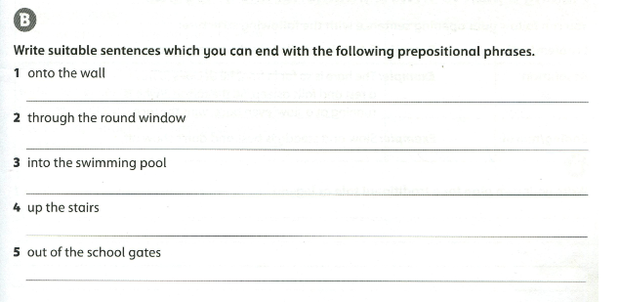
Workbook page 33
The cat jumped onto the wall.
He had a lovely view of the hills through the round window.
You have to pay to go into the swimming pool.
All the smoke went up the stairs.
The children came rushing out of the school gates.

