Slide 1
BE A
Prepositions
SUPERHERO!

Slide 2
https://youtu.be/Fbcimg1r1Ms
https://youtu.be/_XmYzXi3Gxs
https://youtu.be/0aN-HPnlbm8
https://youtu.be/4530pfmquro

Slide 3
https://create.kahoot.it/details/e85ed0e3-dda3-41ab-a20d-d5e90256e485
https://create.kahoot.it/details/5eb474f0-a124-46a8-8a07-036a62abc55f
https://create.kahoot.it/details/9f1d1d10-35b0-4b68-88f6-71c76ba10c0e
https://create.kahoot.it/details/3f9d8e9e-ecf4-41a2-b859-19431c9fcfb0
https://create.kahoot.it/details/2324d4ed-4d6a-4b7b-adcc-a5bbdbc82da7
https://www.liveworksheets.com/worksheets/en/English_as_a_Second_Language_(ESL)/Prepositions_of_place/Prepositions_of_place_(b,_A,_B)_if143587tv
iveworksheets.com/worksheets/en/English_as_a_Second_Language_(ESL)/Prepositions_of_place/preposition-_house_ot54297zn
https://www.liveworksheets.com/worksheets/en/English_as_a_Second_Language_(ESL)/Prepositions_of_time/Prepositions_in,_on,_at_(A,_B,_C)_sa210948nj
https://www.liveworksheets.com/worksheets/en/English_as_a_Second_Language_(ESL)/Prepositions_of_time/Prepositions_of_Time_pc22063zt

Slide 4
What are prepositions?
Do you remember which parts of speech have we covered so far?
Verbs nouns adjectives
Adverbs pronouns conjunctions

Slide 5
Prepositions
A preposition is a word that indicates place or direction.
Examples: across, into, between, above, beyond, towards, behind, over.
Prepositions describe the relationship between the subject of a sentence and another object.
For example: The apple was under the table.
The glider flew through the air.
The boy walked towards the school.
Which of the following words are prepositions?
in
to
house
location
travel
walk
inside
tomorrow
visit
mountain
beside
below
journey
around
off
during

Slide 6
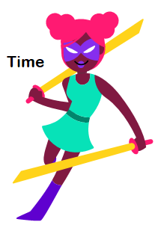
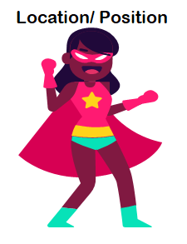
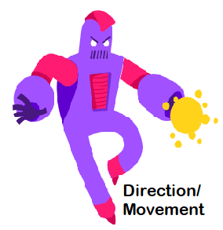
Prepositions
Are classified into 3 groups….

Slide 7
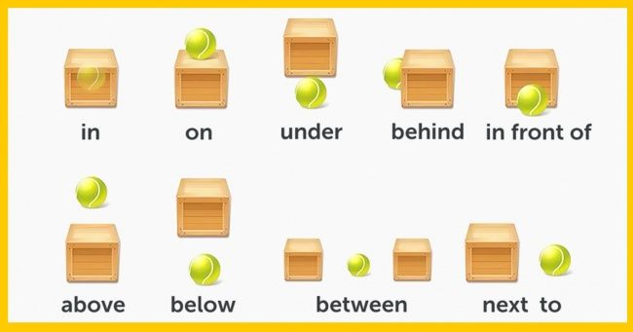
Location

Slide 8
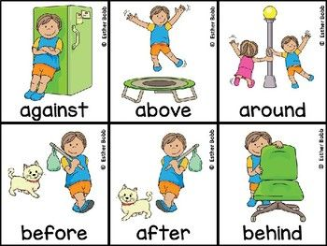
Note that ‘against’ means next to and touching an upright surface for support.
e.g.
The boy is leaning against the fridge.

Slide 9
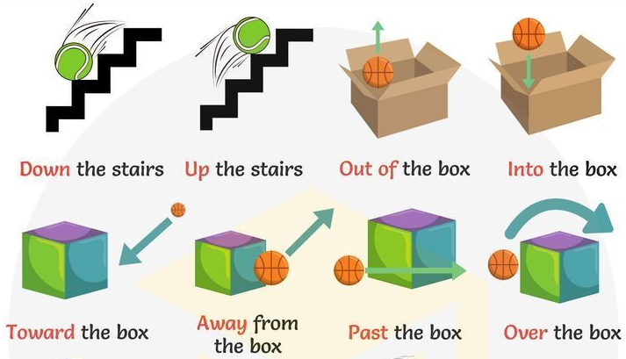
Many prepositions are generally used for movement and direction….

Slide 10
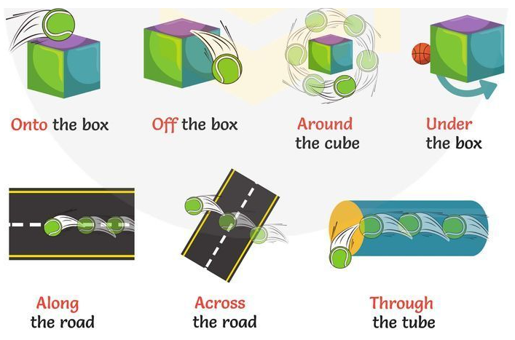

Slide 11
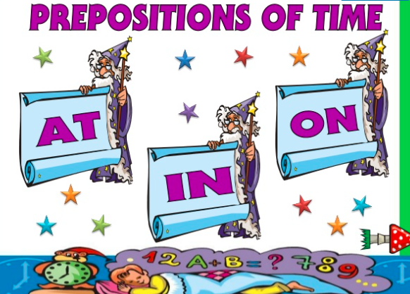

Slide 12
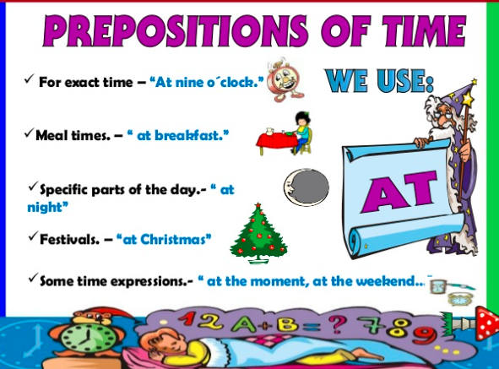

Slide 13
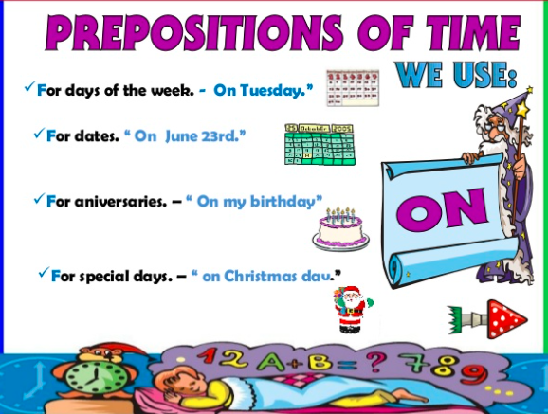

Slide 14
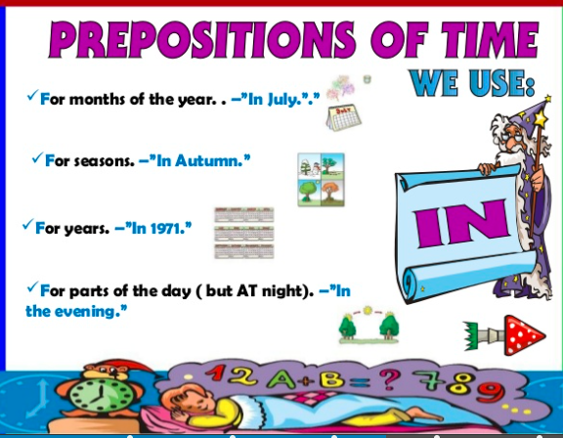

Slide 15
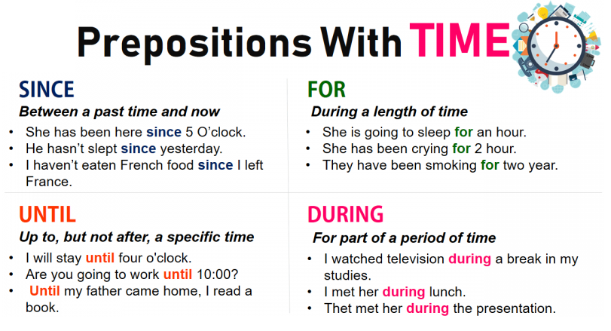

Slide 16

How about you test your skills?
Check the attached game…
‘Who wants to be a millionaire’

