Slide 1
Circuits (Lesson A)

Slide 2
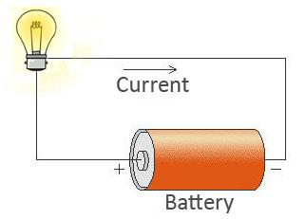
What is an electrical circuit?
Electrical circuit is a closed path in which an electric current can flow.
An electrical circuit consists of simple basic components:
Batteries.
Wires
Bulb /motor /buzzer.
Switches (optional)

Slide 3
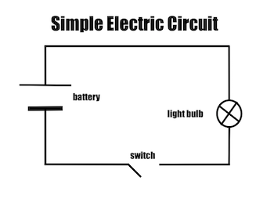
What is a circuit diagram?
A circuit diagram uses symbols to show how the components in a circuit are connected to one another.
It is a model that can help us understand the path of electricity in a circuit.

