Slide 1
Full and empty

Slide 2

1
2

Slide 3

1 2

Slide 4
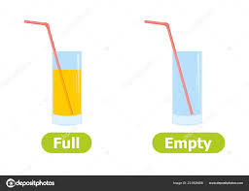
1 2

Slide 5

1 2

Slide 6
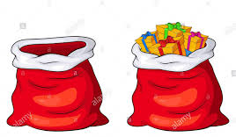
1 2

Slide 7
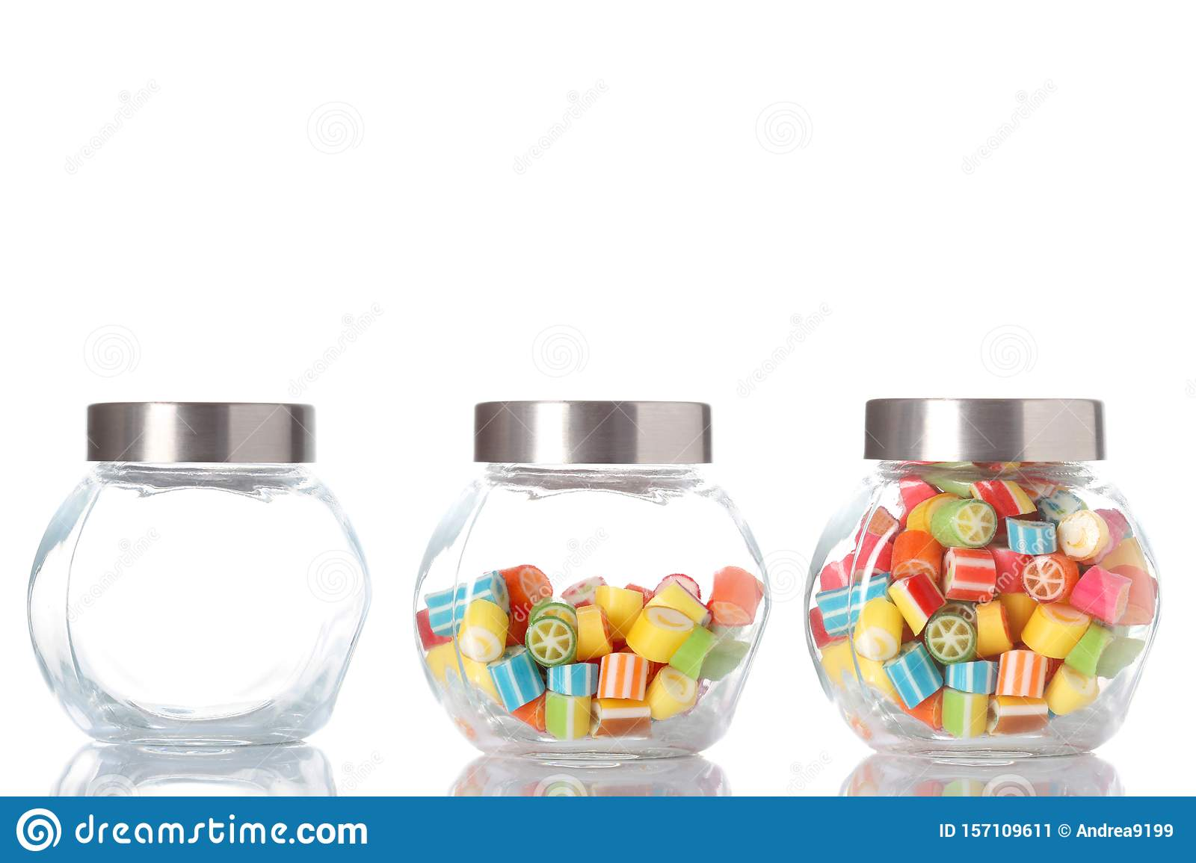
1 2

Slide 8


1 2

Slide 9
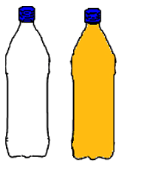
1 2

Slide 10
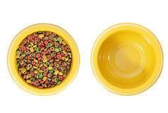
1 2

