Slide 1

Vocabulary Ex. B page 98

Slide 2
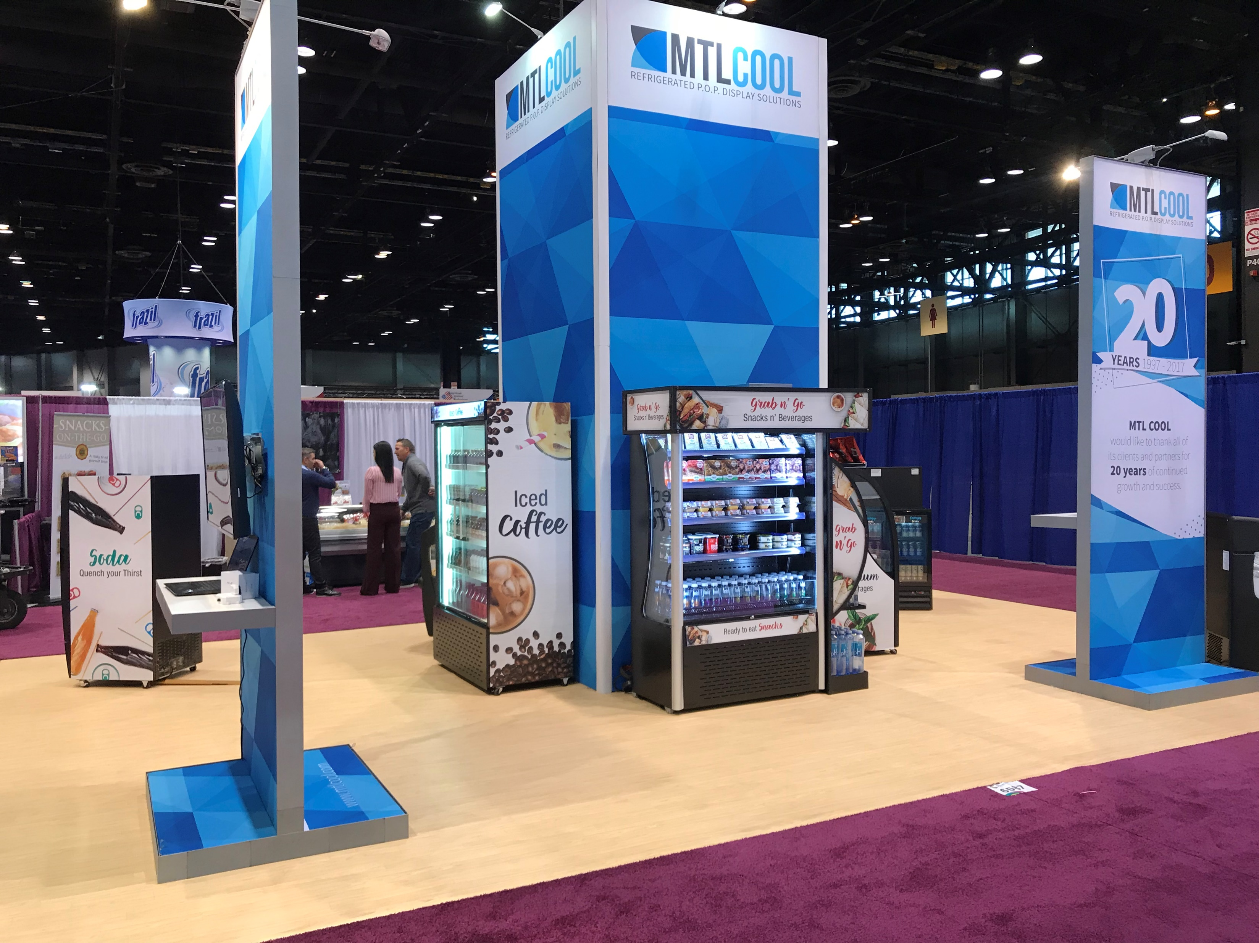

A booth - Newsagent

Slide 3
A booth: is a temporary table, tent, or area that you set up in order to sell something.
Newsagent:a shop that sells newspapers and magazines, as well as some foods and things that people often buy .

Slide 4


Media/ Press

Slide 5
Media: is like the internet, newspapers, magazines, television, etc., considered as a group.
Press: newspapers, and often radio and television news broadcasting.

Slide 6
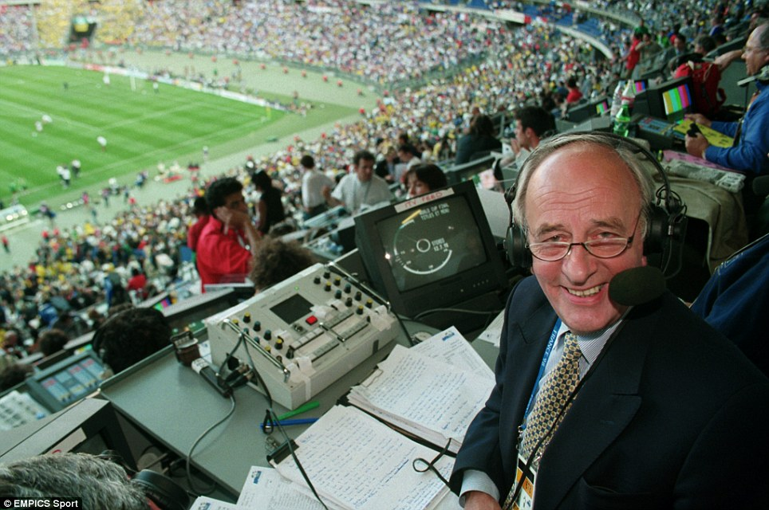
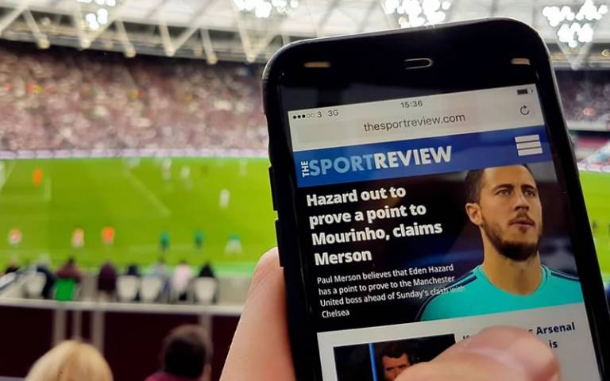
Review/ Commentary

Slide 7
Review: to think or talk about something again, in order to make changes to it or to make a decision about it.
Commentary: a spoken description of an event on the radio or television that is broadcast as the event happens.

Slide 8


News flashes/ Strike

Slide 9
News flashes: a single item of important news that is broadcast separately and often interrupts other programs.
Strike: to hit or attack someone or something forcefully.

Slide 10
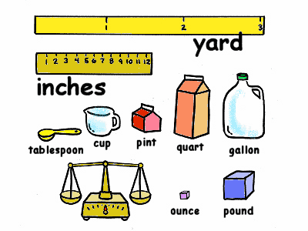
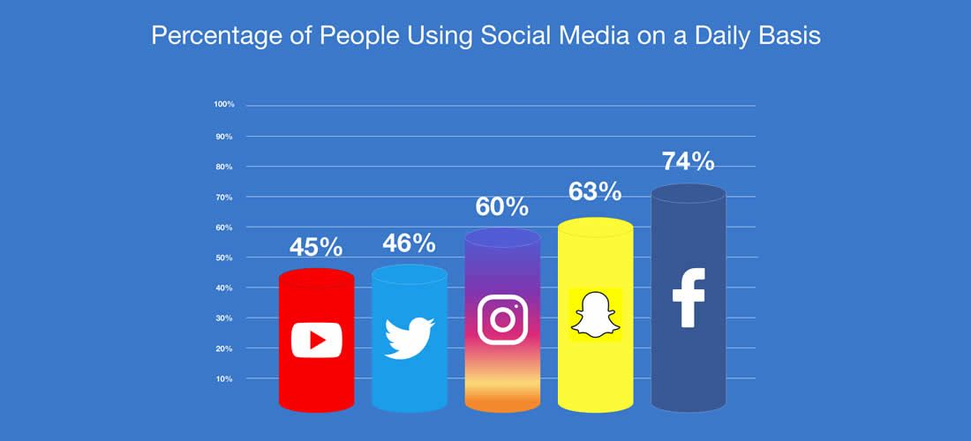
Statistics/ Measurement

Slide 11
Statistics: focuses on making the most of the data in hand.
Measurement: is defined as the act of measuring or the size of something.

Slide 12
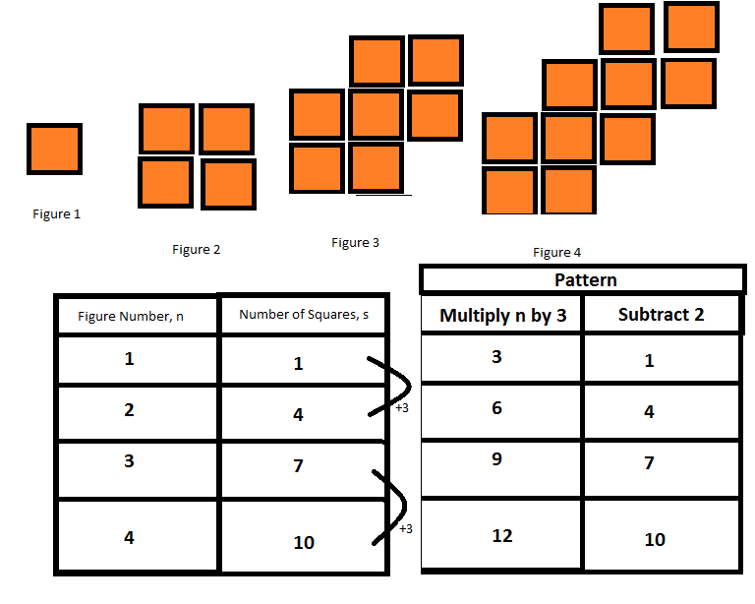

Figures/ Quantity

Slide 13
Figures: the symbol for a number or an amount expressed in numbers.
Quantity :the amount or number of something, especially that can be measured.

