Slide 1
Unit 7 Why do we like symmetry?

Slide 2
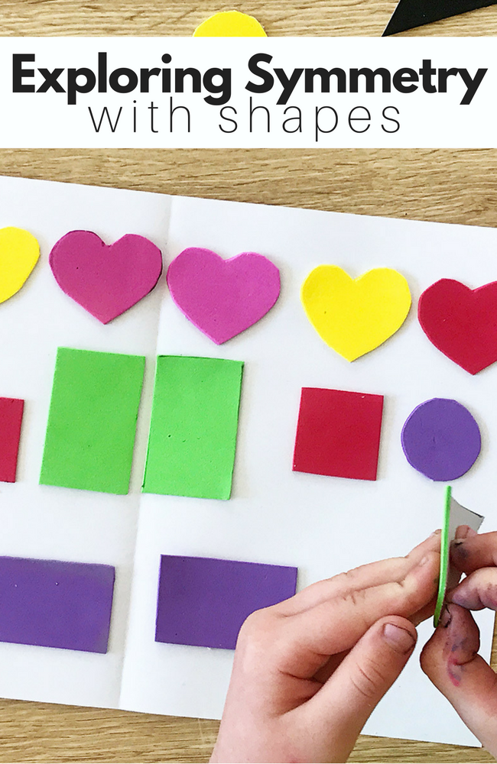
Reflectional Symmetry Rotational https://www.youtube.com/watch?v=j0JGvy2a3MA Translation Symmetry https://www.youtube.com/watch?v=VvBqWeDVqbs https://www.youtube.com/watch?v=_SFv96ZCDGE

Slide 3
Symmetrical, equilateral, identical, infinite, reproduce, repetition, extend, interlocking, dimensions, structure, internal, arrangement, aesthetic.

Slide 4
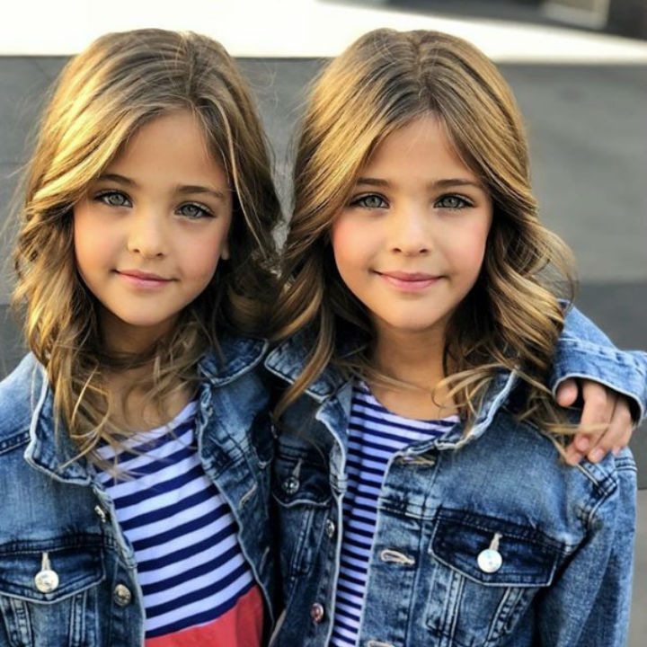
Symmetrical, equilateral, identical, infinite, reproduce, repetition, extend, interlocking, dimensions, structure, internal, arrangement, aesthetic.

Slide 5
Identical: exactly the same, or very similar The tests are identical to those carried out last year.

Slide 6
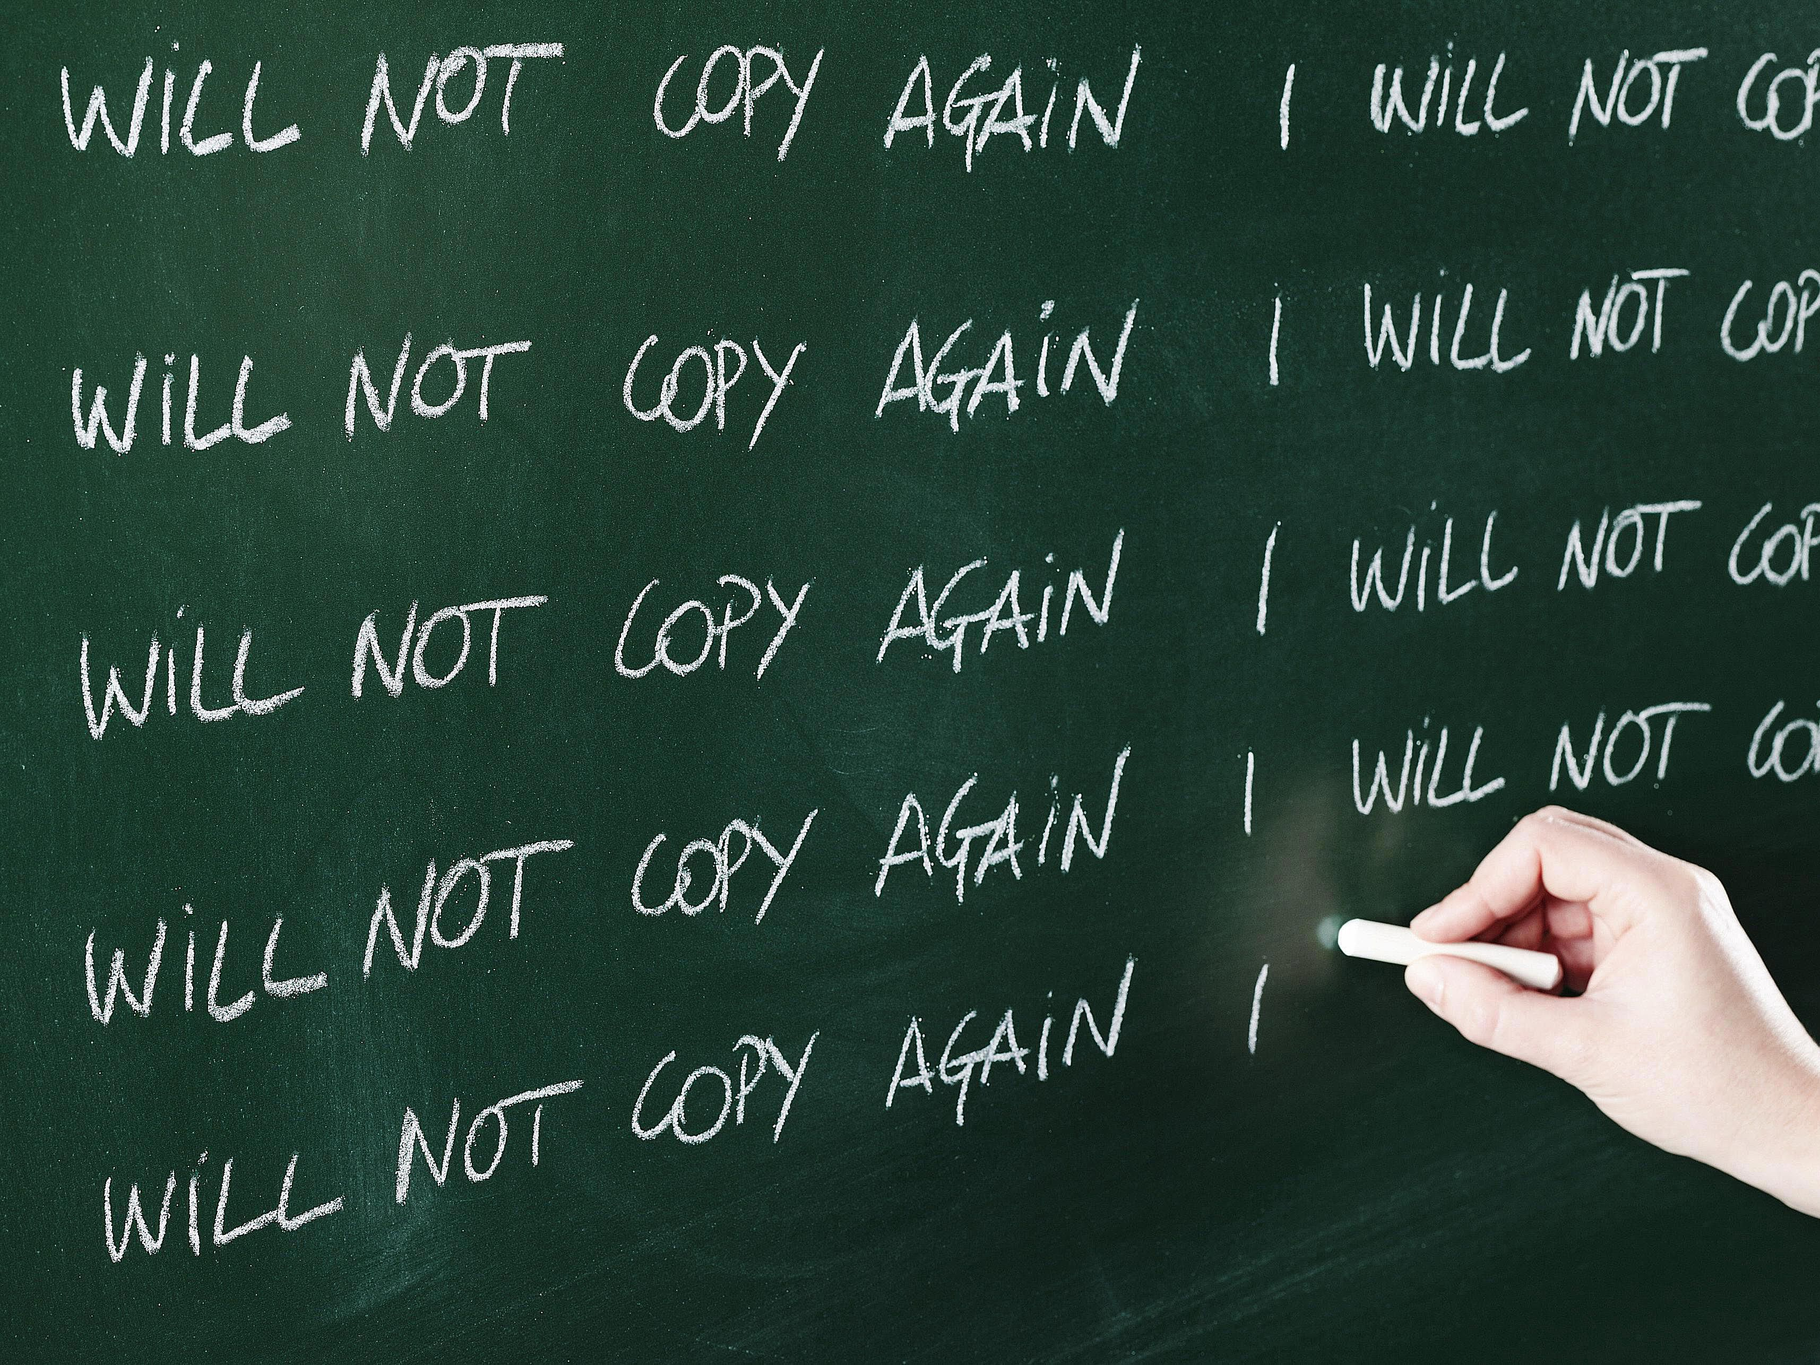
Symmetrical, equilateral, identical, infinite, reproduce, repetition, extend, interlocking, dimensions, structure, internal, arrangement, aesthetic.

Slide 7
Repetition: the act of doing or saying something again: His books are full of repetition.

Slide 8
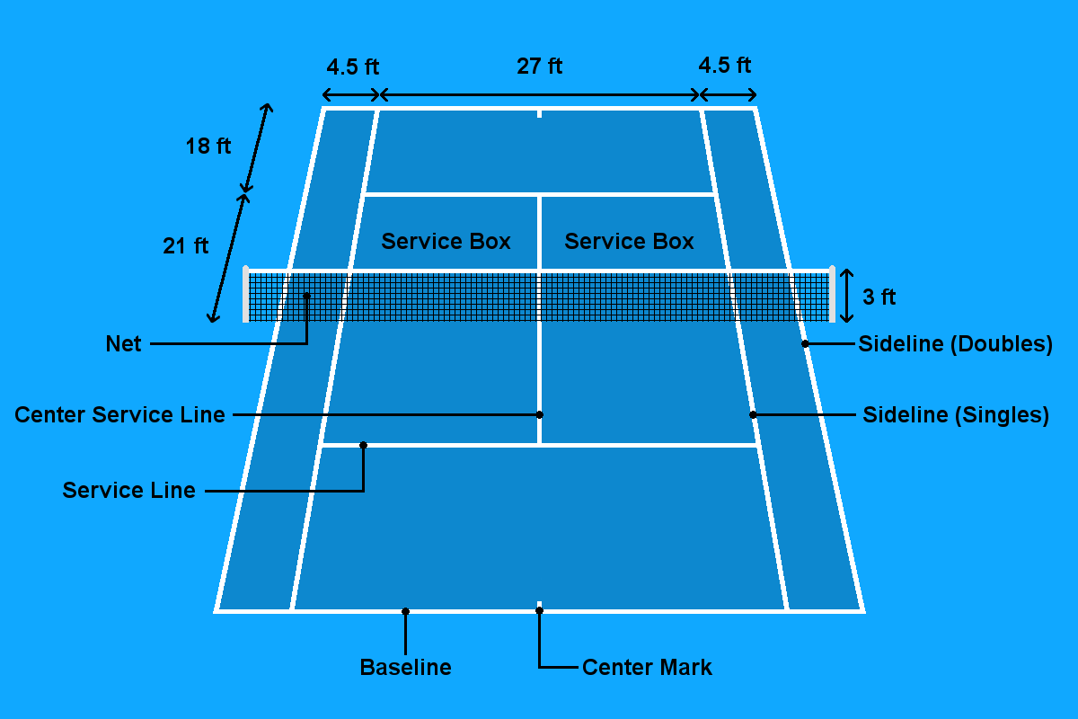
Symmetrical, equilateral, identical, infinite, reproduce, repetition, extend, interlocking, dimensions, structure, internal, arrangement, aesthetic.

Slide 9
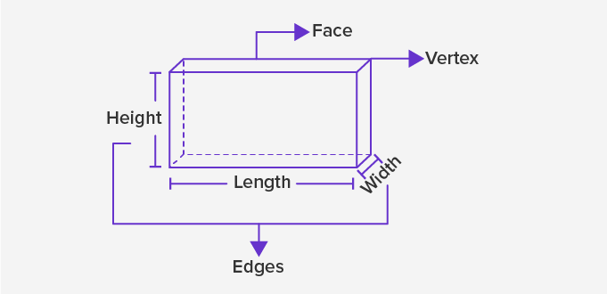
Dimension: a measurement of something in a particular direction, especially its height, length, or width: Please specify the dimensions (= the height, length and width) of the room.

Slide 10
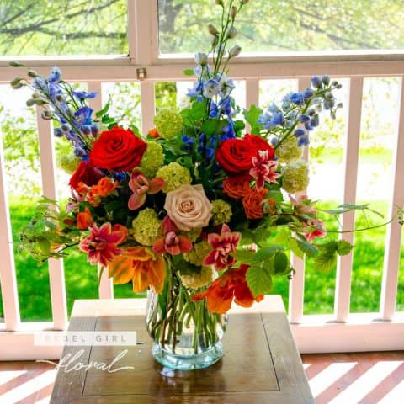
Symmetrical, equilateral, identical, infinite, reproduce, repetition, extend, interlocking, dimensions, structure, internal, arrangement, aesthetic.

Slide 11
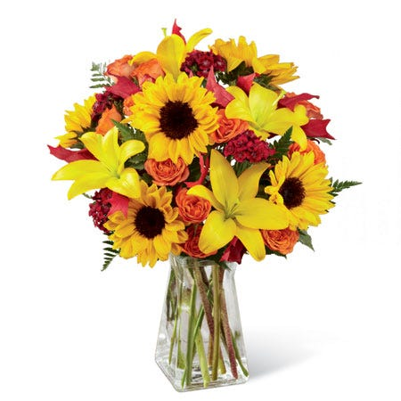
Arrangement: a group of objects that have been put in a particular order or position: There was a striking arrangement of dried flowers on the table.

Slide 12
Symmetrical, equilateral, identical, infinite, reproduce, repetition, extend, interlocking, dimensions, structure, internal, arrangement, aesthetic.

Slide 13
Symmetrical: having two parts that match exactly, either when one half is like an image of the other half in a mirror, or when one part can take the place of another if it is turned 90° or 180°: Common skin moles are round and symmetrical.

Slide 14
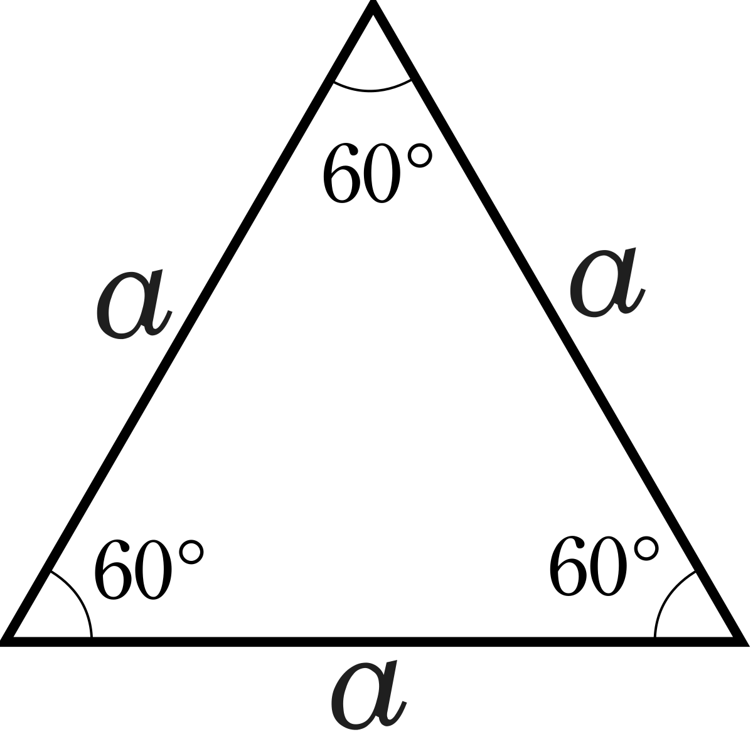
Symmetrical, equilateral, identical, infinite, reproduce, repetition, extend, interlocking, dimensions, structure, internal, arrangement, aesthetic.

Slide 15
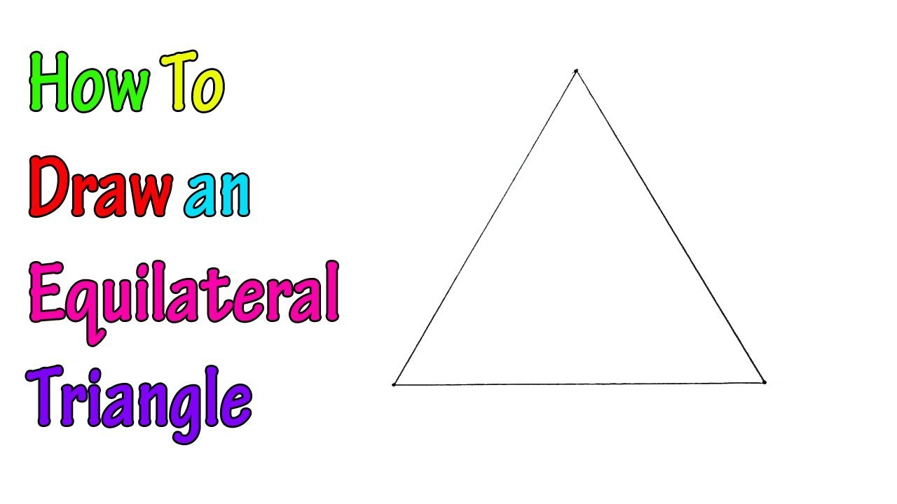
Equilateral: used to describe a shape whose sides are all the same length: an equilateral triangle

Slide 16
Symmetrical, equilateral, identical, infinite, reproduce, repetition, extend, interlocking, dimensions, structure, internal, arrangement, aesthetic.

Slide 17
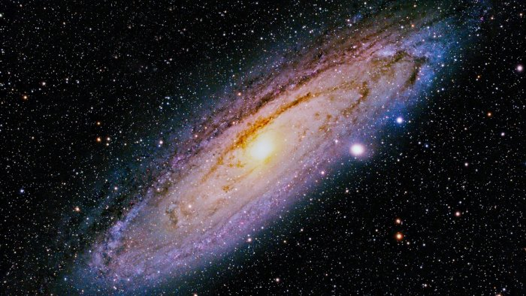
Infinite: without limits; extremely large or great The universe is theoretically infinite.

Slide 18
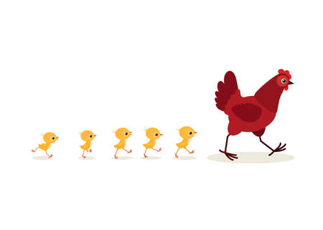
Symmetrical, equilateral, identical, infinite, reproduce, repetition, extend, interlocking, dimensions, structure, internal, arrangement, aesthetic.

Slide 19
Reproduce: to produce a copy of something, or to be copied in a production process: They said the printing was too faint to reproduce well.

Slide 20
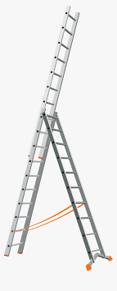
Symmetrical, equilateral, identical, infinite, reproduce, repetition, extend, interlocking, dimensions, structure, internal, arrangement, aesthetic.

Slide 21
Extend: to add to something in order to make it longer; increase: The store has recently extended its hours.

Slide 22
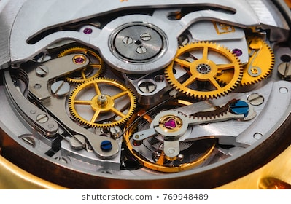
Symmetrical, equilateral, identical, infinite, reproduce, repetition, extend, interlocking, dimensions, structure, internal, arrangement, aesthetic.

Slide 23
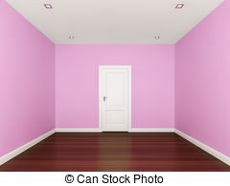
Internal: inside an object or building: An internal wall has been removed.

Slide 24
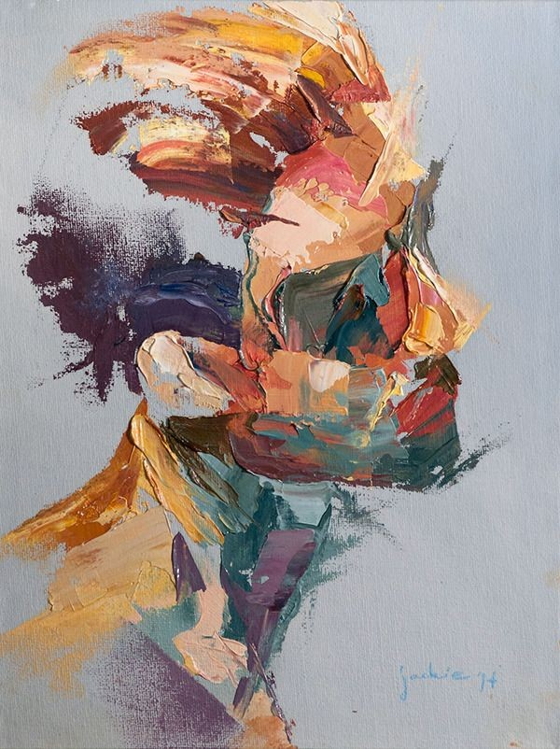
Symmetrical, equilateral, identical, infinite, reproduce, repetition, extend, interlocking, dimensions, structure, internal, arrangement, aesthetic.

Slide 25
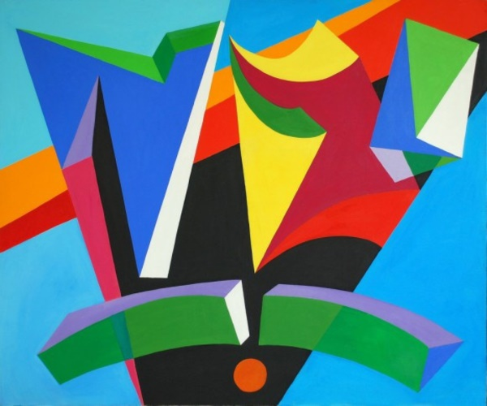
Aesthetic: relating to the enjoyment or study of beauty: The new building has little aesthetic value/appeal.

Slide 26
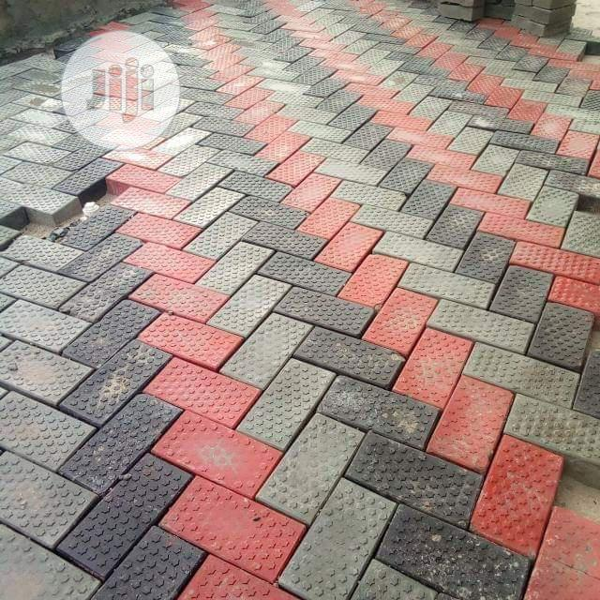
Symmetrical, equilateral, identical, infinite, reproduce, repetition, extend, interlocking, dimensions, structure, internal, arrangement, aesthetic.

Slide 27
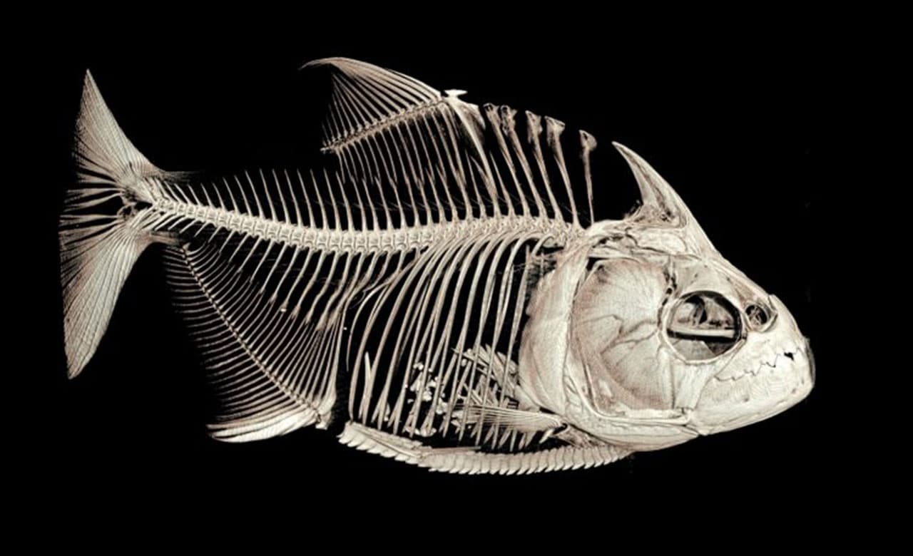
Interlocking: firmly joined together, especially by one part fitting into another: The fish has strong jaws and sharp interlocking teeth.

