Slide 1
Writing News Reports

Slide 2
What does News report describe?

Slide 3
It describes a particular event or topic which is of interest to the public. It is always written in formal impersonal style and gives accurate facts only, not chatty description.

Slide 4
A good news report should consist of:

Slide 5
A short eye- catching headlines which introduces the subject of the report.

Slide 6
Headlines are an important features of news reports. They should both catch the reader’s attention and inform the reader about the subject of the report.

Slide 7
An Introduction which summarizes the event giving information about the time, place and the people involved.

Slide 8
Main Body consisting of two or more paragraphs in which the event is developed in detail. Information about cause and result of the incident should also be included.

Slide 9
A conclusion in which to be taken or people's comments on the events are given.

Slide 10
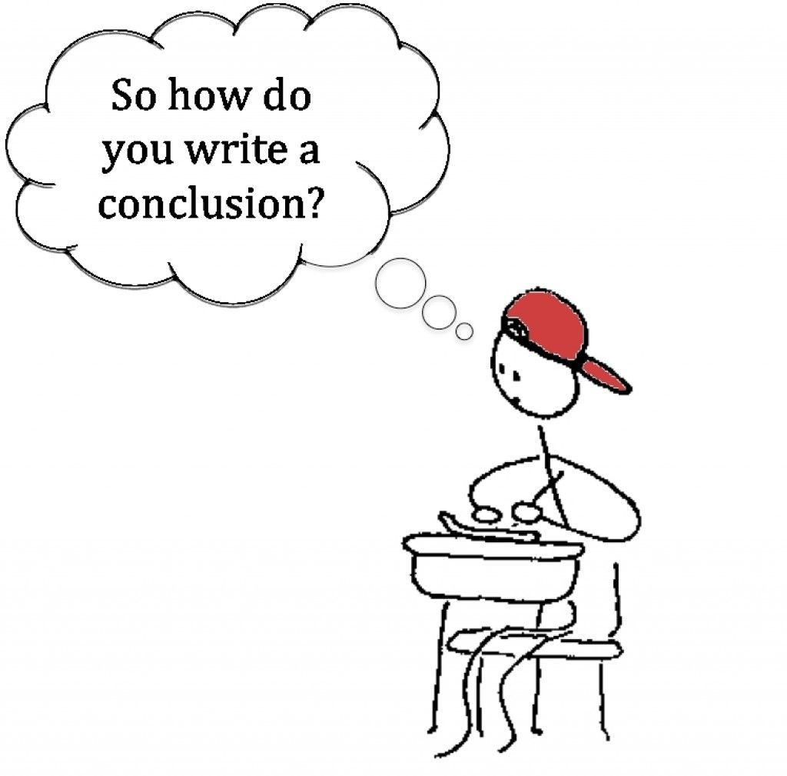

Slide 11
Points to consider

Slide 12
Give all information accurately and in detail.

Slide 13
Do not write about your feelings or your point of view concerning the incident.

Slide 14
Use passive voice and direct reported speech to includes people's comments.

Slide 16
Model

Slide 18
https://schools.peelschools.org/sec/lornepark/SiteCollectionDocuments/EQAO/OSSLT%20StED-Writing%20A%20News%20Report.pdf

