Slide 1
BE A Prepositions SUPERHERO!

Slide 2
https://www.youtube.com/watch?v=p_lgP_XwDig
https://youtu.be/Fbcimg1r1Ms
time
https://youtu.be/_XmYzXi3Gxs
https://youtu.be/0aN-HPnlbm8
https://youtu.be/4530pfmquro

Slide 3
https://create.kahoot.it/details/e85ed0e3-dda3-41ab-a20d-d5e90256e485
https://create.kahoot.it/details/3f9d8e9e-ecf4-41a2-b859-19431c9fcfb0
https://create.kahoot.it/details/5eb474f0-a124-46a8-8a07-036a62abc55f
https://create.kahoot.it/details/2324d4ed-4d6a-4b7b-adcc-a5bbdbc82da7
https://www.liveworksheets.com/worksheets/en/English_as_a_Second_Language_(ESL)/Prepositions_of_place/Prepositions_of_place_(b,_A,_B)_if143587tv
https://www.liveworksheets.com/worksheets/en/English_as_a_Second_Language_(ESL)/Prepositions_of_place/preposition-_house_ot54297zn
https://www.liveworksheets.com/worksheets/en/English_as_a_Second_Language_(ESL)/Prepositions_of_time/Prepositions_in,_on,_at_(A,_B,_C)_sa210948nj
https://www.liveworksheets.com/worksheets/en/English_as_a_Second_Language_(ESL)/Prepositions_of_time/Prepositions_of_Time_pc22063zt

Slide 4
What are prepositions?
Do you remember which parts of speech we have covered so far?
Verbs nouns adjectives
Adverbs pronouns conjunctions

Slide 5
Prepositions
A preposition is a word that indicates place or direction.
Examples: across, into, between, above, beyond, towards, behind, over.
Prepositions describe the relationship between the subject of a sentence and another object.
For example: The apple was under the table.
The glider flew through the air.
The boy walked towards the school.
Which of the following words are prepositions?
in
to
house
location
travel
walk
inside
tomorrow
visit
mountain
beside
later
journey
around
off
during

Slide 6
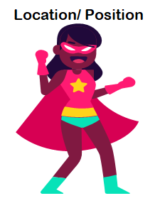
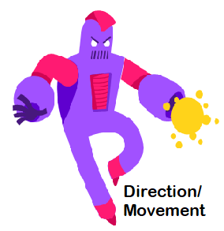
Prepositions
Are classified into 3 groups….

Slide 7
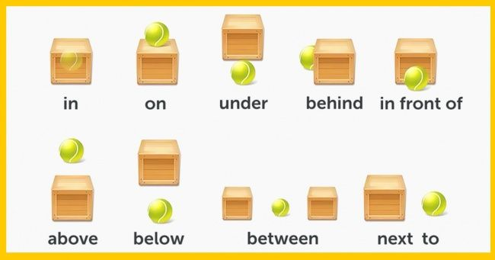
Location

Slide 8
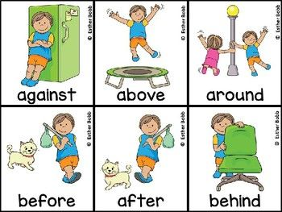
Note that ‘against’ means next to and touching an upright surface for support.
e.g.
The boy is leaning against the fridge.

Slide 9
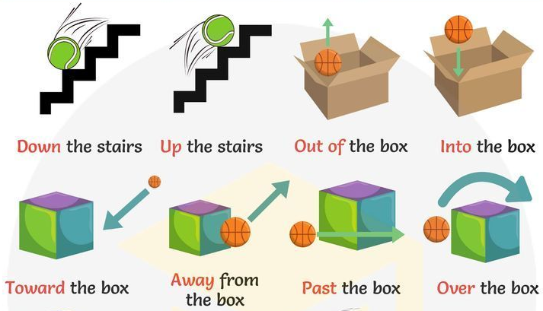
Many prepositions are generally used for movement and direction….

Slide 10
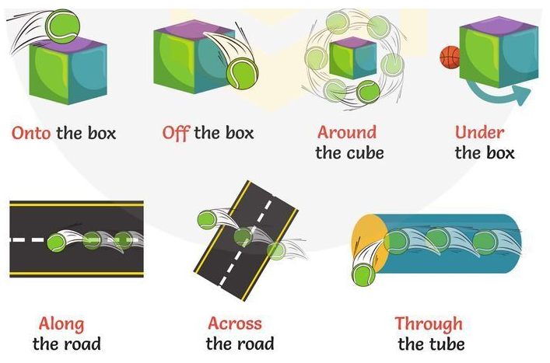

Slide 11
Prepositional Phrases
A prepositional phrase includes the object that the preposition in a sentence is referring to and any other words that link it to the preposition.
For example: He hid beneath the duvet.
A prepositional phrase usually includes a preposition, a noun or pronoun and may include an adjective. IT DOES NOT INCLUDE THE VERB!
Can you pick out the prepositional phrases from these sentences?
The general ordered the troops to retreat to the valley.
The general ordered the troops to retreat to the valley.
Jules was delighted to find a present inside the egg.
Jules was delighted to find a present inside the egg.
Mike didn’t think he could run up the hill.
Mike didn’t think he could run up the hill.
Where could it be? It wasn’t in the box and it wasn’t round the back.
Where could it be? It wasn’t in the box and it wasn’t round the back.
When the siren sounded they all set off into the ancient woods.
When the siren sounded they all set off into the ancient woods.

Slide 16
s
s
y

Slide 17
How about you test your skills? Check the attached game… ‘Who wants to be a millionaire’

