Slide 1
WAS / WERE

Slide 2
WAS/WERE
Positive form
I
He
She
It
We
You
They
was at school yesterday.
were at the beach last week.

Slide 3
WAS/WERE
Negative form
I
He
She
It
We
You
They
was not(wasn't) at school yesterday.
were not(weren’t) at the beach last week.

Slide 4
He was a good boy.
not
He was a good boy.

Slide 5
They were good boys.
not
They were good boys.

Slide 6
WAS/WERE
Yes / No questions
I
he
she
It
we
you
they
at the park yesterday?
Was
Were
at the beach last week?

Slide 7
He was a student ten years ago.
Was
he
?
a student ten years ago
Yes , he was.
No , he wasn’t.

Slide 8
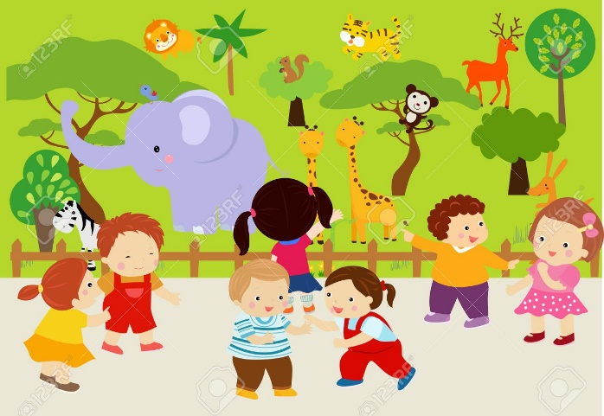
They were in the zoo yesterday.
Were
they
?
in the zoo yesterday
Yes , they were.
No , they weren’t.

Slide 9
I was at home yesterday.
Was
I
?
at home yesterday
Yes , I was.
No , I wasn’t.

