Slide 10
An insect legs

Slide 11
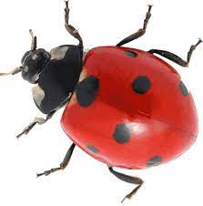

Slide 12
6
six seven

Slide 13
An
insect
has
six
legs.

Slide 14
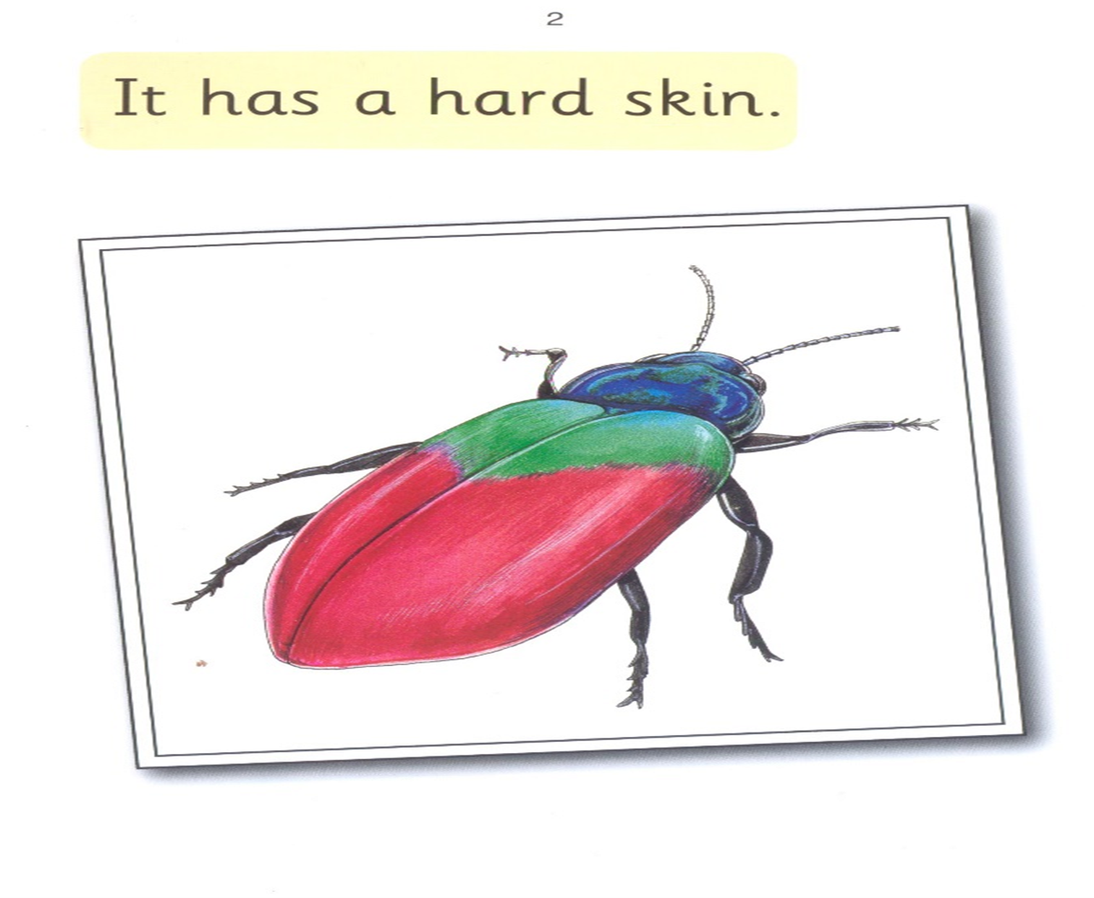

Slide 15
It has

Slide 16
has hard

Slide 17
hard skin

Slide 18
It
has
a
hard
skin.

Slide 19
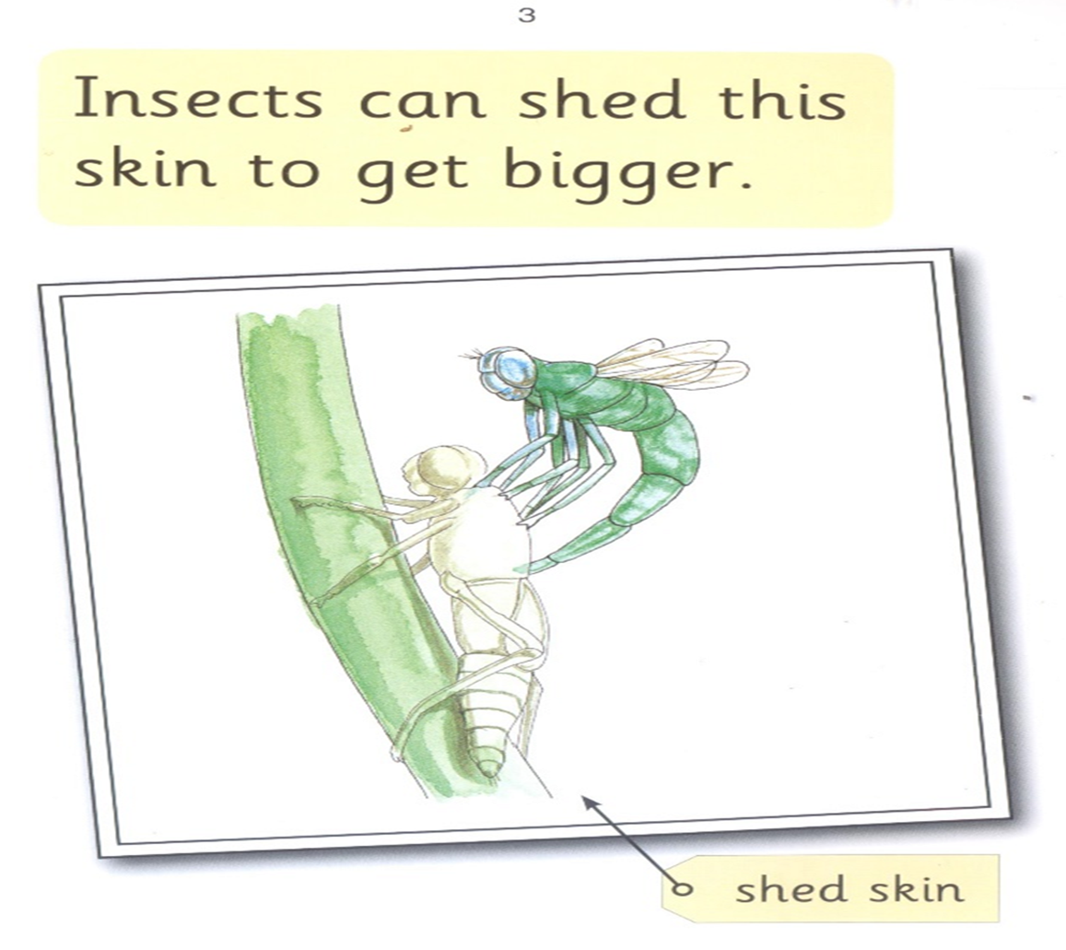

Slide 20
Insect can

Slide 21
shed this

Slide 22
skin to get

Slide 23
shed bigger

Slide 24
Insect
can
shed
this
skin
to
get
bigger.

Slide 25
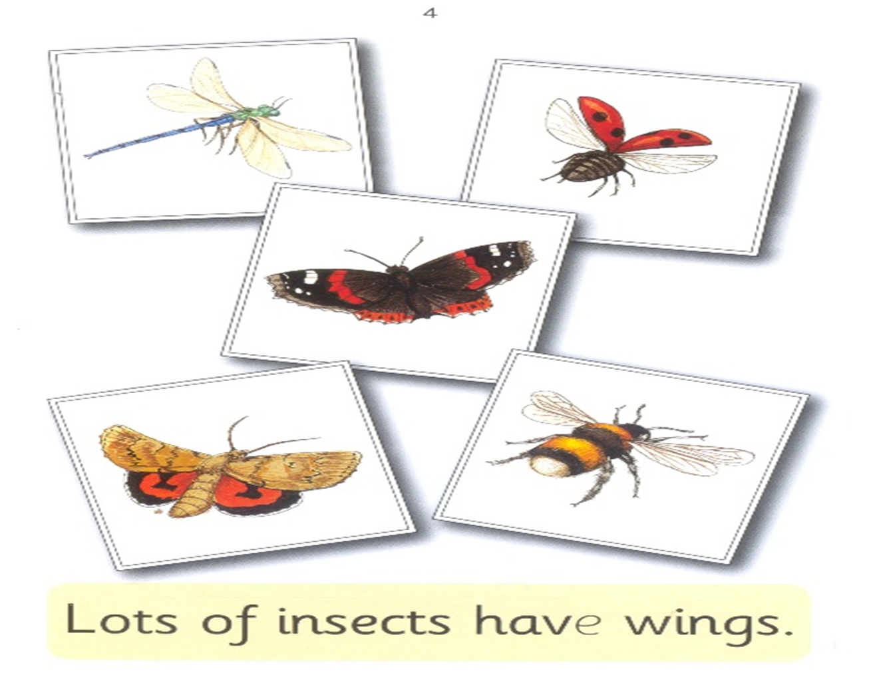

Slide 26
lots of insects

Slide 27
have wings

Slide 28
lots
of
insects
have
wings.

Slide 29
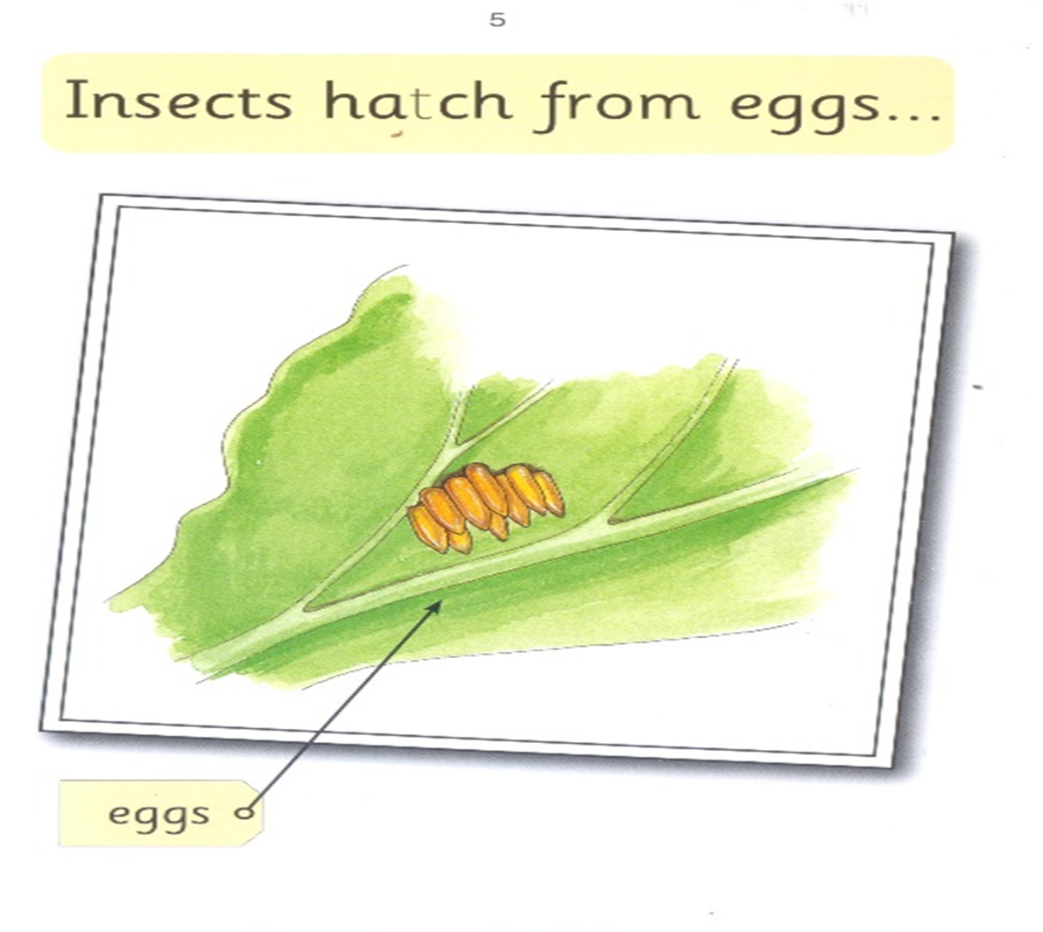

Slide 30
Insects hatch

Slide 31
from eggs

Slide 32
Insects
hatch
from
eggs.

Slide 34
grubs maggots

Slide 36
caterpillars maggots

Slide 37
and start as grubs, maggots or caterpillar.

Slide 39
Born
as
caterpillars…

Slide 40
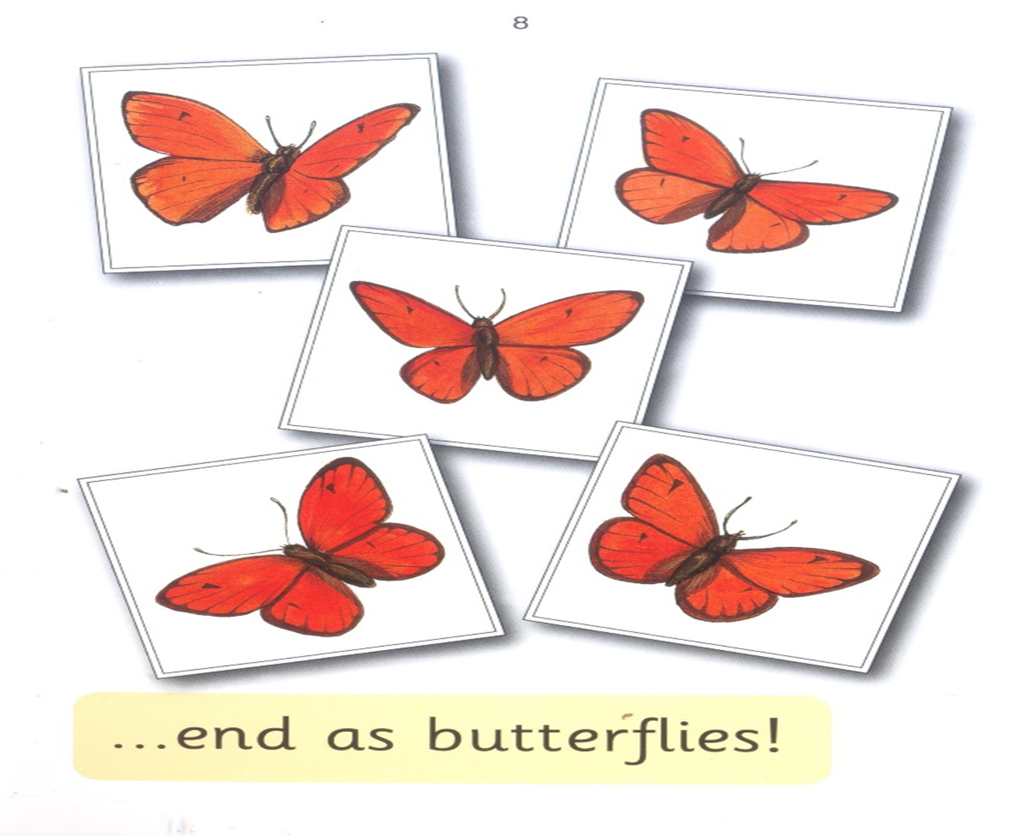

Slide 41
end
as
butterflies…

