Slide 1
Daily message
Today , we are going to learn a new shape.

Slide 2
2D shapes

Slide 3

circle

Slide 4

rectangle

Slide 5

square

Slide 6

triangle

Slide 7

star

Slide 8

heart

Slide 9
3D shapes

Slide 10

sphere

Slide 11

cube

Slide 12
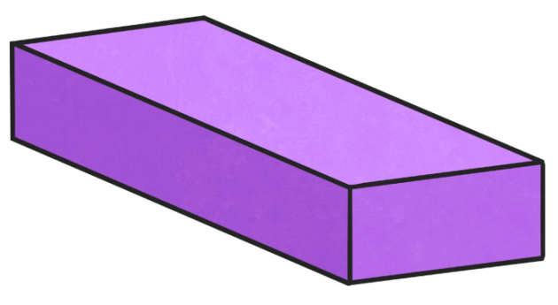
cuboid

Slide 13
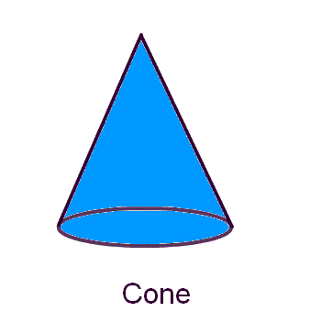
cone

Slide 18
hexagon

Slide 19


2
3
I
6
4
5

Slide 20
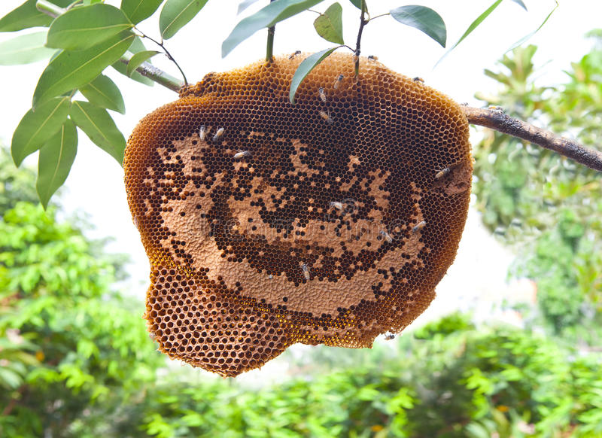
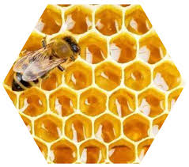

Slide 21
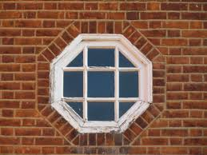

Slide 22
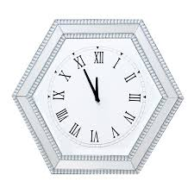

Slide 23
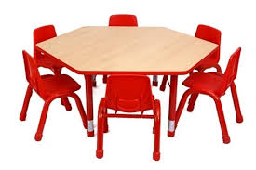

Slide 24
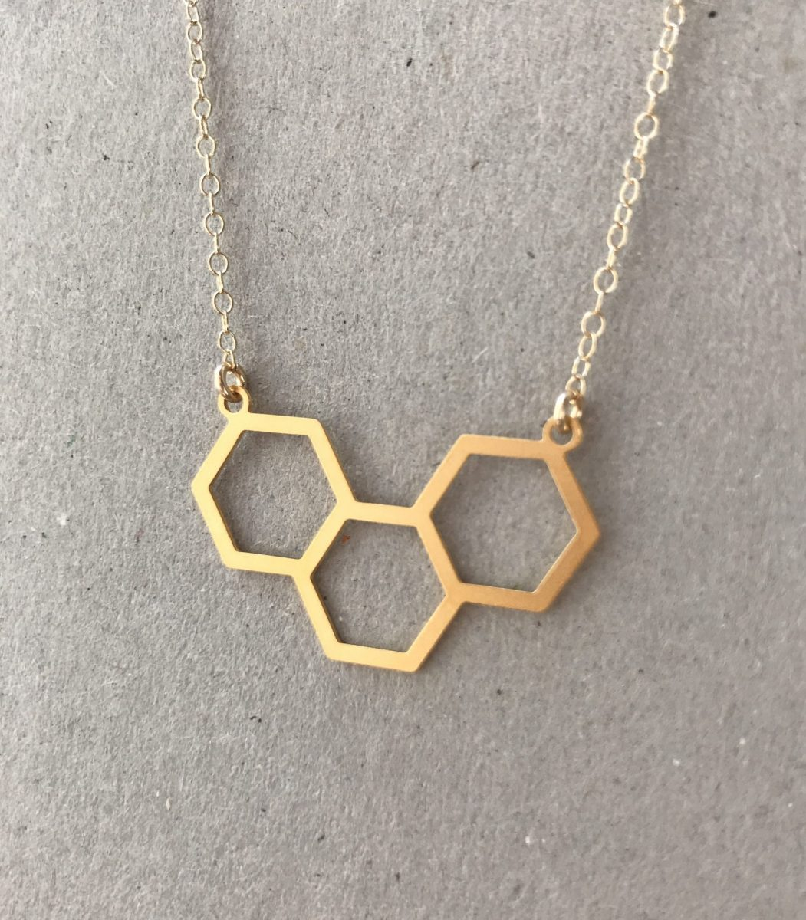

Slide 25
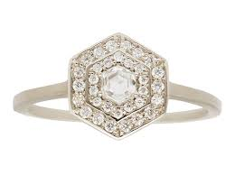

Slide 26
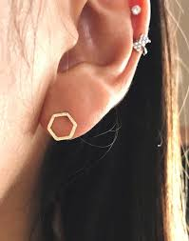

Slide 27
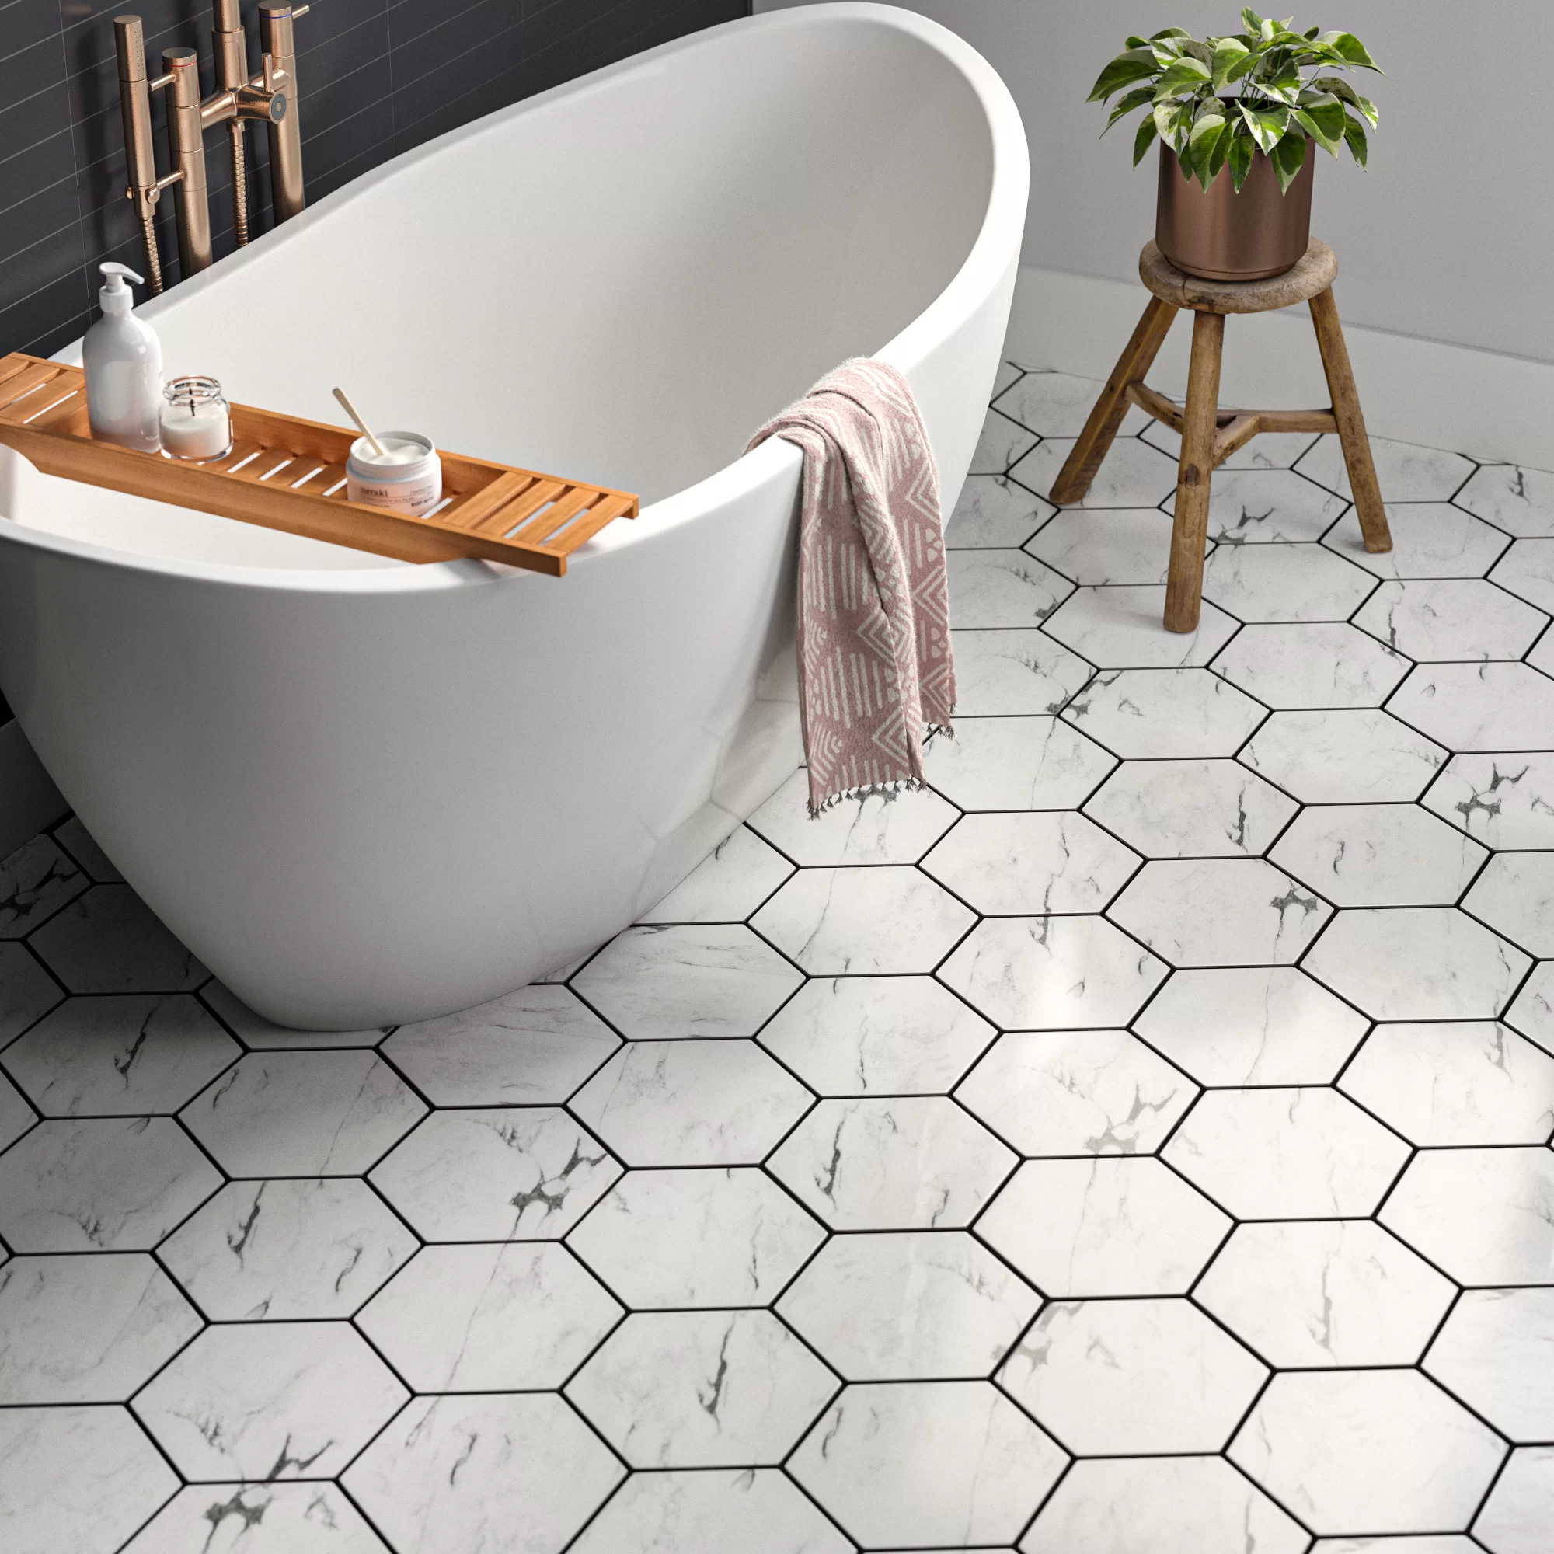

Slide 28
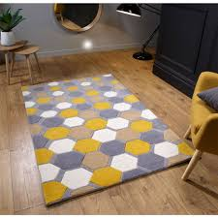

Slide 29
shapes game

Slide 30
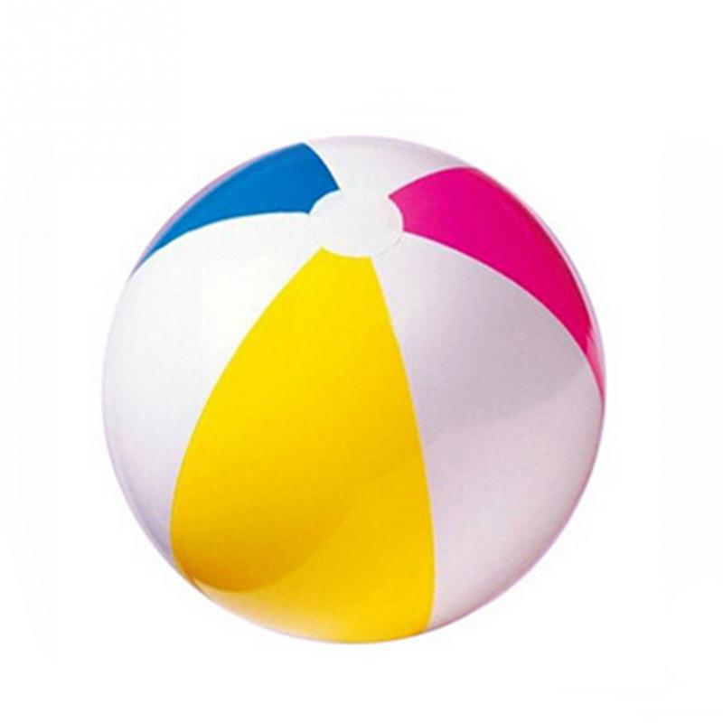

Slide 31


Slide 32


Slide 33
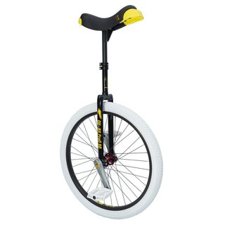

Slide 34
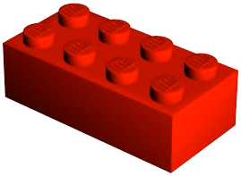

Slide 35
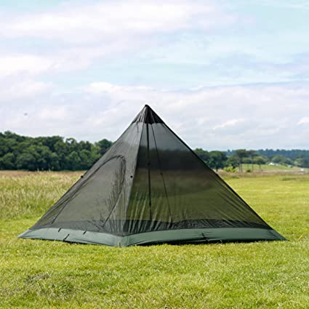

Slide 36
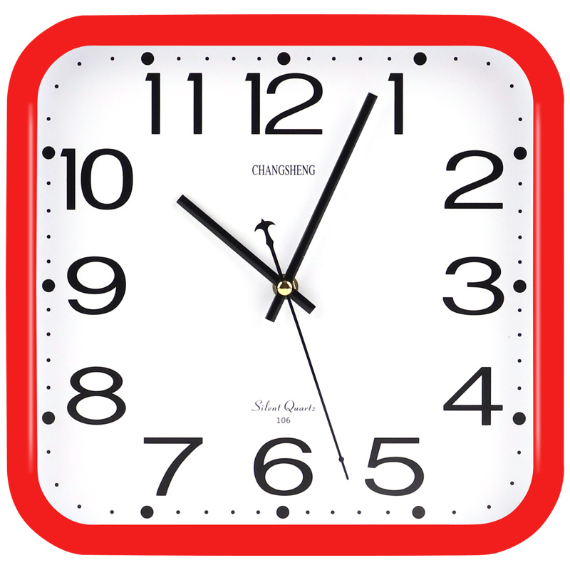

Slide 37
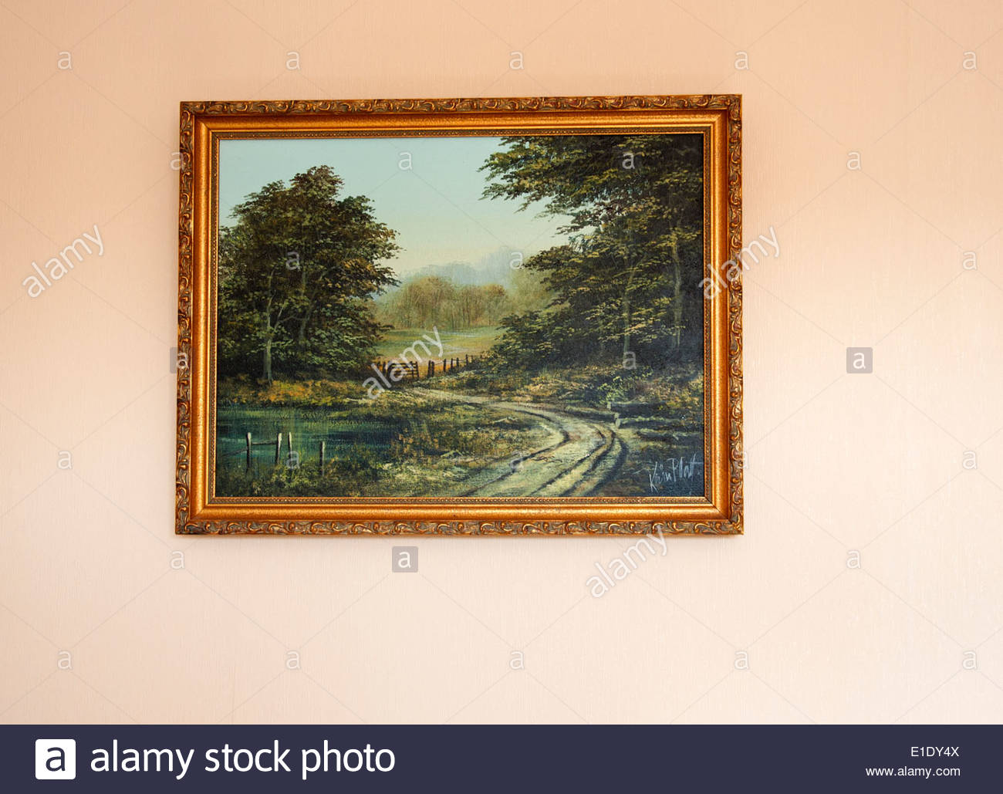

Slide 38


Slide 39
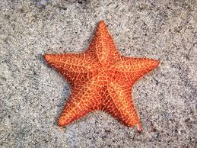

Slide 40


