Slide 1
Daily message
Today , we are going to subtract numbers within 10.

Slide 2
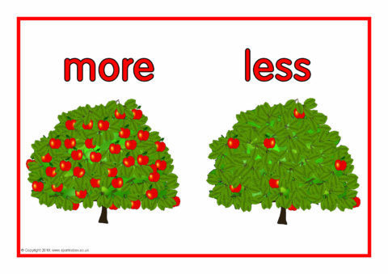
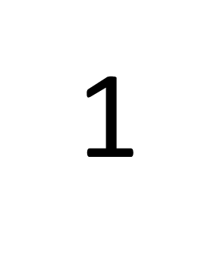
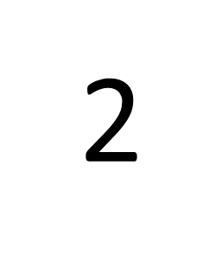

Slide 3
7-1=
6
7

Slide 4
10
10-1=
9

Slide 5
I
0

Slide 6
4
One less than 5 =
One less than 6 =
One less than 1 =
5
0

Slide 7
7
One less than 8 =
One less than 2 =
One less than 3 =
I
2

Slide 8
9
One less than 10 =
One less than 7 =
One less than 9 =
6
8

Slide 9
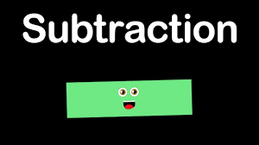

Slide 10
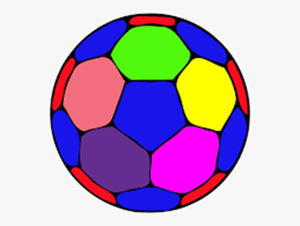
6
7 - 1 =

Slide 11
9 - 3 =
6

Slide 12
3
10 - 7 =

Slide 13
5 - 3 =
2

Slide 14
3 - 1 =
4 - 3 =
3 - 3 =
2
I
0

Slide 15
1
7 - 6 =
8 - 3 =
10 - 4 =
5
6

Slide 16
1
1 - 0 =
5 - 3 =
4 - 4 =
2
0

Slide 17
0
5 - 5 =
4 - 0 =
3 - 1 =
4
2

